Slide 1

Region 7 - Federal Transit Administration
i
Midwest Transit Conference
Kansas City, Missouri
Notes:
The Preferred fonts throughout the template are:
Headers: Franklin Gothic Heavy (48pt or 36Pt)
Major Titles: Franklin Gothic Demi (24 pt)
Standard Text: Franklin Gothic Book (24 pt)
Accessibility Notes:
Remember to add Alt Text/ Captions to photos that are representative of what is happening in the image.
You can right click on the image and choose ‘View Alt Text”, or go to Review -> Check Accessibility -> Alt Text to add or have PPT generate Alt text

Slide 2


FTA’s Mission, Vision, and Values
Mission
Vision
Improve America’s Communities through Public Transportation
A Better Quality of Life for All Built on Public Transportation Excellence
Values
Service | Provide reliable, transparent, responsive, and anticipatory services to meet stakeholder needs.
Integrity | Commit to the highest professional and ethical standards.
Innovation | Foster new ideas, concepts, and solutions for improved outcomes.
Resiliency | Optimize decisions, resources, and systems to make long-term positive impacts on the environment, infrastructure, and safety.
Notes:
FTA's Mission, Vision, and Values were created to enhance mobility, promote economic growth, and improve the quality of life in communities. As transportation evolved, the FTA has adapted its strategies to address challenges concerning sustainability and technological advancements.

Slide 3
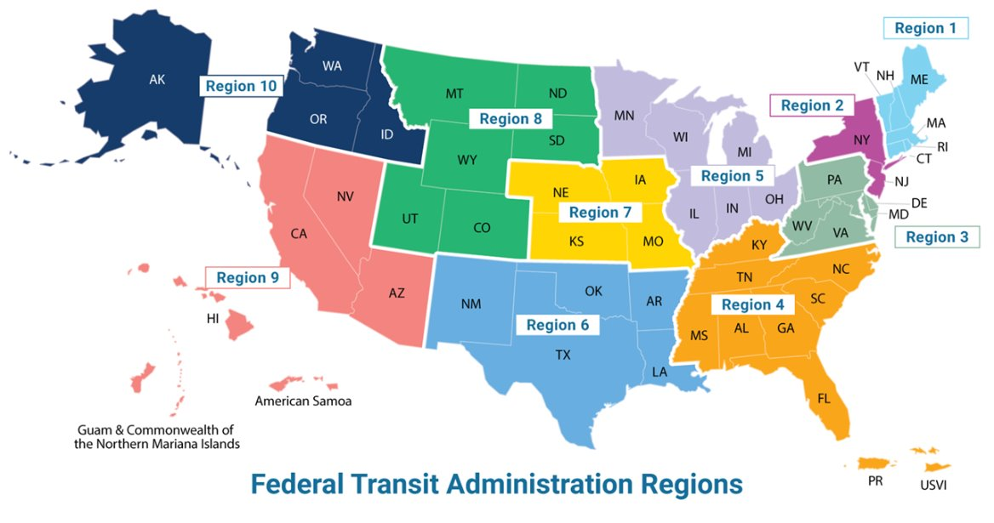
FTA Regional Offices

Slide 4
Regional Office Highlight

Slide 5
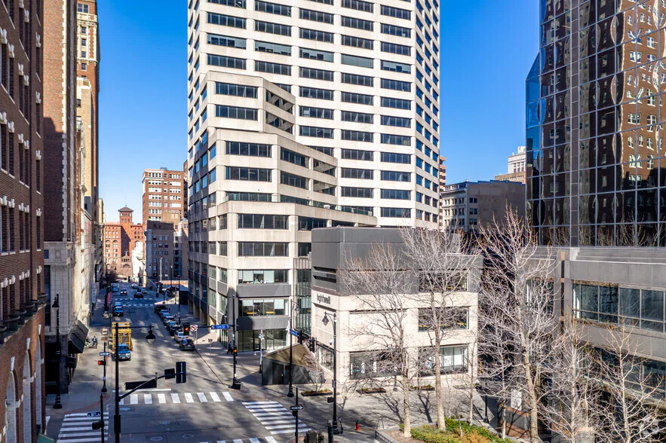
Regional Office Highlights
Congratulations and well wishes to Mark Bechtel, Cathy Monroe and Shannon Graves on their retirement!
Our office along with the National Grant Cadre Team worked to award lapsing funds.
TrAMS closing September 25.
Stay tuned for TrAMS re-open dates.
The Regional office is moving in 2026.

Slide 6
National FTA News

Slide 7
Investing in America – Global Sports / Major Events
Over a 10-year period, beginning in 2025, the US will host at least seven global sporting events and a celebration of the Nation’s 250th Anniversary, providing many opportunities to showcase America’s values and stature.
2025
2026
2028
2031
2033
2034
FIFA Club World Cup
Jun 15 – Jul 13
CONCACAF
Gold Cup
Jun 14 – Jul 6
WC26 FIFA Men's World Cup
Jun 11-Jul 19
US 250th Anniversary
“America 250”
July 4
  LA28 Summer Games
  Olympics
  Jul 14-30
  Paralympics
  Aug 15-27
Men’s Rugby World Cup
Women’s Rugby World Cup
  Salt Lake Winter Olympics

Slide 8
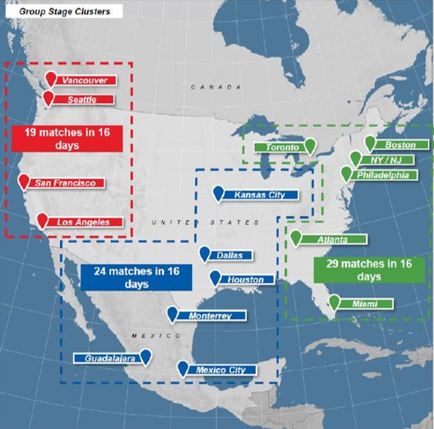
World Cup 2026 – Multiple Cities and Events
DOT/FTA Role & Support
DOT is a member of White House Task Force
FTA providing technical assistance and support for recipients
Ensuring appropriate use of funds
Resources
Major Events Dear Colleague Letter (June 2024)
  Topics include: Charter service, borrowing/loaning buses, spare ratio, accessibility, safety, and other considerations
Contact
FTA_GlobalSports@dot.gov
Regional Office
Notes:
‘Charter service’’ means (but does not include demand response service to individuals):
(1) Transportation provided by a recipient at the request of a third party for the exclusive use of a bus or van for a negotiated price.
(2) Transportation provided by a recipient to the public for events or functions that occur on an irregular basis or for a limited duration

Slide 9
Upcoming NOFOs
(as of September 2, 2025)
Opening Date | NOFO | Operating Administration/Office | Closing Date
3/28/2025 | Safe Streets and Roads for All | Office of the Secretary | 06/26/2025
05/14/2025 | Bus Programs: Buses and Bus Facilities Competitive Grants; Low- or No-Emission Bus Grants | Federal Transit Administration | 07/14/2025
Fall 2025 | All Stations Accessibility Program | Federal Transit Administration | TBA
Fall 2025 | Ferry Programs: Electric or Low Emitting Ferry; Ferry Service for Rural Communities; Passenger Ferry Boat Program | Federal Transit Administration | TBA
Fall 2025 | Transit Oriented Development Planning | Federal Transit Administration | TBA
Fall 2025 | Strengthening Mobility & Revolutionizing Transportation (SMART) | Office of the Secretary | TBA
Notes:
Information regarding upcoming NOFOs can be found here: https://www.transportation.gov/infrastructure-investment-and-jobs-act/key-notices-funding-opportunity
https://www.transportation.gov/grants/dashboard

Slide 10
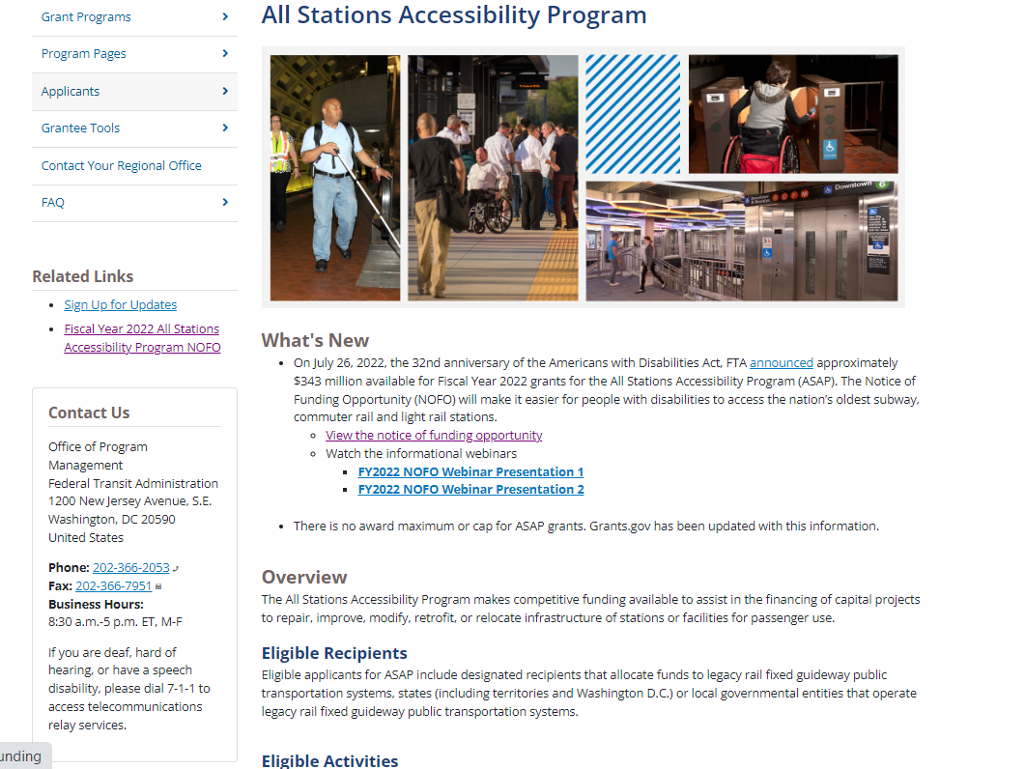
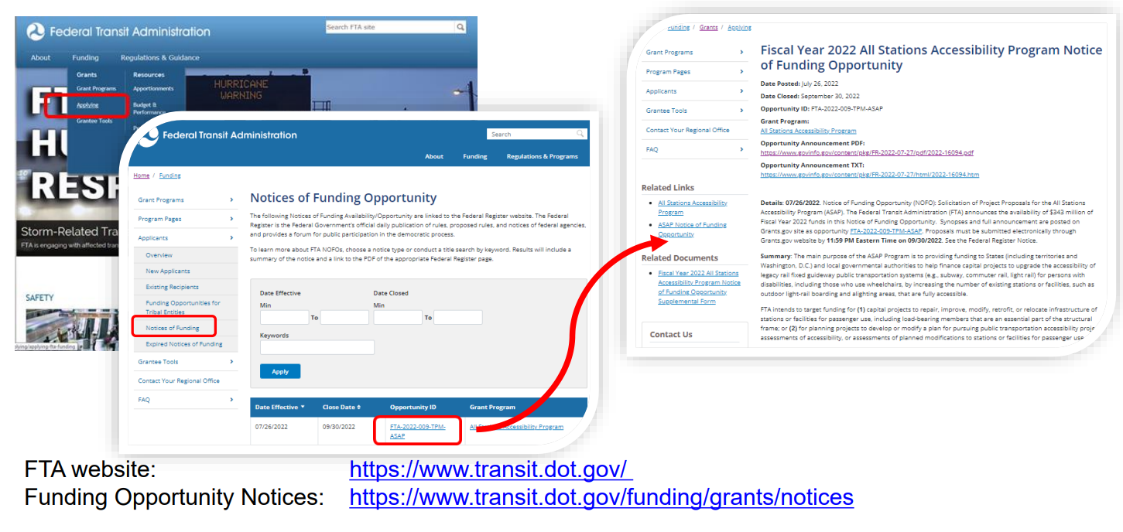
Notices of Funding Opportunities (NOFOs)
To be notified, Sign Up for FTA Email Notifications: https://public.govdelivery.com/accounts/usdotfta/subscriber/new
From the FTA website:

Slide 11
Recipient Tools Highlight

Slide 12
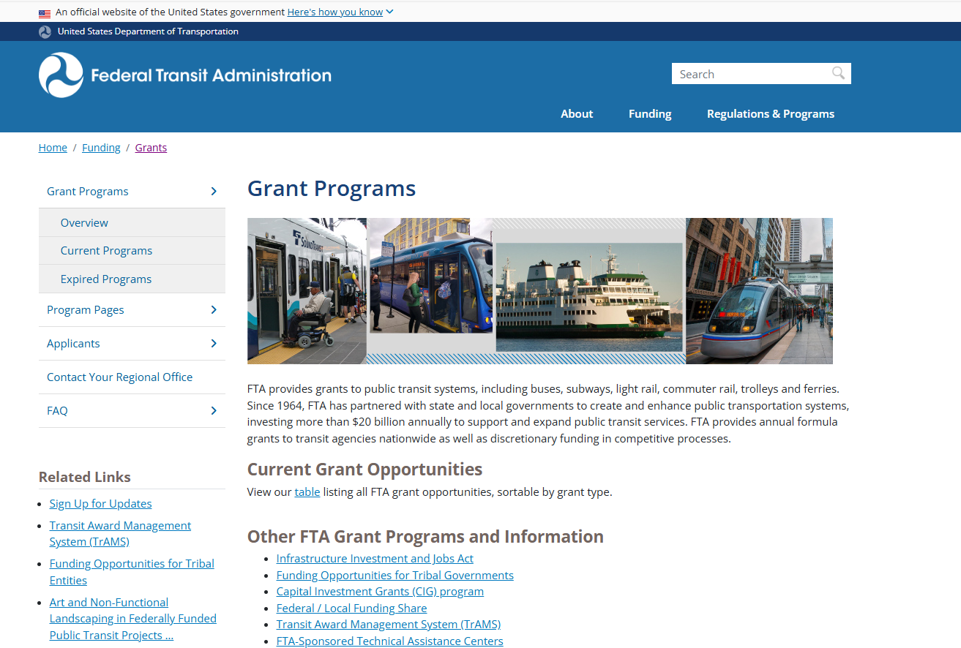
Recipient Tools Highlight: Grant Programs
FTA’s Website www.transit.dot.gov
  Grant Programs | FTA
Remember the Three C’s Comprehensive, Continuing, and Cooperative (49 U.S. Code § 5303)
  Work with your respective Metropolitan Planning Organization (MPO) or state DOT to make sure your projects are included in the fiscally constrained Transportation Improvement Plan (TIP/STIP)

Slide 13
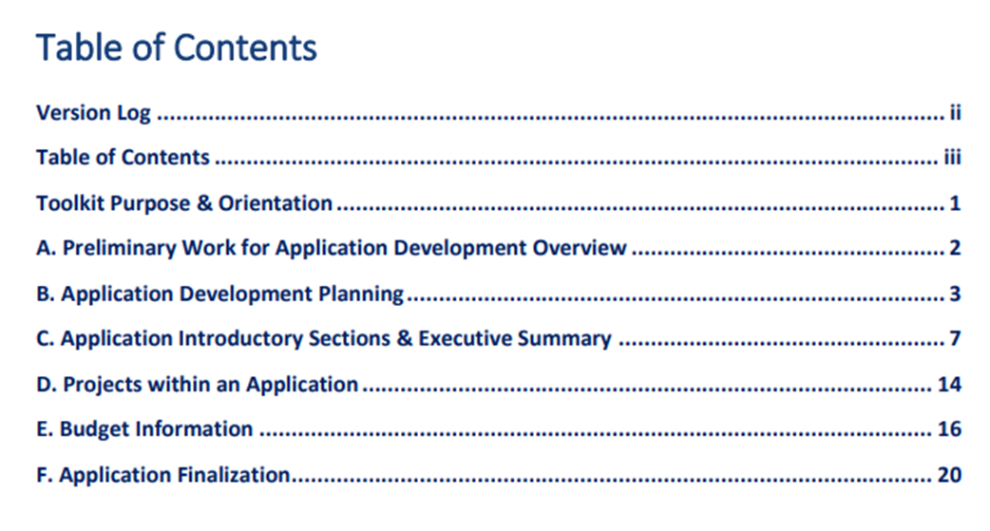
Recipient Tools Highlight: Recipient Toolkit
This toolkit may be consulted to help with decisions on developing applications for award in the Transit Award Management System (TrAMS). It includes information for recipients on application development, consistent with FTA Circulars and other information materials, including:
preliminary work for application development
considerations for application planning
key elements of an application
  information on developing the executive summary
  projects within the application
  budget descriptions
Navigate to transit.dot.gov: Funding > Grants > Applying > Existing Recipients > FTA Recipient Award Toolkit
Notes:
The toolkit can be found at this link: FTA Recipient Award Toolkit | FTA

Slide 14
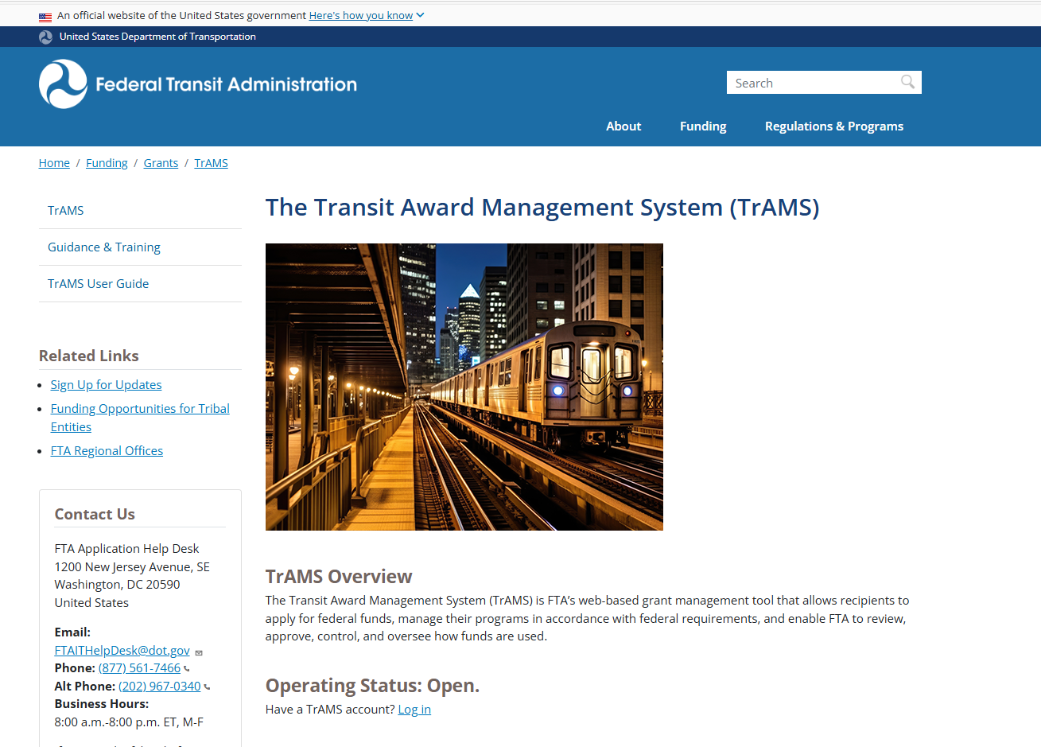
Recipient Tools Highlight: Transit Award Management System or TrAMS
The Transit Award Management System (TrAMS) | FTA
  Update your Points of Contact !
  Have you signed your Certs and Assurances?
  Have you reviewed your grant and funding timelines?
    Awarded and Lapsing
    Obligated and Period of Performance
Website www.dot.gov
Home >Funding>Grants>TrAMS
TrAMS Guidance and Training
TrAMS User Guide
TrAMS Help Desk
Notes:
The toolkit can be found at this link: FTA Recipient Award Toolkit | FTA

Slide 15
Circular Updates
FTA has updated its program guidance and award management requirements for several circulars
Updates and consolidation of circulars incorporate provisions from the Fixing America’s Surface (FAST) Act; the Infrastructure Investment and Jobs Act (IIJA) and the Uniform Administrative Requirements for Federal Awards
FTA Circular 4220.1G – Third Party Contracting –January 17, 2025
FTA Circular 5010.1F – Award Management – Nov 1, 2024
FTA Circular 9040.1H- Rural Area Formula – Nov 1, 2024
FTA Circular 9050. 1A – Urbanized Formula – Nov 1, 2024 *New
FTA Circular 9070.1H – Enhanced mobility of Seniors and Individuals with Disabilities
Navigate to transit.dot.gov: Funding > Regulations and Programs> FTA Circulars
And FTA 2024 Circular Update | FTA
Notes:
The toolkit can be found at this link: FTA Recipient Award Toolkit | FTA

Slide 16
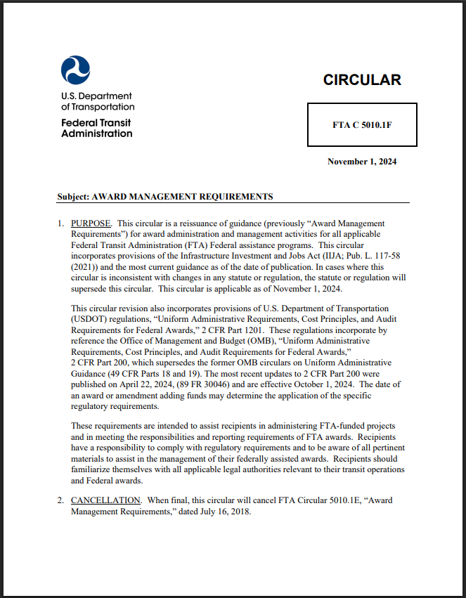
Circular 5010.1F and
2 CFR Part 200 Update
  Circular 5010.1F effective November 1, 2024
  Uniform Guidance 2 CFR 200 Updated for FTA programs effective October 1, 2024
  Capitalization level increased from $5,000 to $10,000
  Real Property reporting updates

Slide 17
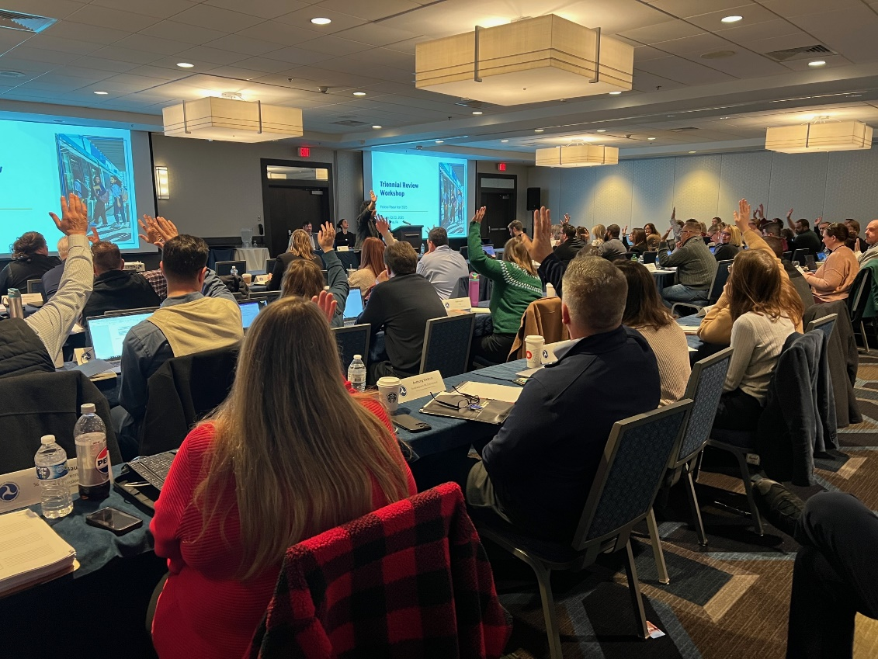
FY 2025 Program Oversight Update
  Oversight Tracking System (OTrak) access for recipients for findings, communications and management
  FY 25 Contractors Manual available; stay tuned for new years
  Webinars to be scheduled for next review year
  Procurement rates high for number of findings
  Safety is now included in review

Slide 18
Safety News and Data – Annual Trends

Slide 19
Background
General Directive 24-1 required agencies subject to the Public Transportation Agency Safety Plan (PTASP) regulation to:
1
Conduct a safety risk assessment
2
Identify safety risk mitigations
3
Provide information to FTA within 90 days
Notes:
Following the issuance General Directive 24-1, FTA conducted an initial analysis of how transit agencies are responding.
The directive, issued in September 2024, requires agencies subject to the Public Transportation Agency Safety Plan, or PTASP, regulation to:
Conduct a safety risk assessment related to assaults on transit workers,
Identify safety risk mitigations, and
Provide this information to FTA within 90 days of the issuance of the General Directive.

Slide 20
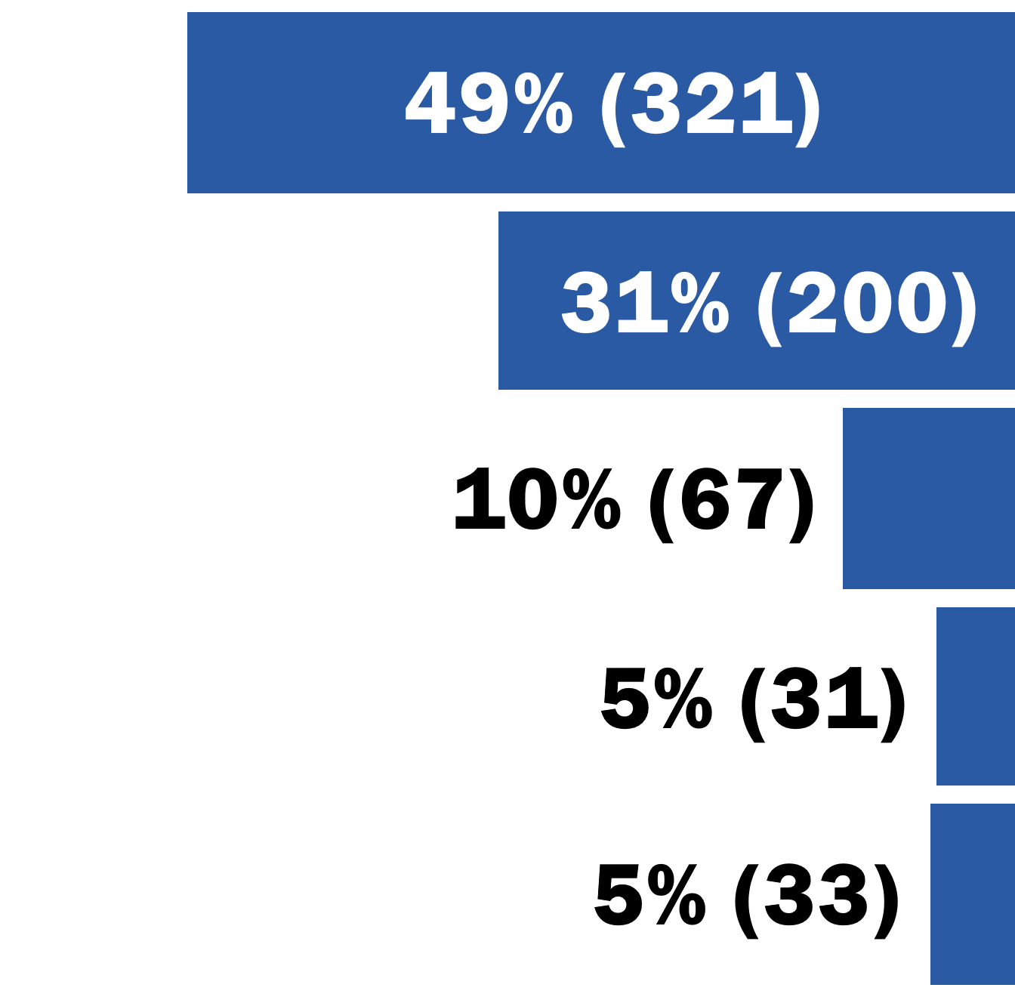
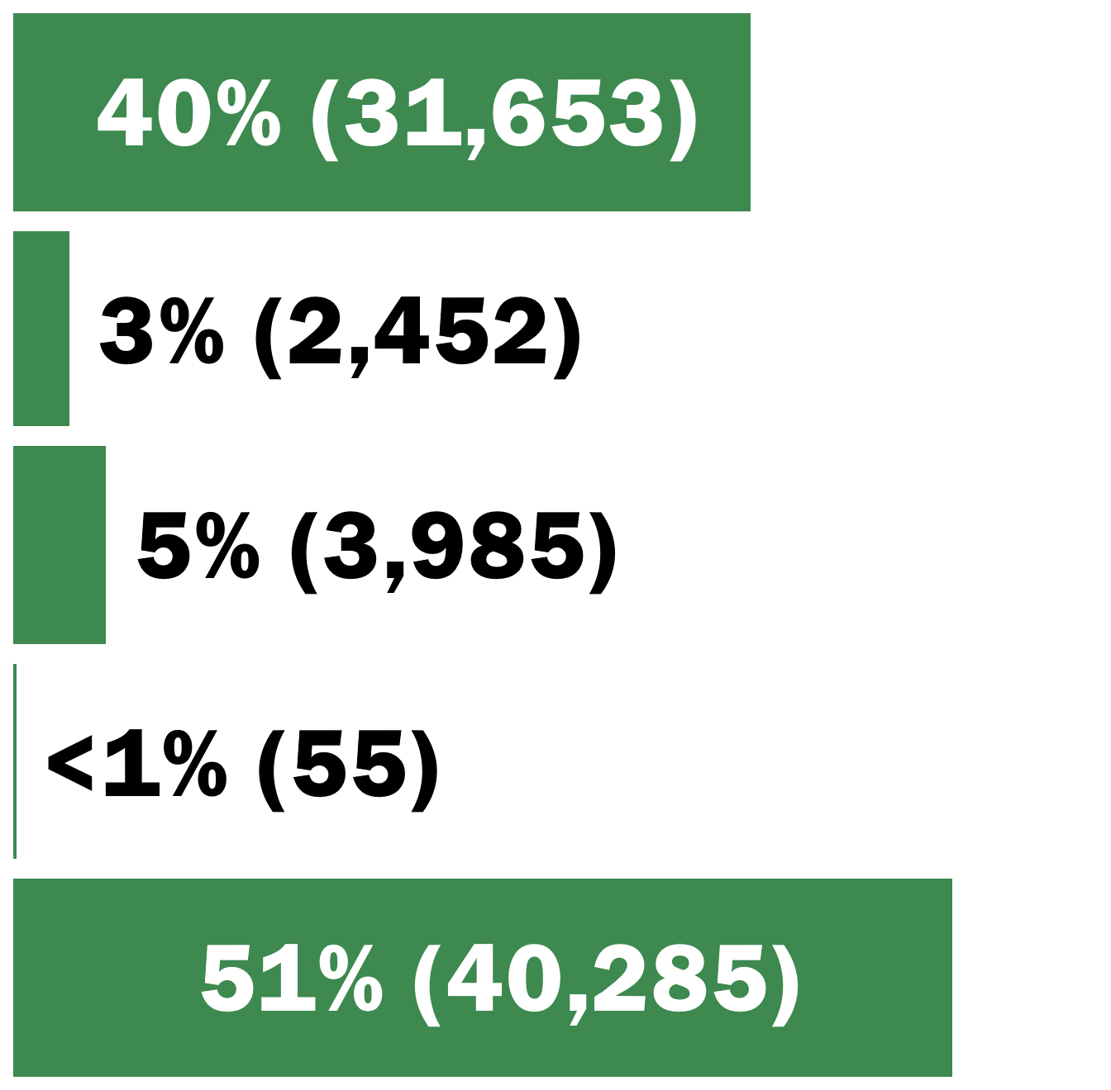
Sources of Bus Transit Fatalities and Injuries
Bus Transit Fatalities and Injuries by Source, Oct 2019–Apr 2025
Fatalities
Injuries
Collisions between Buses and Motor Vehicles
Collisions between Buses and People
Homicides and Assaults
Suicides and Suicide Attempts
All Others (e.g. personal injuries on a bus)
Source: National Transit Database (NTD)
FY2024–25 data are preliminary.
Produced Using NTD Data Pulled On: 8/1/2025
Notes:
Most bus transit fatalities result from:
Collisions between bus transit vehicles (BTV) and other motor vehicles, and
Collisions between BTV and people who were not inside a motor vehicles, including pedestrians, bicyclists, and customers.
Additionally, 10% of bus transit fatalities result from homicides and another 5% result from suicide.
******************
Additional information that may be helpful:
Slide produced using NTD data pulled on Aug 1, 2025.
All charts on this table are based on NTD events that occurred from October 2019 to April 2025. Data from 2024 and 2025 are still subject to NTD reporter revision.
All mentions of “buses” on this slide includes traditional bus vehicles providing revenue service as well as all other vehicles fitting the NTD definition of bus transit vehicles (e.g. vanpool vans).
“Collisions between Buses and People” excludes collisions where the NTD reporter indicates a suicide, homicide, or assault was involved.
“Suicides and suicide attempts” include occasions where a person jumps or lies in front of buses and are injured or killed by the collision. This tally only includes those collisions where the NTD reporter identified an injury or fatality as a suicide.
Non-collision suicide fatalities and injuries are also included in this category.
“Homicides and Assaults” includes fatalities and injuries resulting from homicide and assault events, including those reported to NTD as collisions due to NTD reporting policy.
On the rare occasion where someone commits a homicide or assault and then commits suicide, the person committing suicide was tallied in the Suicides and Suicide Attempts category. All other people injured or killed (e.g. victims, law enforcement, etc.) were tallied in the Homicides and Assaults category.
Facts not shown on this slide that may be helpful for discussion:
Some bus transit injuries result from different types of events than bus transit fatalities. The events that result in the most bus transit injuries are:
Collisions between buses and other motor vehicles (which are shown)
Personal injuries occurring on-board buses
Personal injuries occurring when boarding or alighting from a bus
Data analysis notes:
Data include only NTD Full Reporters. Rural bus agencies and urban bus agencies operating 30 or fewer vehicles at maximum service are excluded.
Bus modes include standard Bus, Bus Rapid Transit, Commuter Bus, Demand Response, Publico, Trolleybus, and Vanpool modes.)

Slide 21
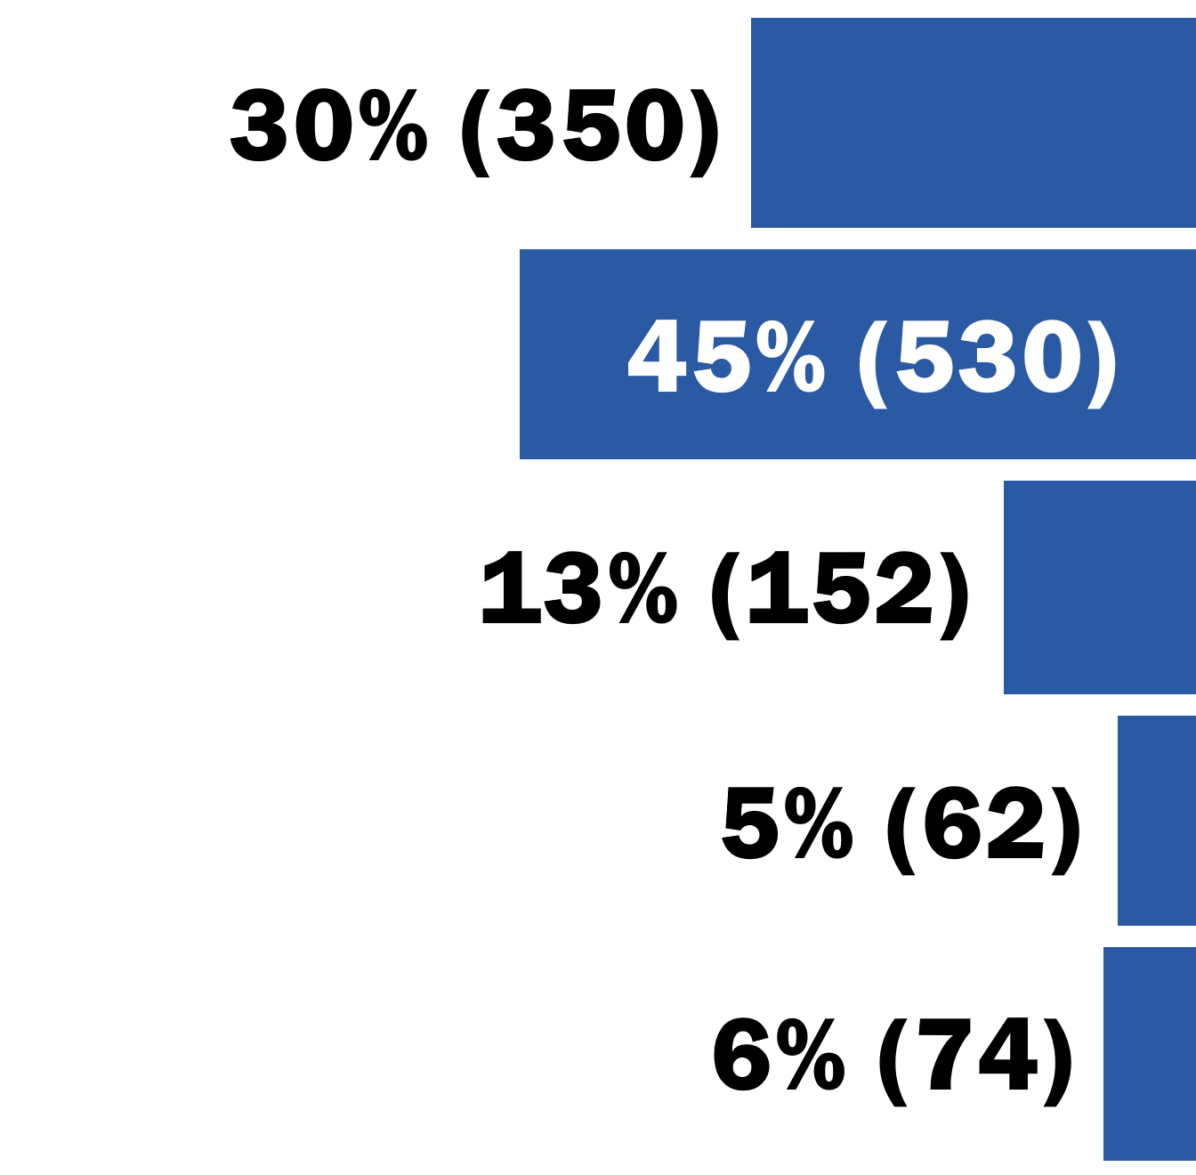
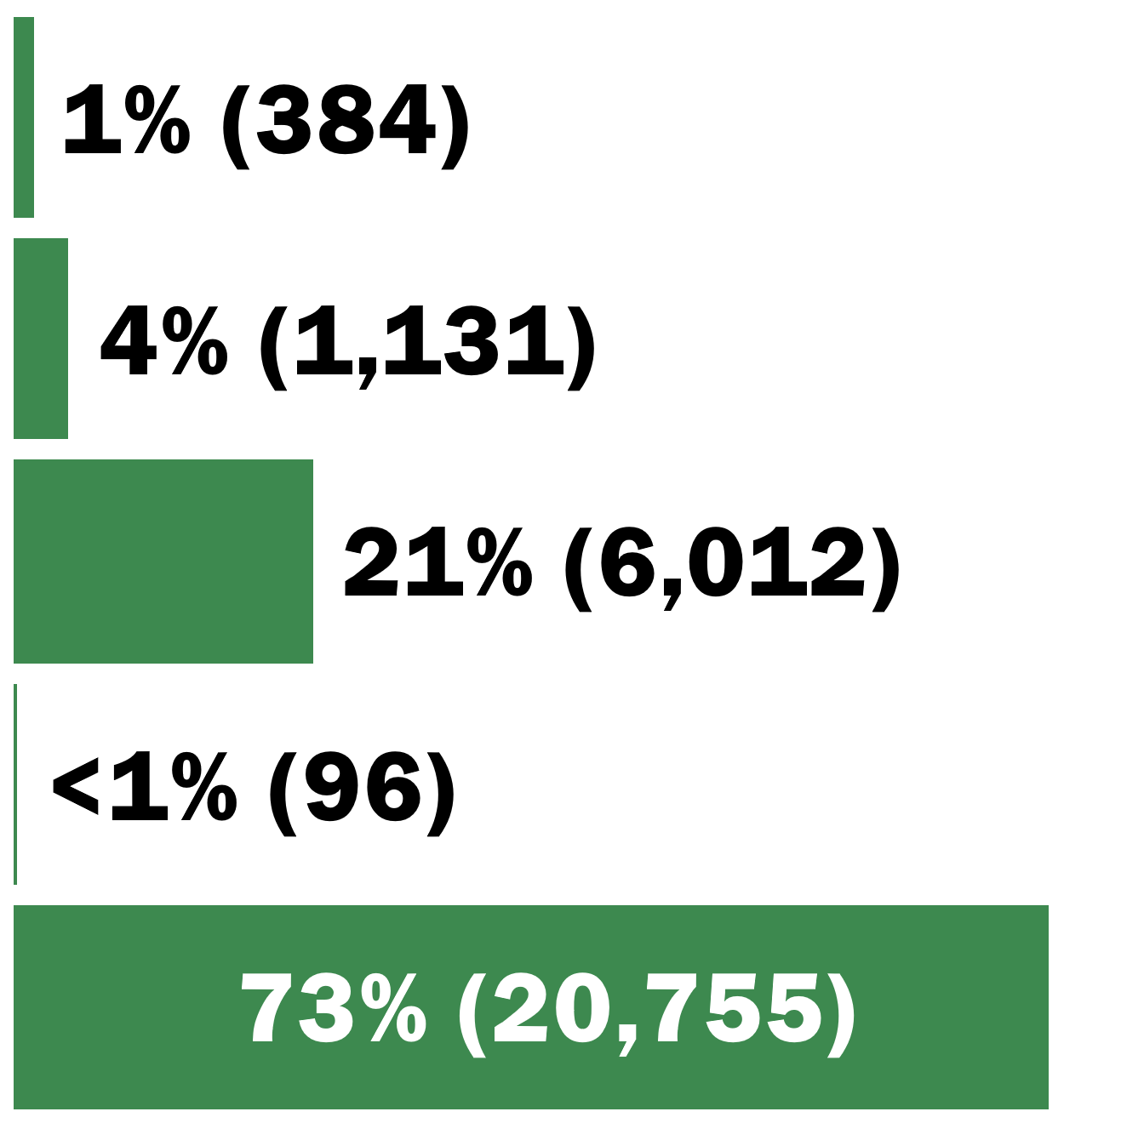
Sources of Rail Transit Fatalities and Injuries
Rail Transit Fatalities and Injuries by Source, Oct 2019–Apr 2025
Fatalities
Injuries
Suicides and Suicide Attempts
Collisions between Rail Vehicles and People
Homicides and Assaults
Personal Injuries on the Right-of-Way
All Others (e.g. personal injuries in stations)
Source: National Transit Database (NTD)
FY2024–25 data are preliminary.
Produced Using NTD Data Pulled On: 8/1/2025
Notes:
Most rail transit fatalities result from:
Suicides committed on transit property, and
Collisions between trains and people who were not inside a motor vehicle: people who have ended up on the rail right-of-way for some reason, including trespassers, customers, pedestrians, or bicyclists.
Additionally, 13% of rail transit fatalities result from homicides and another 5% result from personal injuries on the rail right-of-way.
**************
Notes about the metrics in case they are helpful:
Slide produced using NTD data pulled on Aug 1, 2025.
All charts on this table are based on NTD events that occurred from October 2019 to April 2025. Data from 2024 and 2025 are still subject to NTD reporter revision.
Suicides and suicide attempts include occasions where a person jumps or lies in front of trains and are injured or killed by the collision. This tally only includes those collisions where the NTD reporter identified an injury or fatality as a suicide.
Non-collision suicide fatalities and injuries are also included in this category.
Homicides and assaults includes occasions where a person shoves another person in front of a train, or attacks another person in any way, resulting in a collision. This is true even if the event was reported to NTD as a collision.
Collisions between Rail Vehicles and People excludes collisions where the NTD reporter indicates a suicide, homicide, or assault was involved.
Collisions between rail vehicles and trespassers on the ROW who are not suicides or victims of assault or homicide are included in this category.
On the rare occasion where someone commits a homicide or assault and then commits suicide, the person committing suicide was tallied in the Suicides and Suicide Attempts category. All other people injured or killed (e.g. victims, law enforcement, etc.) were tallied in the Homicides and Assaults category.
Personal injuries on the ROW includes events where a person is found dead on the ROW when there is no evidence of a collision.
Facts not shown on this slide that may be helpful for discussion:
Most rail transit injuries result from different types of events than rail transit fatalities. The events that result in the most rail transit injuries are:
Personal injuries occurring in rail stations and other revenue facilities
These are often slips, trips, and falls on station stairs, elevators, escalators, and ramps
Homicides and assaults (which are shown)
This includes both assault victims and those injured while assisting victims
Personal injuries occurring onboard rail transit vehicles
Data analysis notes:
Data include only NTD Full Reporters. Rail agencies overseen by FRA are excluded.
Rail modes include Cable Car, Heavy Rail, Inclined Plane, Light Rail, Monorail/Automated Guideway, Streetcar, and Hybrid Rail modes.)

Slide 22
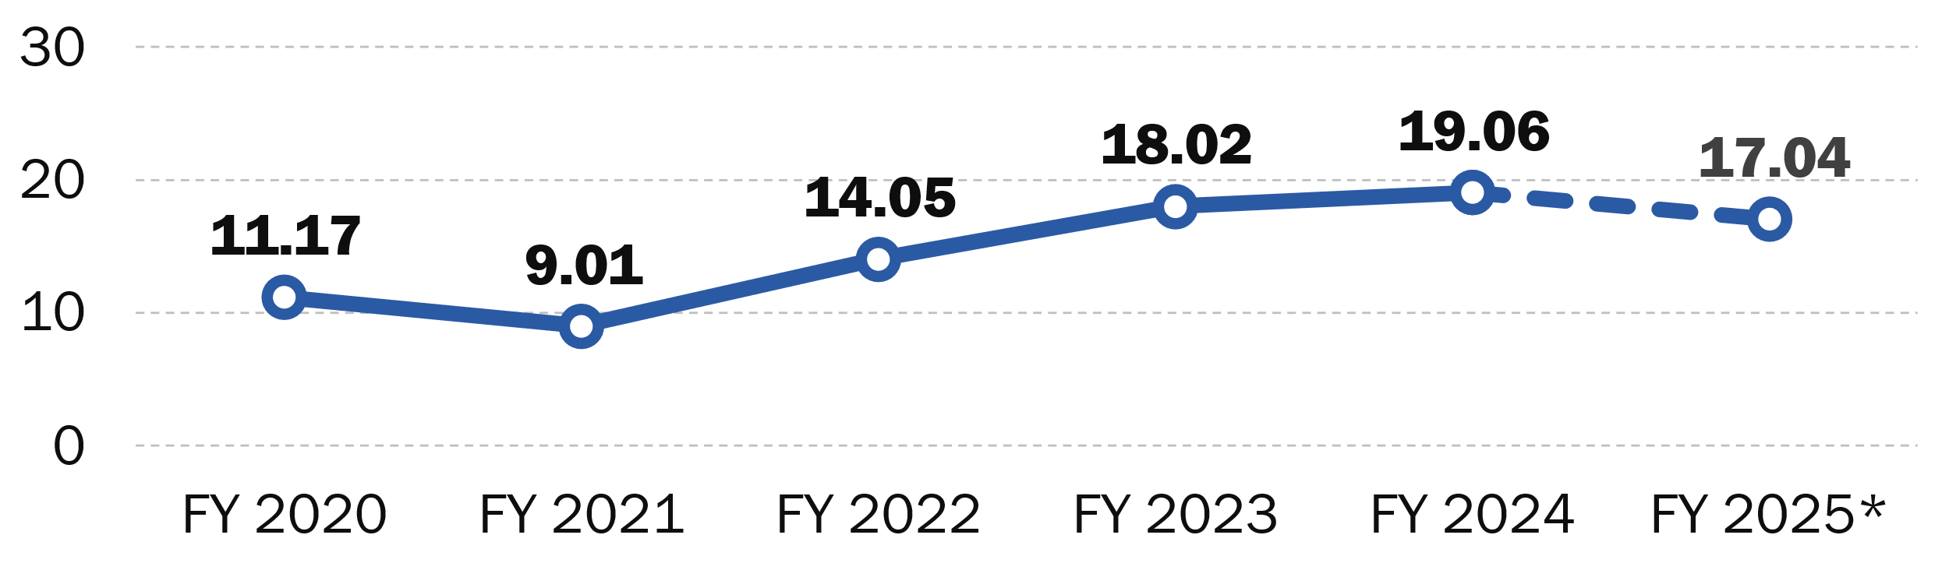
Major Assaults on Transit Workers:
FY 2020–25
Major Assault Events against Transit Workers per 100 Million Vehicle Revenue Miles
(100M VRM)
Major Assaults | 364 | 284 | 459 | 615 | 675 | 360
Fatalities | 0 | 12 | 1 | 3 | 5 | 2
Injuries | 368 | 290 | 469 | 656 | 723 | 388
Raw Event, Fatality, and Injury Counts
Source: National Transit Database (NTD)
FY 2024–25 data are preliminary. *FY 2025 only includes data from Oct 2024–Apr 2025.
Produced Using NTD Data Pulled On: Aug 1, 2025
Notes:
FY 2024-25 data are preliminary. FY 2025 only includes data from Oct 2024–Apr 2025. FY 2023 rate is subject to minor revision until 2024 NTD Annual Reporting is validated.
Data is as of Aug 1, 2025.
******************
(Notes about the metrics in case they are helpful:
The event rates shown are per 100 million “vehicle revenue miles” (VRM), which provide a good general estimate of the amount of bus and rail transit service provided by agencies
VRM is actually a measurement of the total number of miles buses and individual railcars travel during revenue service.
NTD reporters began submitting event data for all assaults on transit workers in the middle of 2023. In prior years, NTD only collected data for assaults on transit workers that met certain thresholds. Please see a 2022 or earlier NTD Safety and Security Reporting Policy Manual for more details.
This analysis only tallies major assaults on transit workers. Please see the latest NTD Safety and Security Reporting Policy Manual for more details on the criteria FTA uses to delineate “major” security events.
Prior to the reporting change noted above, “assaults on transit workers” included any major assault or homicide event that resulted in fatalities or injuries to a transit worker. During this time, resulting fatalities and injuries include only the workers killed or injured during an assault on transit workers.
After the reporting change noted above, “assaults on transit workers” included any major assault or homicide event where NTD reporters specified any transit worker was attacked, including assaults and homicides reported as collisions per NTD reporting policy. During this time, resulting fatalities and injuries included all people killed or injured during an assault on transit workers, including bystanders who were not transit workers.
On the rare occasion of a murder-suicide or assault-attempted suicide, any fatality marked as suicide or injury marked as attempted suicide within the NTD event report has not been included as a fatality or injury here, since it was a suicide.
Nine of the twelve assaults on transit workers fatalities reported in FY 2021 resulted from an active shooter event on Santa Clara Valley Transportation Authority property on May 26, 2021.
(Additional information that may be helpful:
All charts on this table are based on NTD events that occurred in fiscal years (FY) 2020 to 2025. Data from FY 2024-25 are still subject to NTD reporter revision.
(Data analysis notes:
This is an analysis of bus and rail modes.
Bus modes include standard Bus, Bus Rapid Transit, Commuter Bus, Demand Response, Publico, Trolleybus, and Vanpool modes.
Rail modes include Cable Car, Heavy Rail, Inclined Plane, Light Rail, Monorail/Automated Guideway, Streetcar, and Hybrid Rail modes.
Data include only NTD Full Reporters. Rural bus agencies and urban bus agencies operating 30 or fewer vehicles at maximum service are excluded.
Modes overseen by the Federal Railroad Administration or the United States Coast Guard are also excluded.
The NTD has not changed the thresholds that require bus or rail modes to submit fatality data since 2019.
The NTD has not changed the thresholds that require bus or rail modes to submit injury data since 2019.

Slide 23
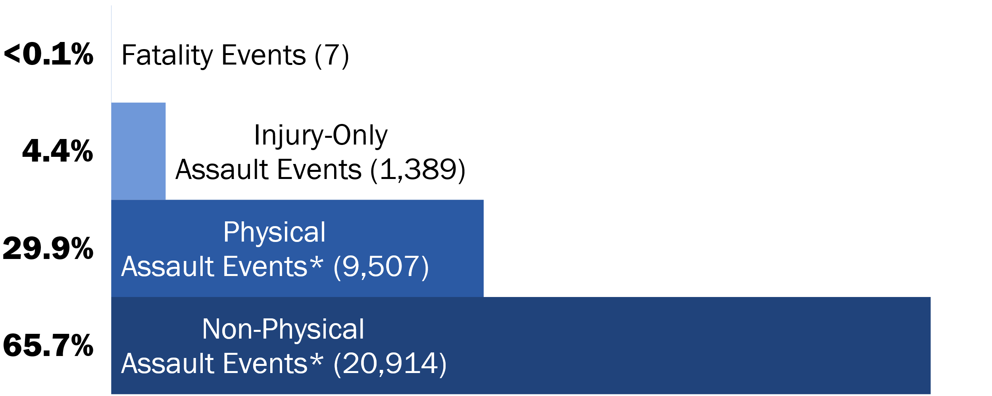
All Assaults on Transit Workers by Severity: April 2023–April 2025
This New Data Collection Started April 2023
Source: National Transit Database (NTD)
*Starred categories are events that do not result in a transit worker fatality or injury.
Produced Using NTD Data Pulled On: Aug 1, 2025
Notes:
2024 and 2025 data are preliminary.
All data was pulled on Aug 1, 2025.
******************
NTD reporters began reporting all assaults on transit workers events in April 2023. This slide shows how severe the assaults on transit workers that occurred from April 2023 to April 2025 were.
Most assaults on transit workers reported during this time period were non-physical in nature, such as threats or intimidation that did not involve any contact with the transit worker.
Over 90% of assaults on transit workers during this time period would not meet the pre-2023 threshold for NTD, as they did not result in a fatality or injury.
(Data analysis notes:
2024 and 2025 data shown here are still subject to NTD reporter revision.
This is an analysis of bus and rail modes.
Bus modes include standard Bus, Bus Rapid Transit, Commuter Bus, Demand Response, Publico, Trolleybus, and Vanpool modes.
Rail modes include Cable Car, Heavy Rail, Inclined Plane, Light Rail, Monorail/Automated Guideway, Streetcar, and Hybrid Rail modes.
Data include only NTD Full Reporters. Rural bus agencies and urban bus agencies operating 30 or fewer vehicles at maximum service are excluded.
Modes overseen by the Federal Railroad Administration or the United States Coast Guard are also excluded.
“Assaults on Transit Workers” include any assault or homicide event where NTD reporters specified any transit worker was attacked, including assaults and homicides reported as collisions per NTD reporting policy.
A “fatality event” includes any of these events resulting in the death of any person, including a non-worker.
An “injury-only assault event” includes any of these events resulting in no deaths but resulting in injuries to at least 1 person (worker or non-worker) that qualified for NTD reporting, typically injuries serious enough to merit immediate medical transportation from the scene. Please see the latest NTD safety and security event reporting policy manual for more details.

Slide 24
Mitigation Status
What mitigations are rail/multi-modal transit agencies deploying?​
#1 De-Escalation Training
#2 Video/Audio Surveillance
#3 Operating Policies and Procedures
#4 Signage Informing Riders of Surveillance/Penalties
Notes:
Source: General Directive 24-1 Full Analysis Presentation
Status of Implementing Mitigations:​
De-Escalation Training
27 completed
56 in progress
2 planned​
Video/Audio Surveillance
53 completed
21 in progress
3 planned​
Operating Policies and Procedures
43 completed
23 in progress
4 planned​
Signage Informing Riders of Surveillance/Penalties
40 completed
18 in progress
8 planned

Slide 25




Mitigation Effectiveness Evaluation – Rail/Multi-modal Agencies
69% found Video/Audio Surveillance to be effective
68% found Automatic Vehicle Location to be effective
66% found Patrol Strategies to be effective
53% found Operator Area Protective Barriers to be effective
Notes:
Source: General Directive 24-1 Full Analysis Presentation

Slide 26
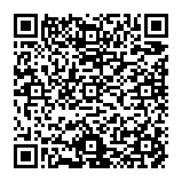
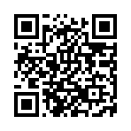
General Directive Resources
On January 16, 2025, FTA published responses to General Directive 24-1: Required Actions Regarding Assaults on Transit Workers.
View FTA's Analysis
View FTA's General Directive Website

Slide 27




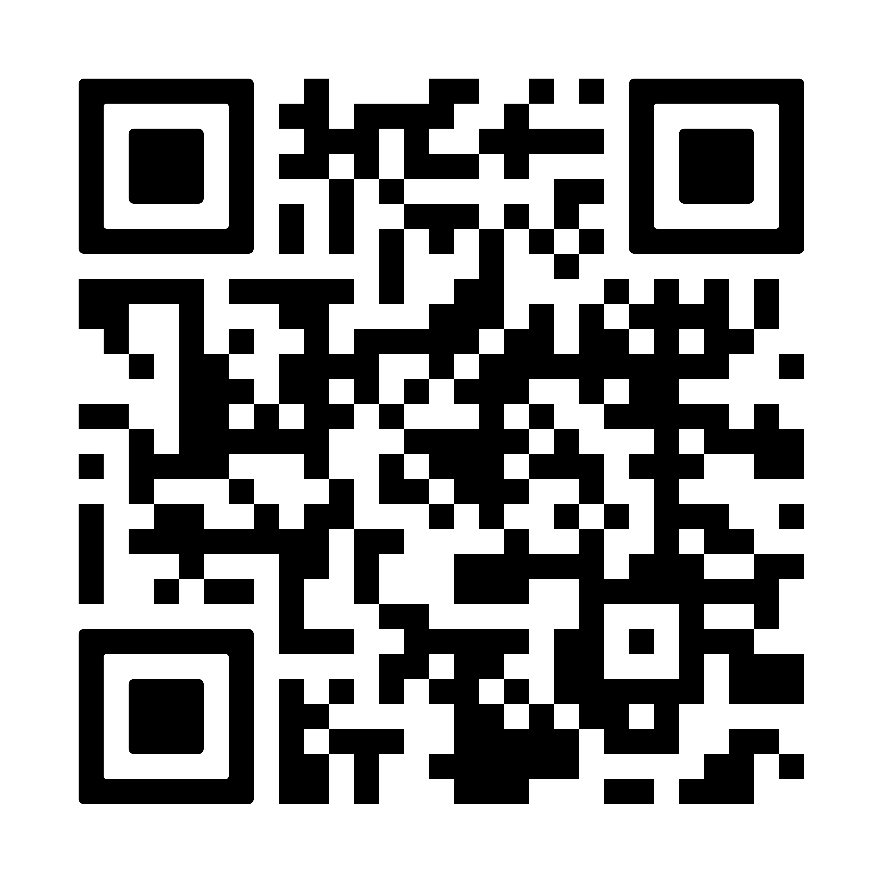
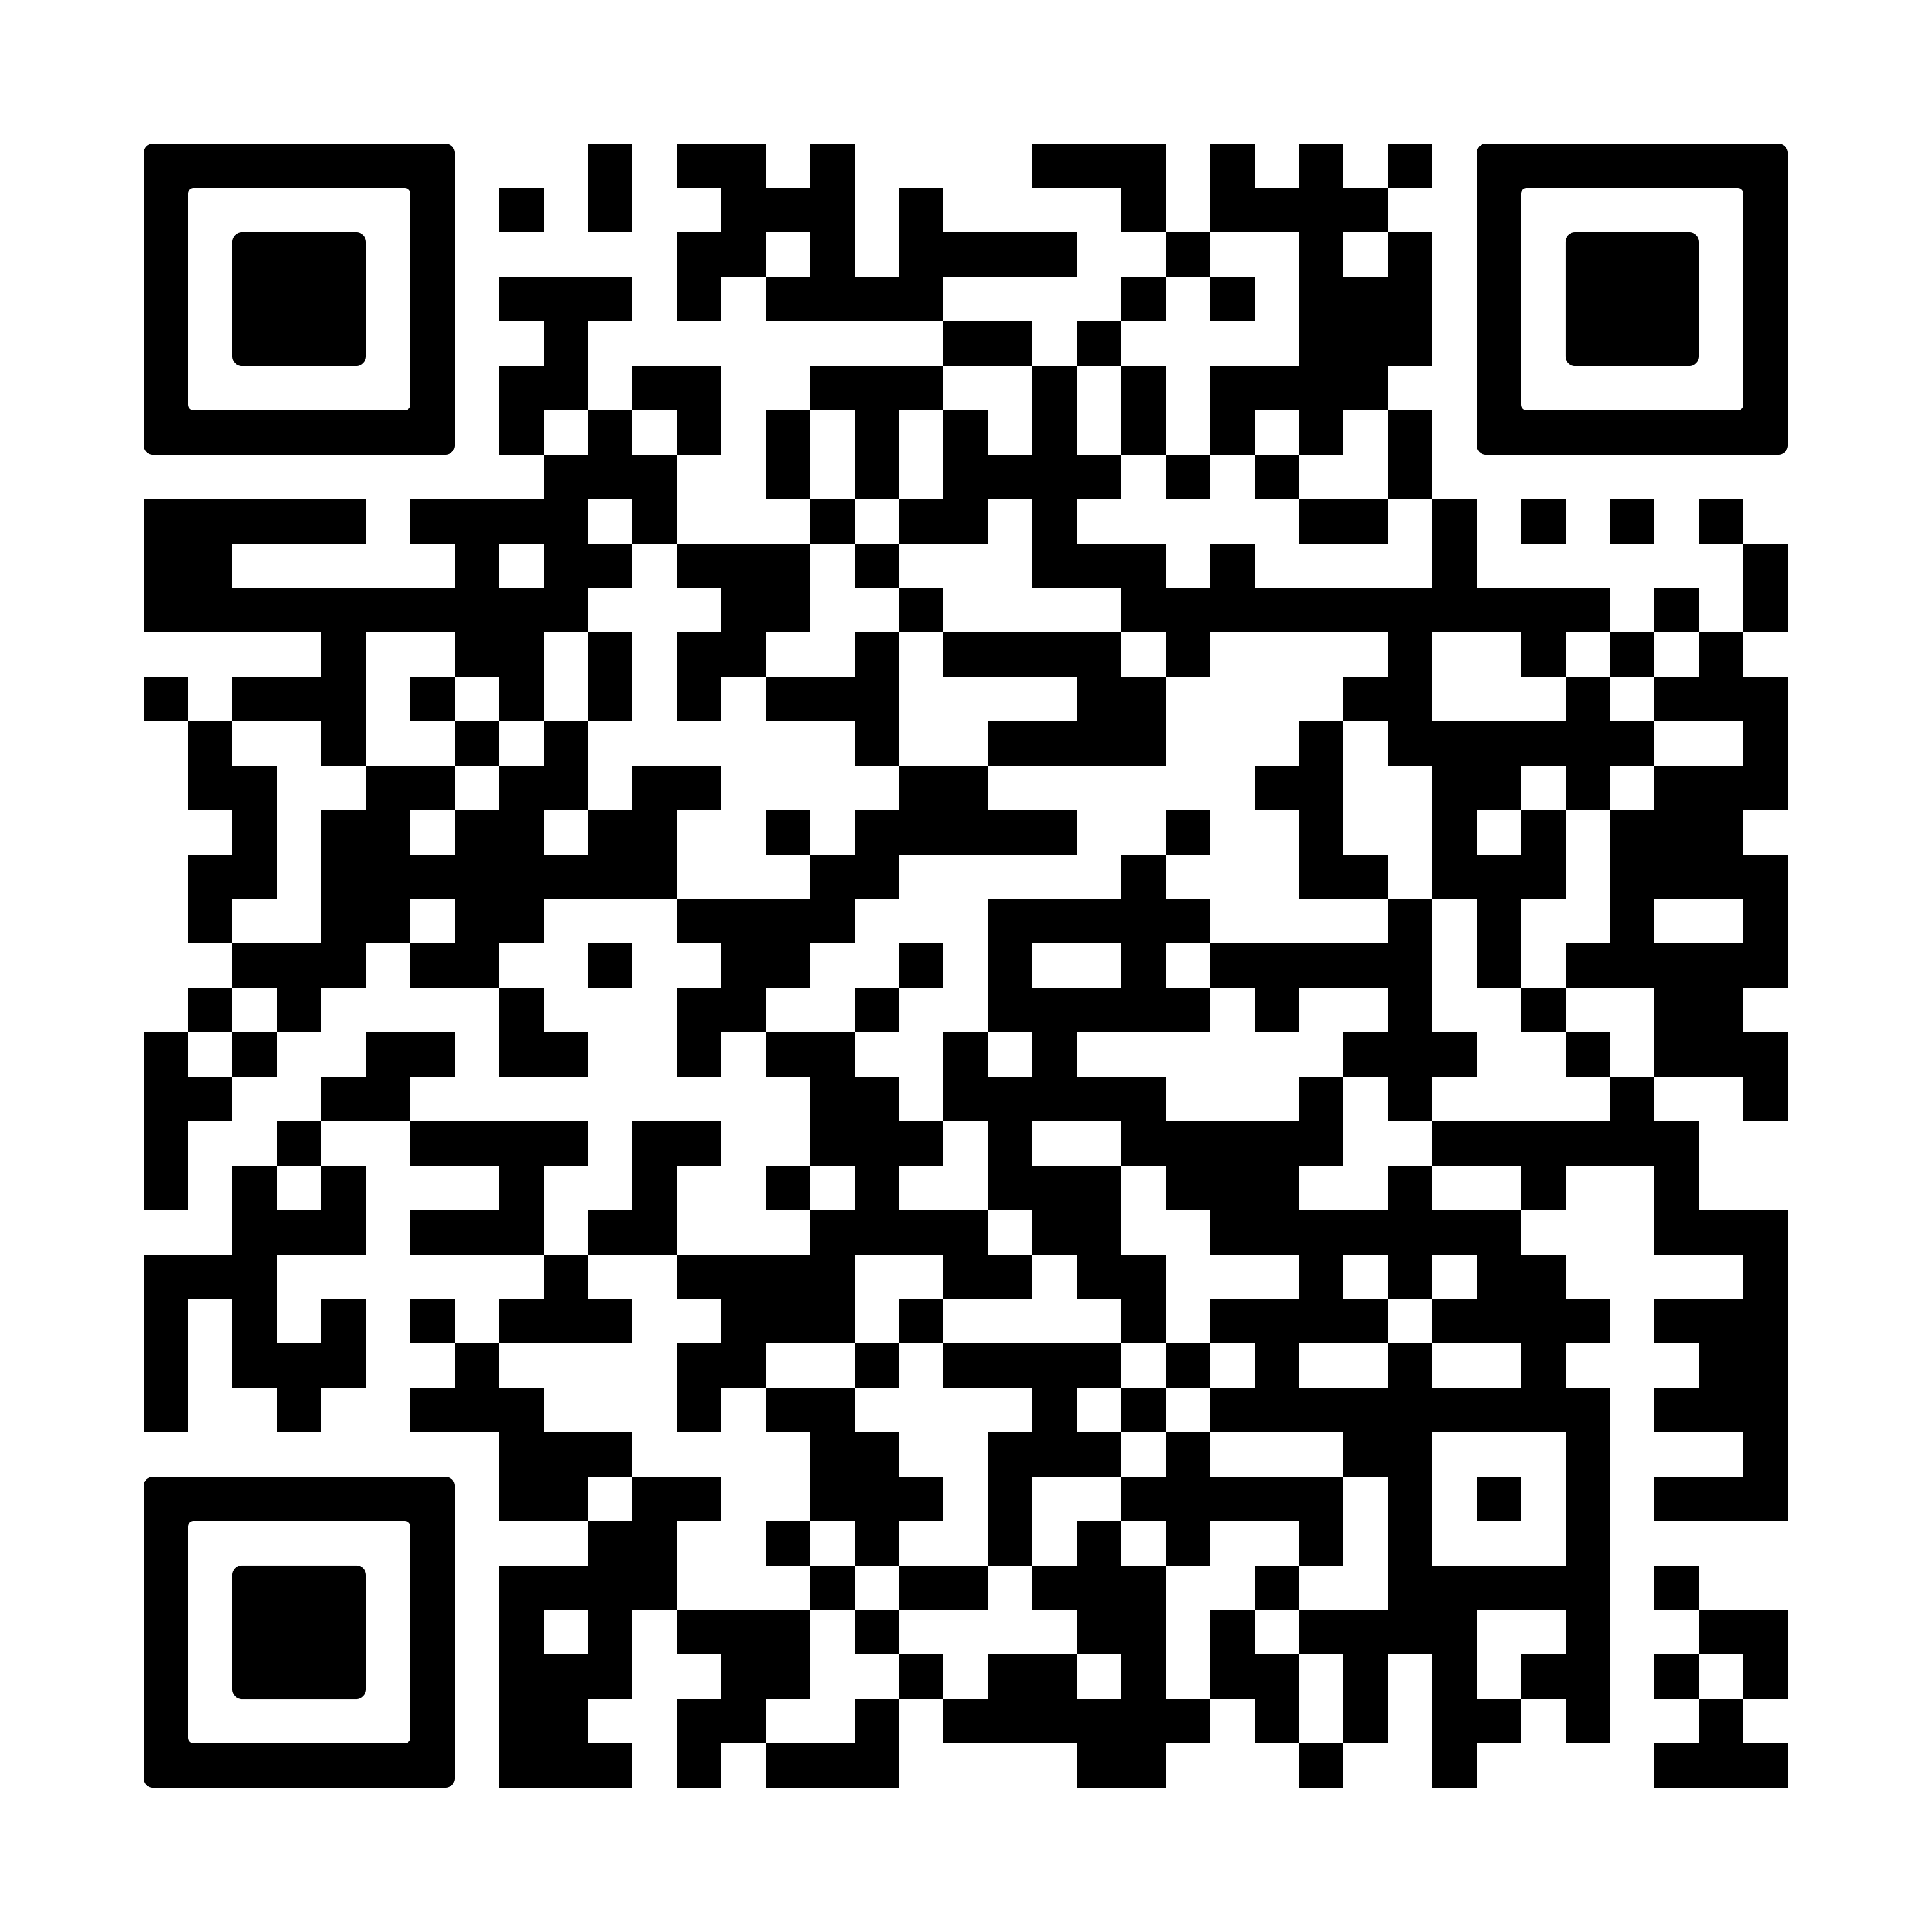
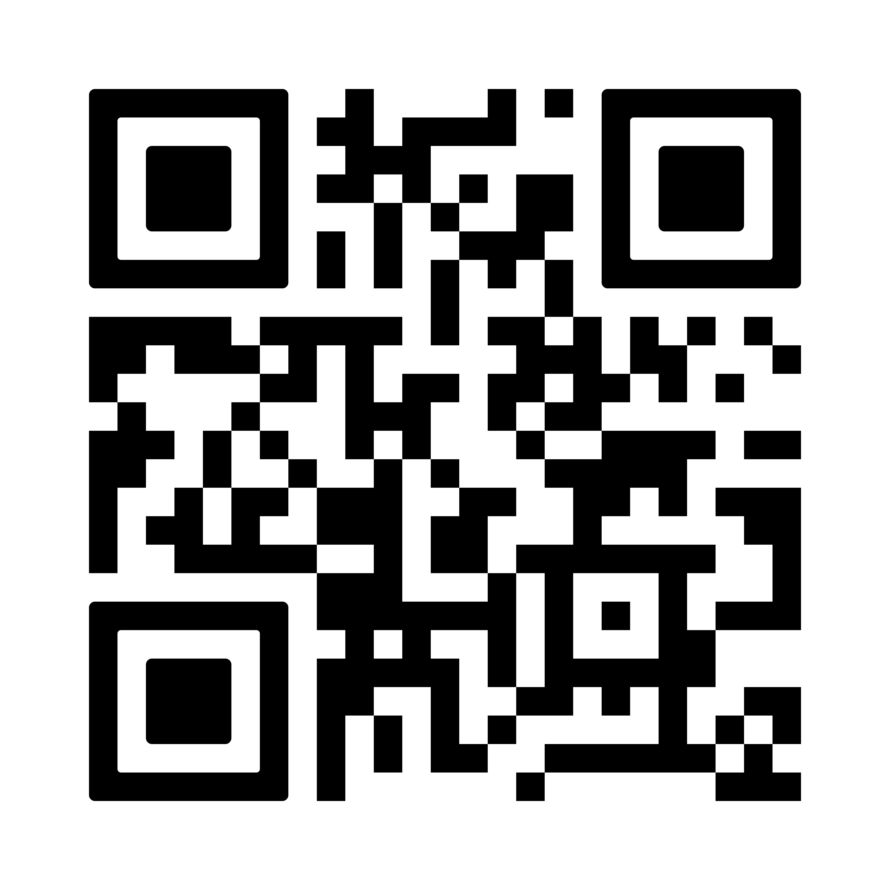
Safety Resources
Conference Presentations
TSO Spotlight Newsletter
Webinars

Slide 28
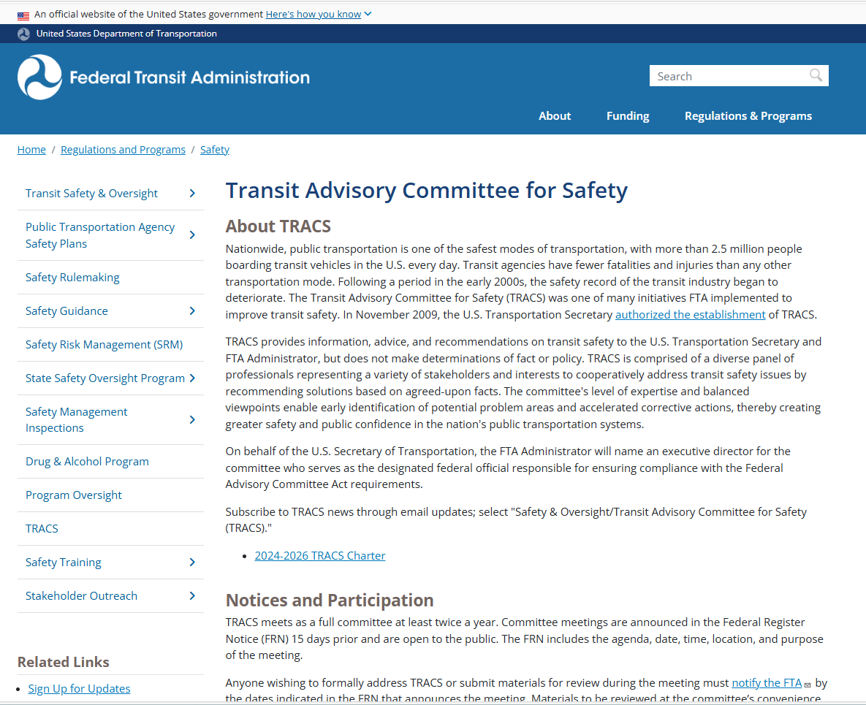
Transit Advisory Committee for Safety (TRACS) New Member Solicitation
  Federal Register notice for new Member Solicitations
  Seeking applicants to serve two-year terms
  Provides information, advice and recommendations to the US Secretary of Transportation and FTA were hybrid (on-site/virtual)
  Federal Register :: Transit Advisory Committee for Safety; Solicitation of Nominations
https://www.transit.dot.gov/regulations-and-guidance/safety/transit-advisory-committee-safety-tracs

Slide 29

Regional Reminders
Winding down for Fiscal Year
Funds must be programmed in the TIP/STIP in the current Fiscal Year
Complete Certifications and Assurances
Look on FTA website and at existing circulars
Keep using FTARegion7@dot.gov

