Slide 1

Transit Data:
Transparency and Optimization
2025 Midwest Transit Conference
September 4, 2025

Slide 2

Who am I?
Tyler Means, AICP
Chief Mobility & Strategy Officer
Oversee planning, scheduling, IT and mobility services
Passionate about mobility and community development
A Gemini that loves the beach

Slide 3
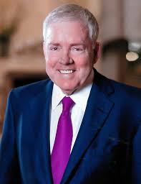
“If we have data, let’s look at data. If all we have are opinions, let’s go with mine.” – Jim Barksdale
Former CEO
McCaw Cellular/AT&T
Netscape
Former COO/VP
FedEx

Slide 4
“If we have data, let’s look at data…”– Jim Barksdale
Putting data on a pedestal
  Fact and truth should drive decisions
Opinions, gut feelings, beliefs…
  No replacement for concrete data
Notes:
Talk about analytics here

Slide 5
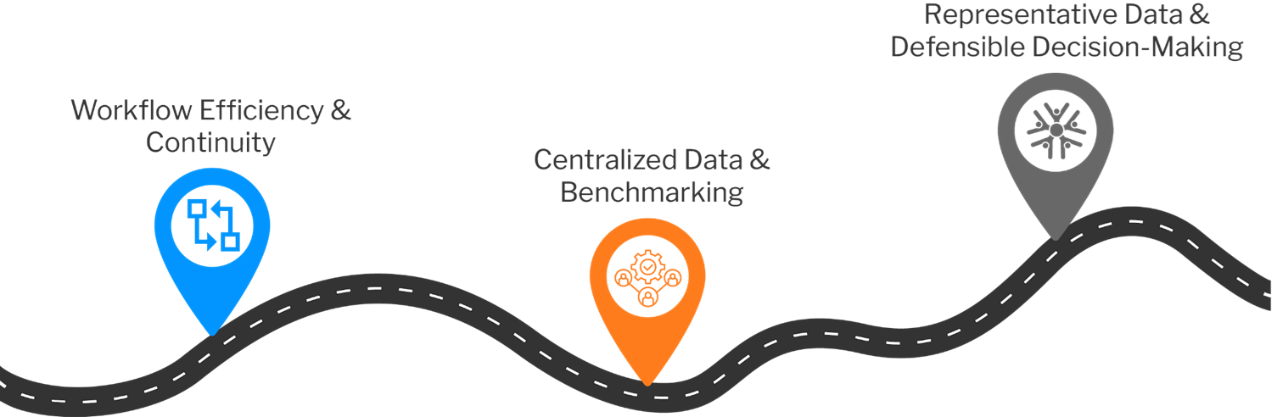
Doing More with Less

Slide 6
Defining Success
Before moving ahead with solutioning, one must understand what they are solving for
Regarding transit, I boil down success into three focuses
  Decreasing service costs
  Improving service efficiencies
  Improving customer satisfaction

Slide 7
A little bit about the KCATA
The Kansas City Area Transportation Authority connects people to opportunities through safe, reliable public transportation.
As a bi-state agency, KCATA is charged with serving the transportation and development needs of the Kansas City region.

Slide 8
Storytelling is Critical for Funding & Community Support
The Power of a Good Story
Effectively communicate value to secure funding
  Align data and analysis with goals and objectives of funders
At the same time, it is important to gain an understanding of diverse stakeholders
  Craft a narrative that resonates with community priorities
  Justify investments
  Build public trust
Notes:
NorthStar
Having ample number of operators to provide frequent and safe transit services
Doubling Down
Removed routes with low ridership
Removed routes with a high cost/ride
Found opportunities to interline/merge routes and work shifts

Slide 9
Optimizing via Data
Turning the Focus to Data-driven Decision Making
When done well, customer and public feedback can drive operations
  Allocate resources to meet public need and build public trust
Helps validate local funding investments in transit
  Local electeds love to hear that their constituents are part of the solution
Use advanced tools to broaden representation, ensue inclusivity and make engagement proactive
  Allows public engagement to become part of the strategic process
  Too often traditional engagement methodologies are reactive or simply checking a box

Slide 10
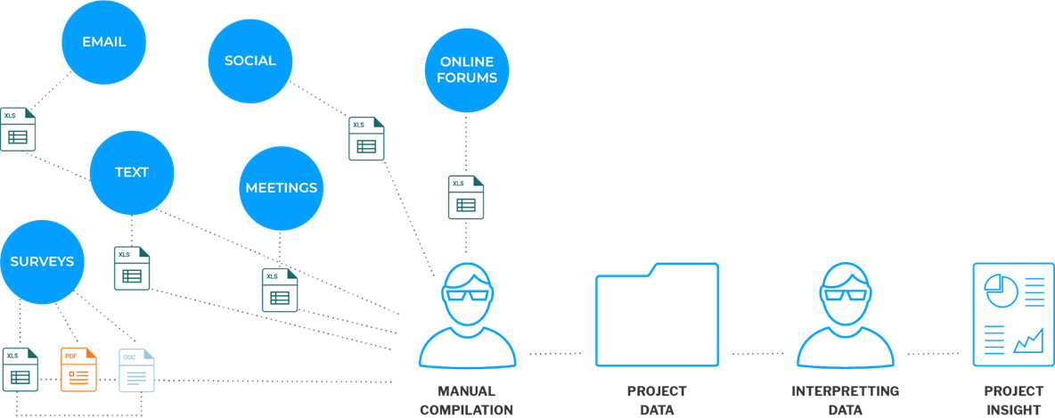
Mapping How Community Data is Gathered

Slide 11
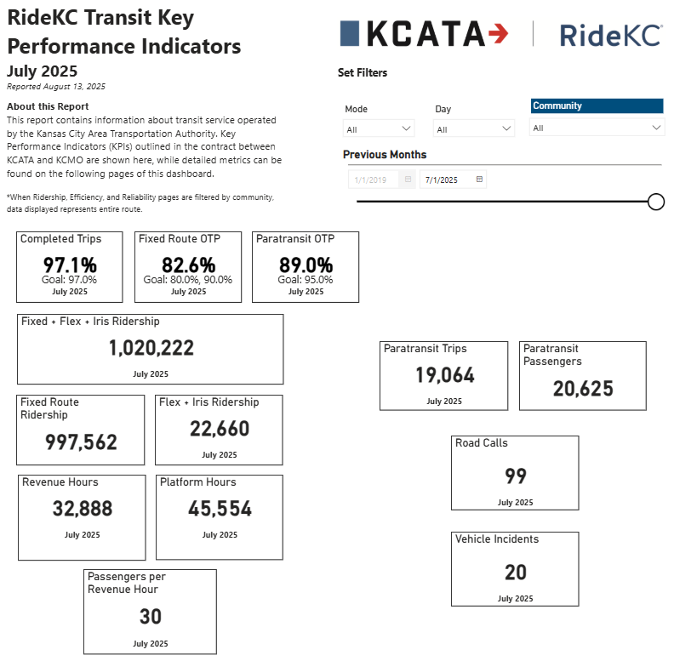
Hard Data helps tell the Story
Notes:
Hard data helps tell the story. Validates/disproves your perspective and the community experience.

Slide 12
All About Building Trust
As communities grow and evolve, so do the needs and expectations of their residents.
Keeping up requires relationship building and engagement
THE OPPORTUNITY
Expand Awareness
Proactively Engage Riders
Streamline Internal Efforts
Increase Representation
Defend Tough Decisions
Notes:
Expand Your Reach: increase awareness, improve access, and drive engagement
Hear From More Residents: start getting more diverse perspectives.
Centralize Your Work: effectively collect, organize, and use your data.
Proactively Engage Residents: build trust, strengthen relationships, and encourage participation.
Increase Representation: demonstrate the broad and representative involvement of your community.

Slide 13

Don’t Recreate the Wheel
You don’t need to wait for a project or the next survey to start.
Look for ways to become a data-driven organization by integrating existing workflows through technology.
CENTRALIZE AND STORE INFORMATION
Communications
Engagement/Planning
Customer Service
Board Meetings
Mobile Apps
Notes:
NorthStar
Ensure that the service delivered meets the expectations, and hopefully desires, of customer base

Slide 14
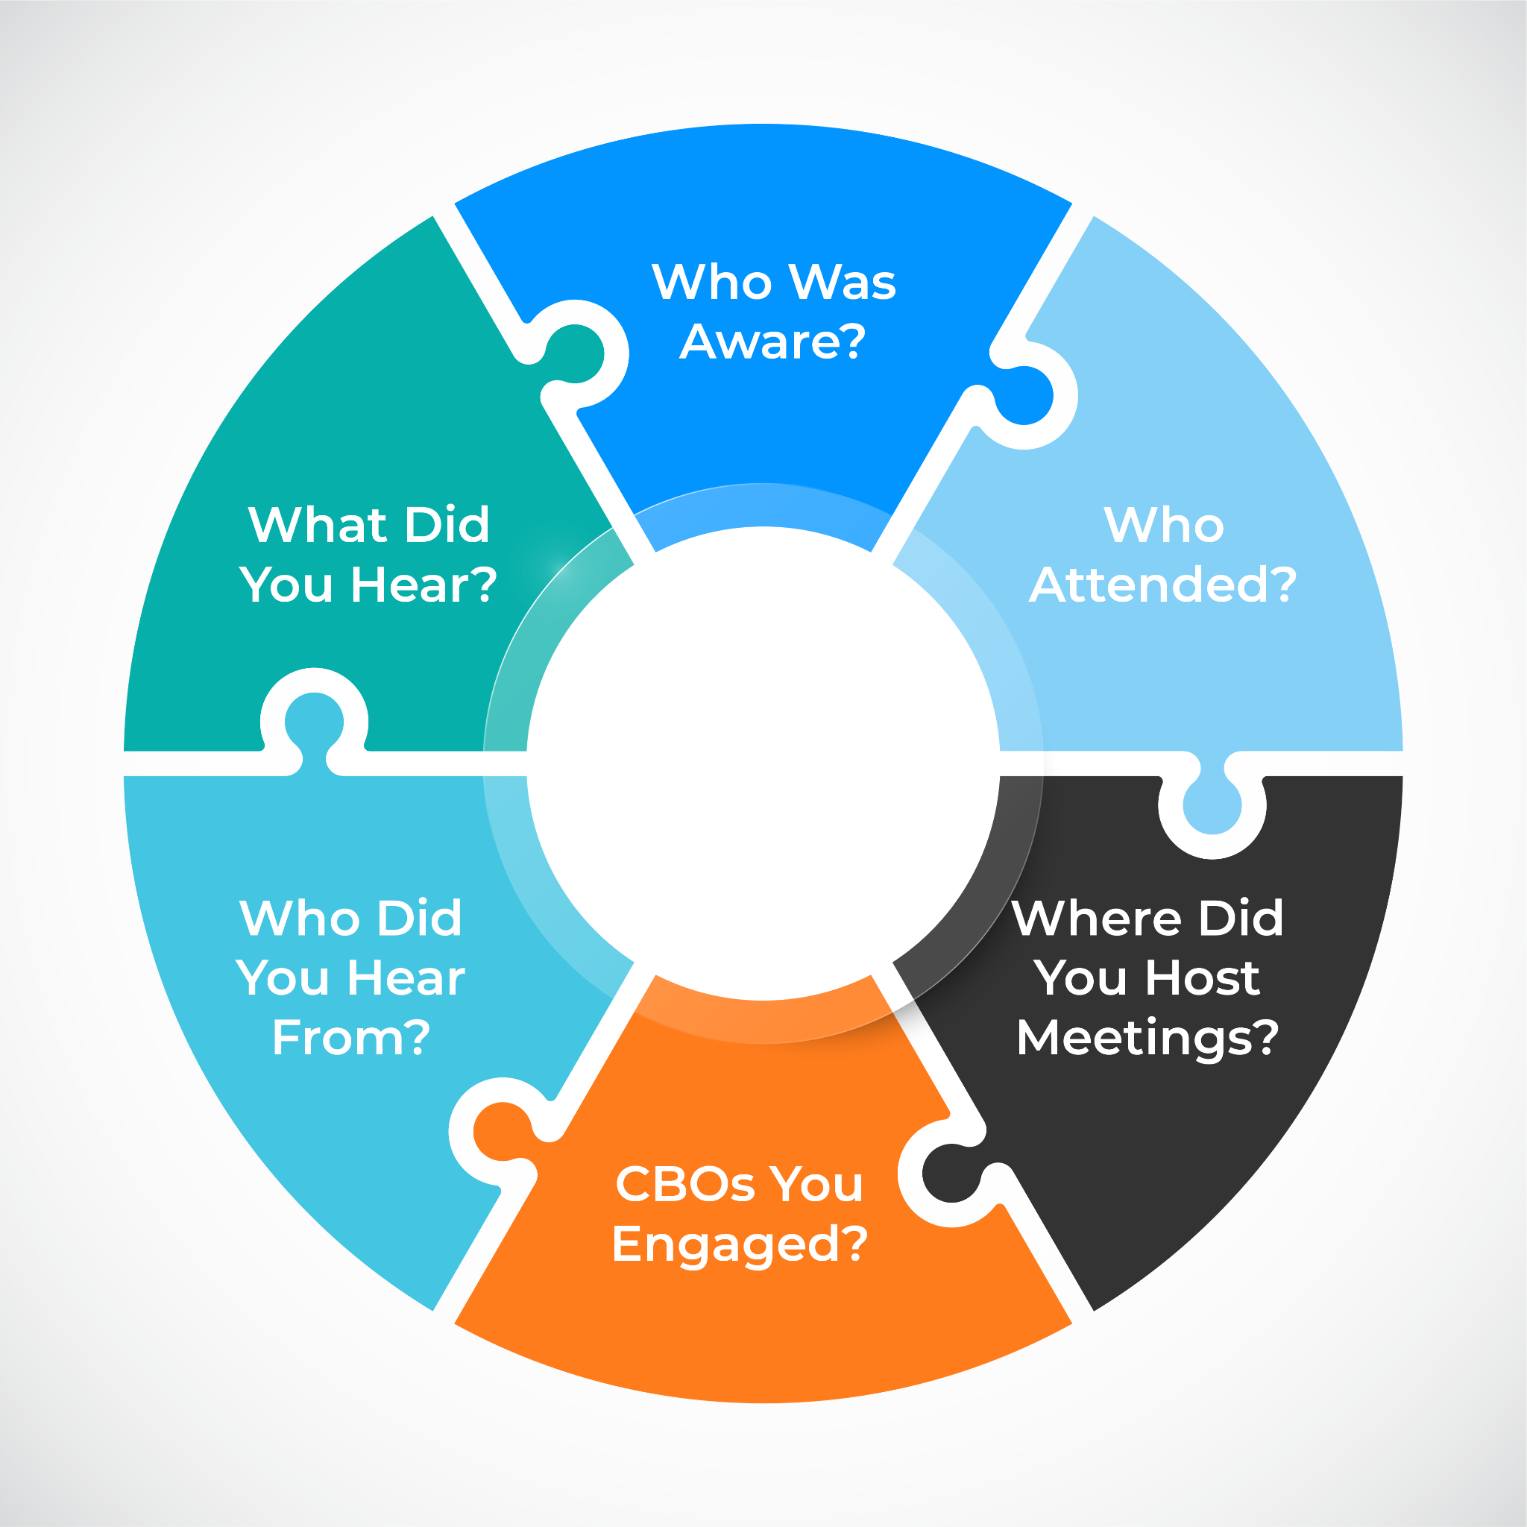
Build a System of Record to See Beyond the Survey
When you do plan for a project, make sure you can tell the whole story.
Store this data so that it compounds over time.
Aim for representing the community, not just ‘more’.
Notes:
Addressing the concern that traditional engagement often amplifies the loudest voices, while data-driven approaches consolidate diverse inputs over time, revealing trends and gaps that inform equitable service design.

Slide 15

Building Culture for Long-term Success
Public engagement is an ongoing process, and stems from a culture of transparency and curiosity.
Start small but stay consistent.

Slide 16
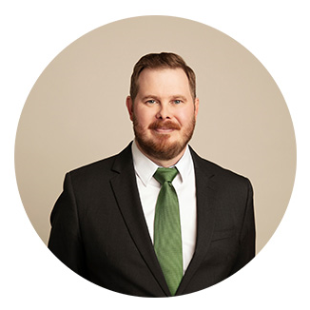
Questions
Tyler Means, AICP
Chief Mobility & Strategy Officer

