Slide 1
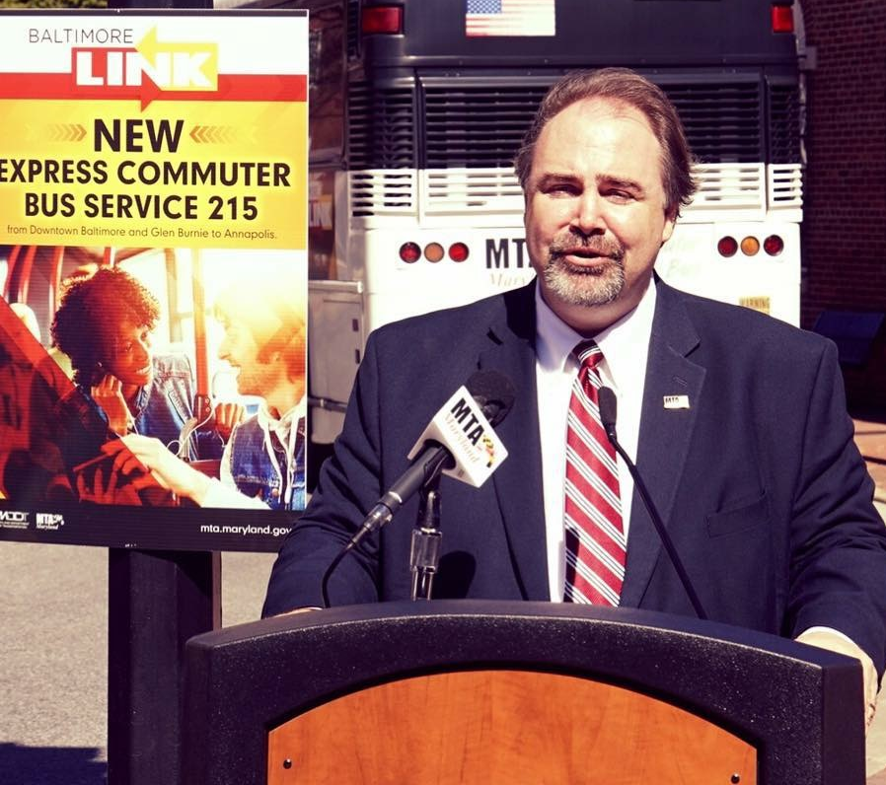

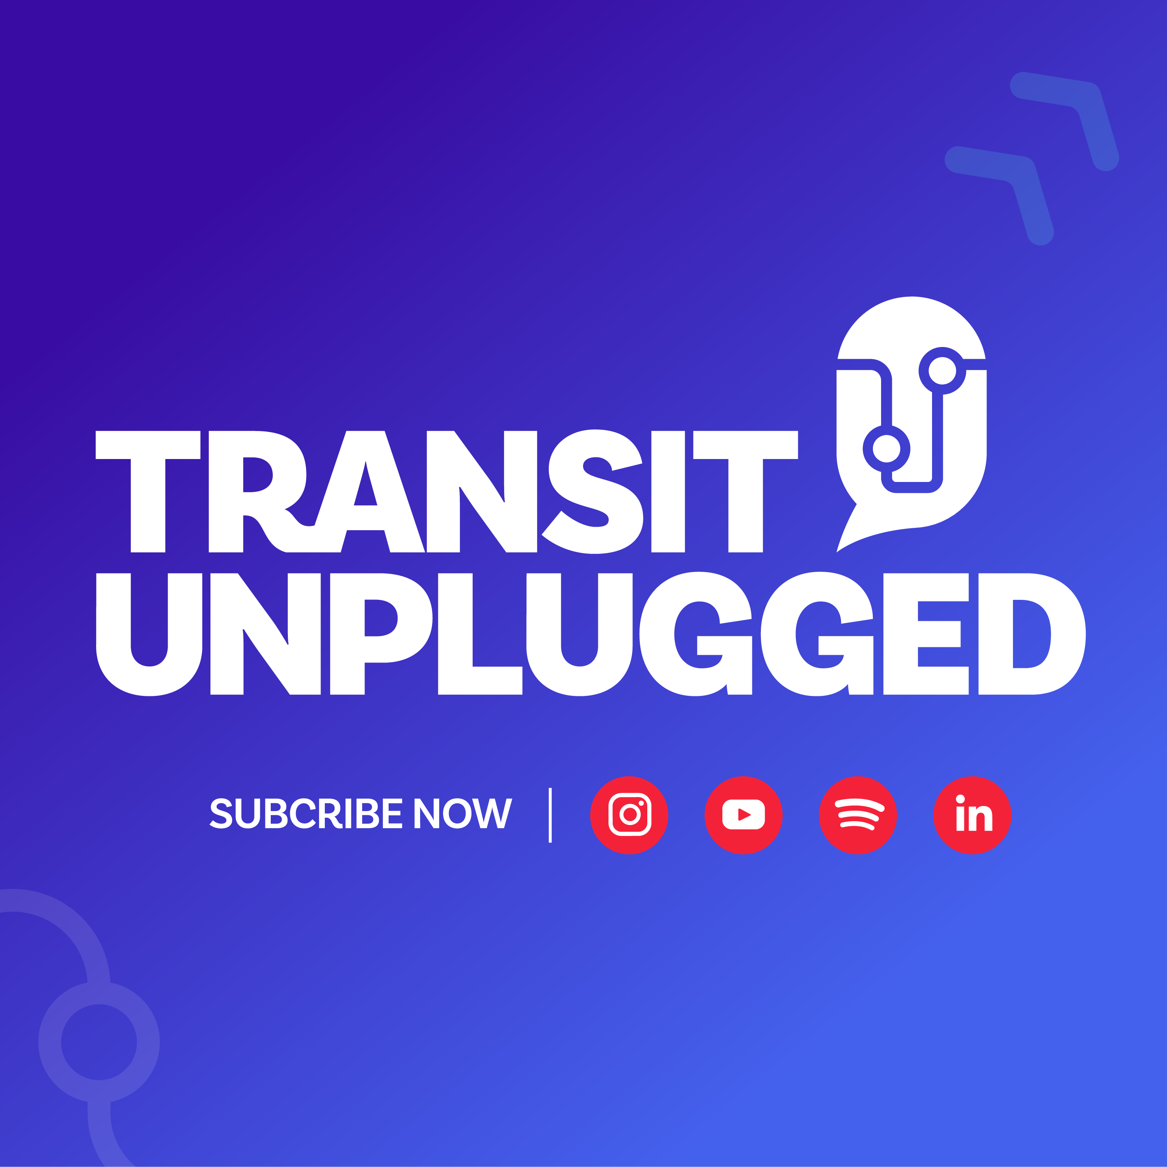
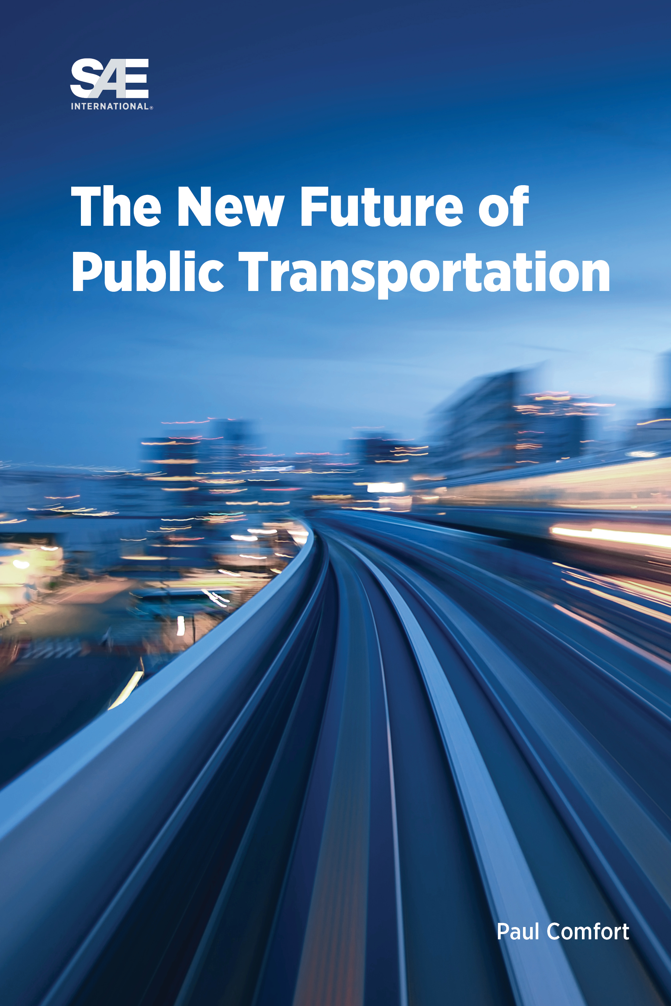
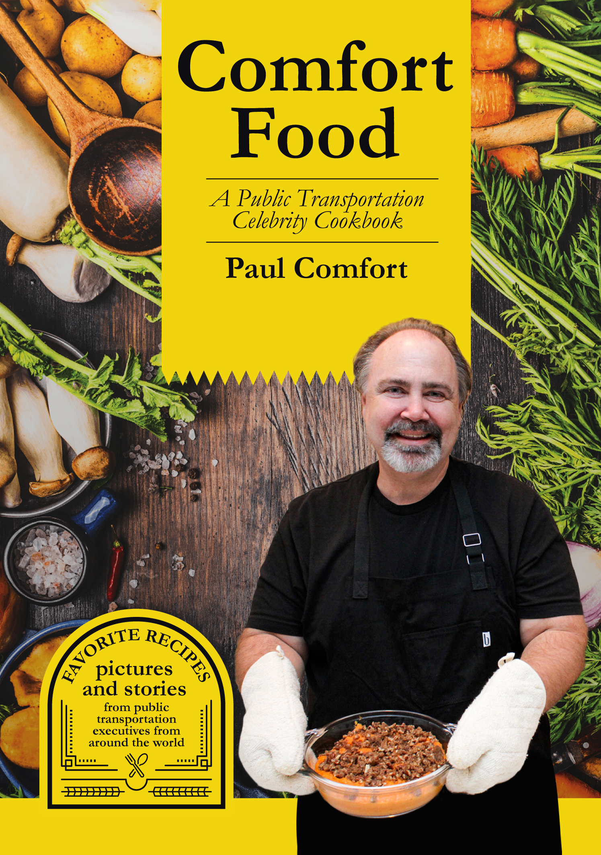
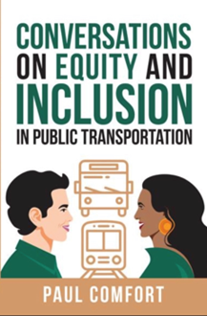
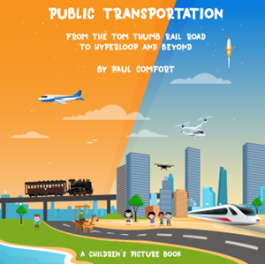
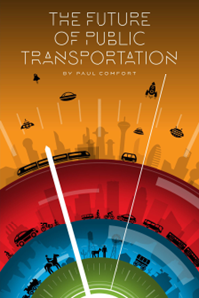

Paul Comfort
SVP/Chief Customer Officer of Modaxo Americas
30+ Year Experience in Public Transit and Local Government, Small/Medium/Large
CEO of MTA Baltimore
Top Transit Podcast/TV Host
NATA Executive Director
Villanova University Adjunct Faculty
Best selling
Author of
6 books

Slide 2
A New Administration, New Priorities and A New You
Midwest Transit Conference
Paul Comfort, Author/Podcaster

Slide 3
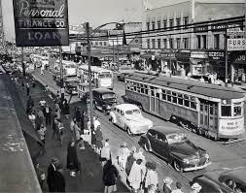
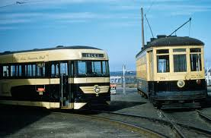
1950’s “Hey Day” for Public Transportation

Slide 4
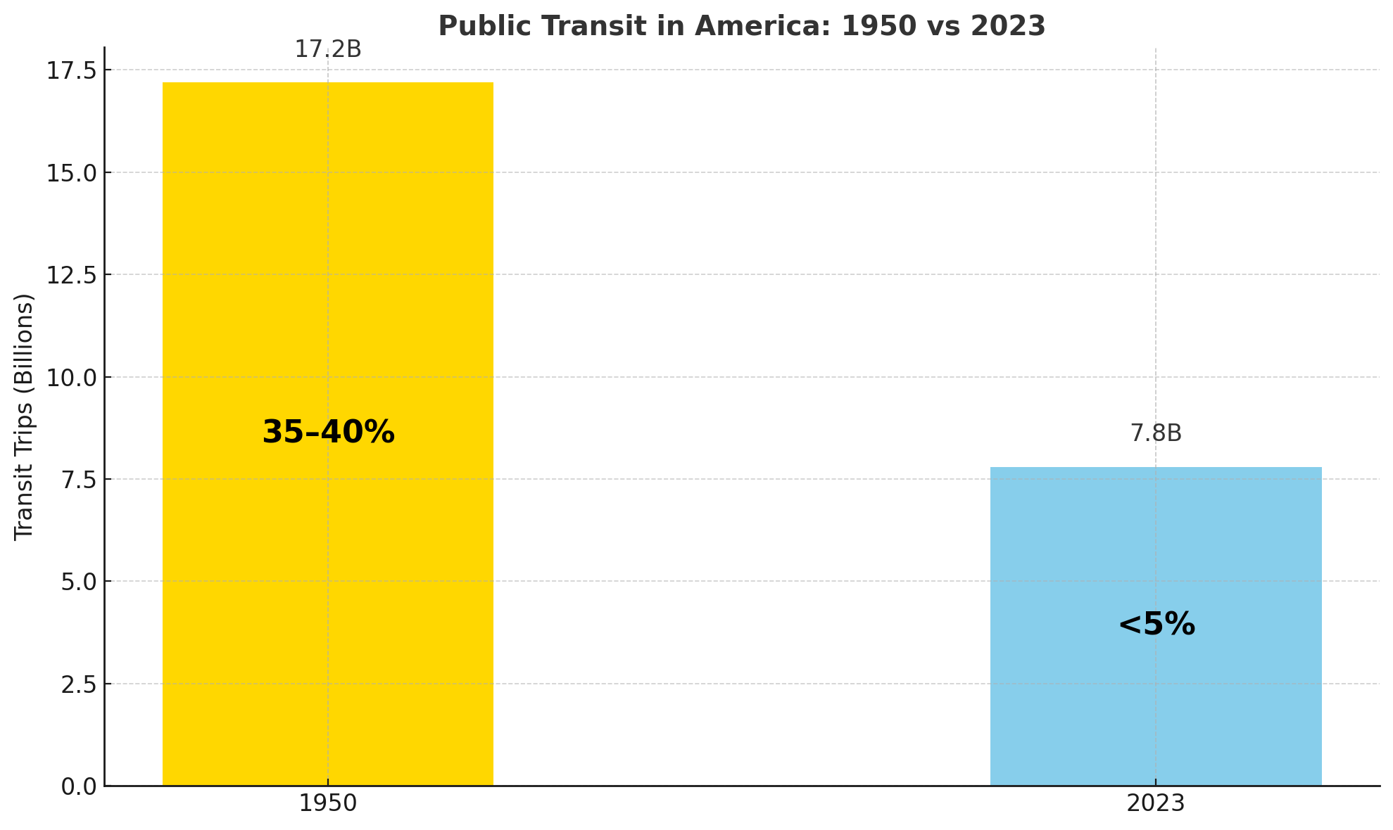
Notes:
1950s
In 1950, around 17.2 billion trips were taken on public transit in the U.S.
At that time, the U.S. population was about 150 million, so that’s approximately:
115 transit trips per person per year
An estimated 30-40% of urban Americans used public transit regularly, especially in cities like New York, Chicago, Boston, and Philadelphia.
📍 Today (2024-2025)
In 2023, there were about 7.8 billion public transit trips (according to APTA).
With a population of about 335 million, that’s:
~23 transit trips per person per year
Less than 5% of Americans use transit as a regular commuting method (per U.S. Census data on commuting).

Slide 5
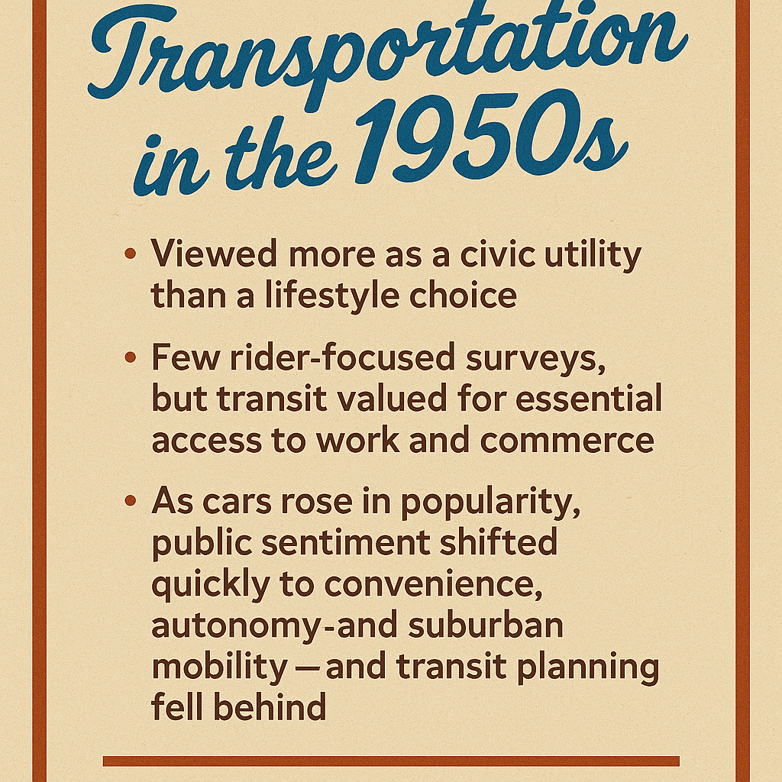
🚋 Public Transit in the 1950s: Community & Rider Perspectives
🛠️ Viewed as essential infrastructure, not a personal choice—like water or electricity
👔 Primarily used for commuting to work and accessing commerce, especially in cities & profitable
🧾 Few rider-focused surveys existed—data was mostly operational or financial
🚗 Car ownership was rising, shaping public attitudes toward personal convenience and independence
🌆 Transit was still heavily used, but the seeds of suburbanization and car culture were taking hold
📉 Public interest in expanding transit declined as highways and automobiles became the national focus

Slide 6
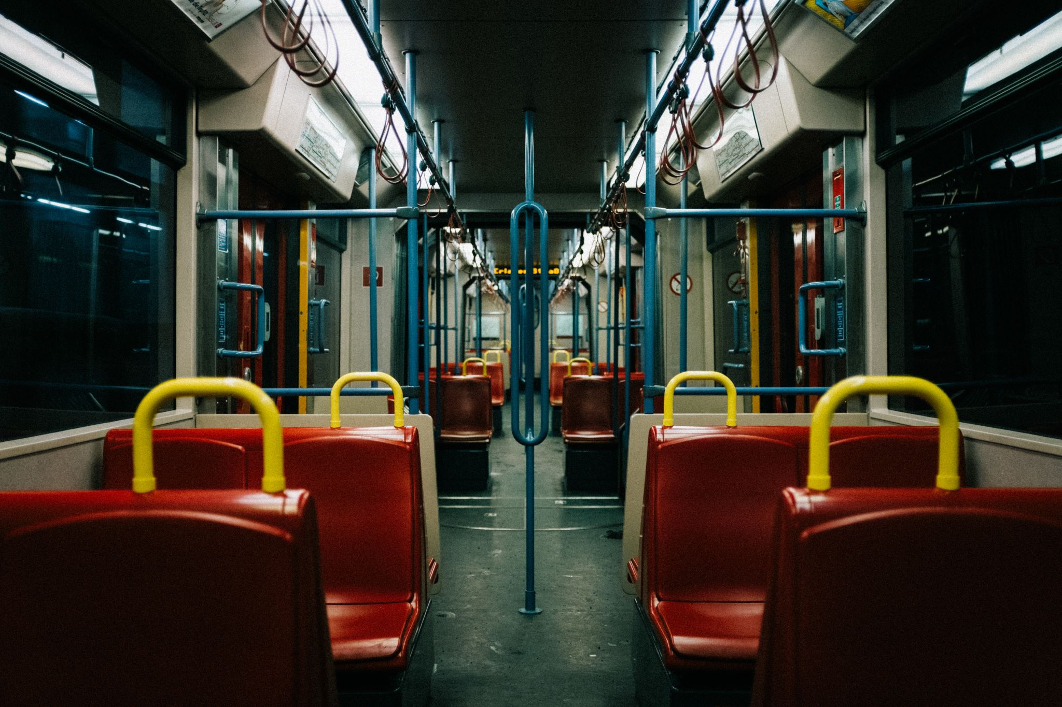
📉 Key Takeaway:
Public transit usage per capita has dropped by over 80% since the 1950s.

Slide 7
Ridership, Ridership, Ridership..
For decades, it’s been all about one metric:
Ridership. Ridership. Ridership.
🚌 1950: 17.2 billion trips
📉 2023: 7.8 billion trips
➡️ Steady decline.
But here's the disconnect:
🧍‍♂️ Only ~4% of people use transit regularly
💬 Yet 84% say transit is valuable to their community
🚨 As an industry, we focus on making the 4% become 4.2%...
…instead of speaking directly to the 84%.
Time to modernize our value proposition.

Slide 8
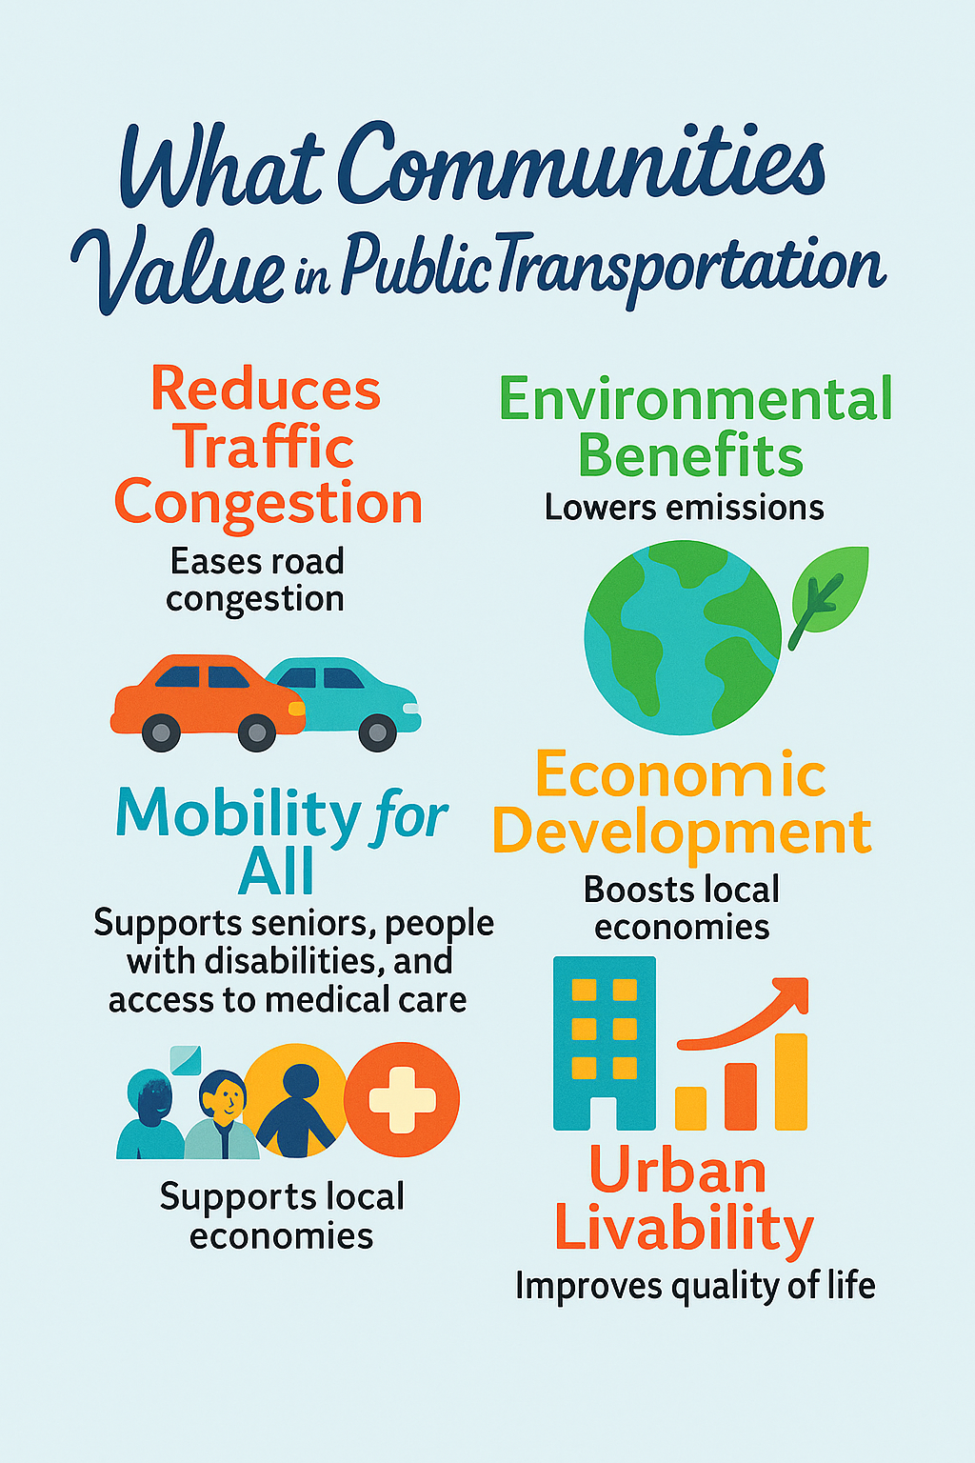
What the 84% Value
When most people say they value public transportation, they’re not talking about riding it themselves.
They’re talking about the positive impact transit has on their community—
cleaner air, less traffic, economic opportunity, and mobility for everyone.
Surveys from APTA, TransitCenter, Pew Research, and local MPOs consistently confirm this:
Public support for transit goes far beyond ridership.

Slide 9
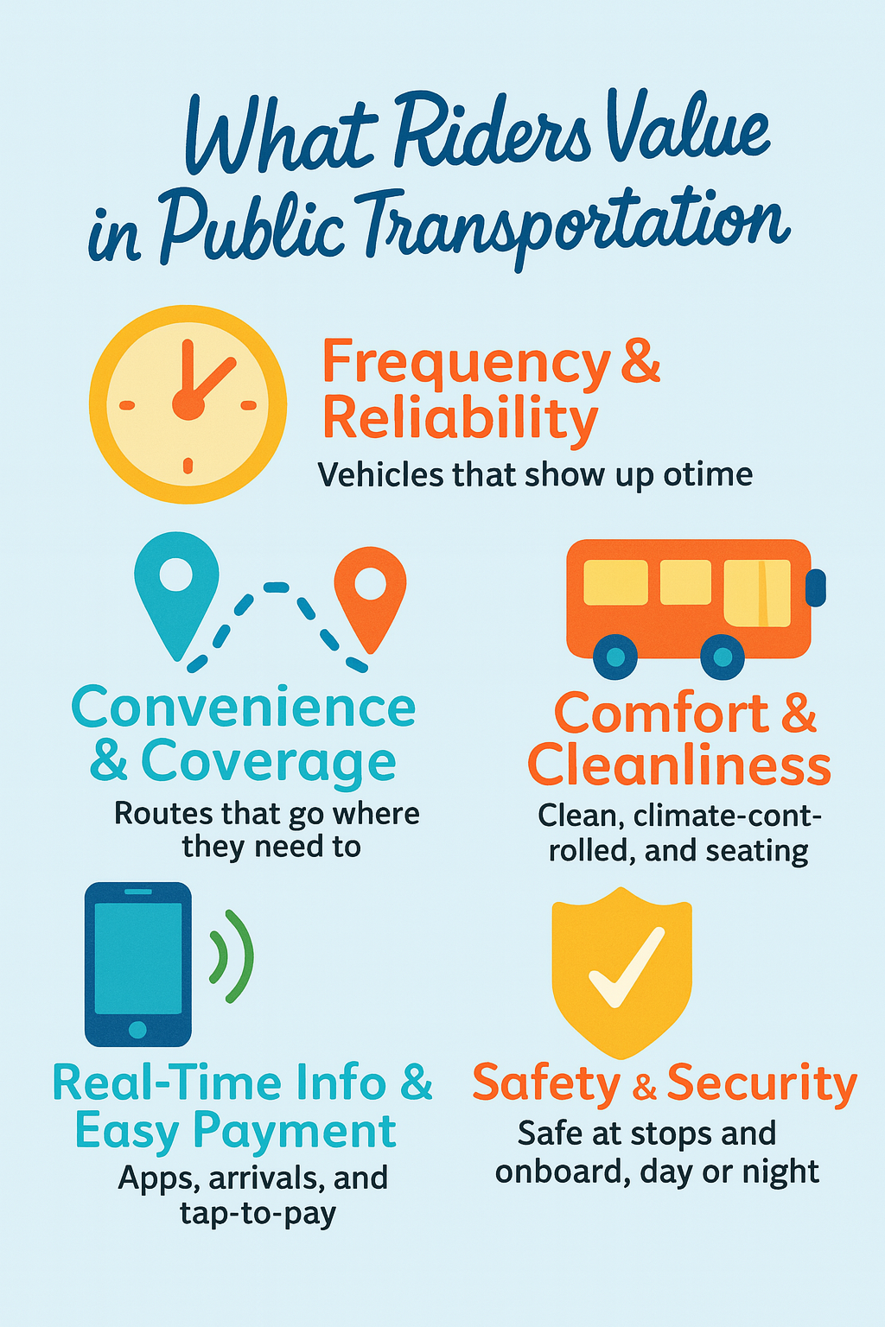
Riders Want
🔍 What Surveys Show Riders Want
Research from APTA, TransitCenter, and others confirms that riders consistently value:
🕒 Frequency & Reliability – #1 priority across all surveys
📍 Convenience & Coverage – routes that match real-life needs
🧼 Comfort & Cleanliness – clean, climate-controlled vehicles boost satisfaction
📱 Real-Time Info & Easy Payment – riders expect mobile tools and tap-to-pay
🛡️ Safety & Security – essential, especially for women, seniors, and night riders

Slide 10

What should we be focused on in Rural Public Transportation?
Hint…. Coordination

Slide 11
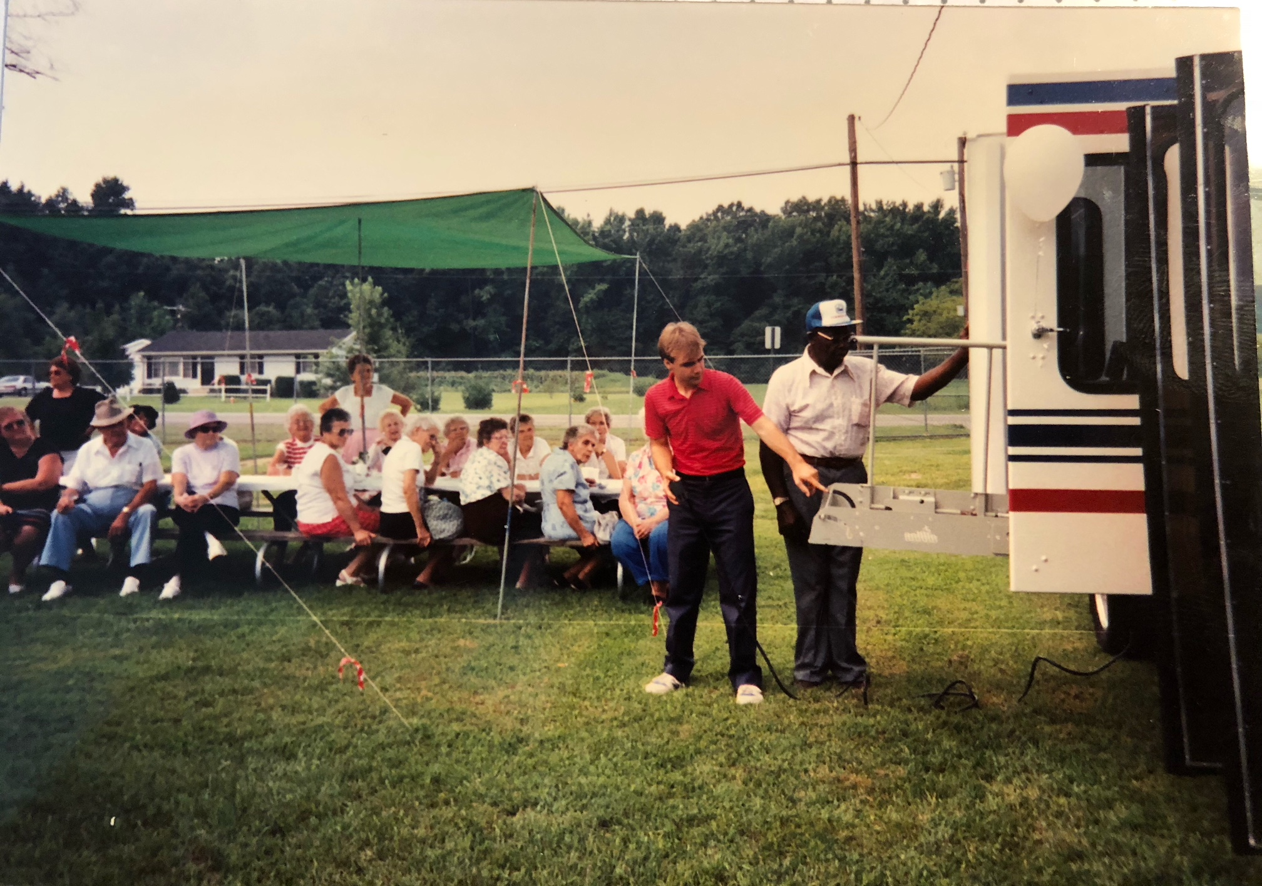
Rural County Transit
Need for Coordination
Senior Centers – Dept of Aging
Adult Day Care – Health Dept.
Deviated Fixed Route – County Govt
Call A Ride – County Govt
Medical Assistance – Local Providers

Slide 12

🔑 What’s Driving Integration:🤝
🤝 Inter-agency cooperation
💳 Integrated fare systems
📲 Emerging technologies & apps
🚀 This is the future of mobility:
Connected. Convenient. Customer-Centered.

Slide 13
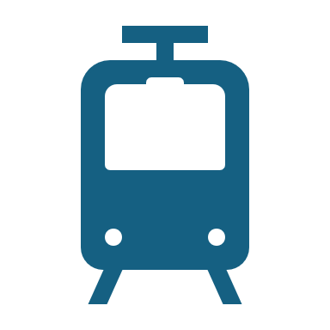
Modes Working Together
🚍 Transit – the urban mobility backbone
🚄 Intercity Rail – regional and long-distance connections
🚗 Shared Mobility – flexible first/last mile options
🚐 Microtransit – on-demand service for underserved areas
🚲 Active Transportation – walk, bike, scooter for short trips

Slide 14
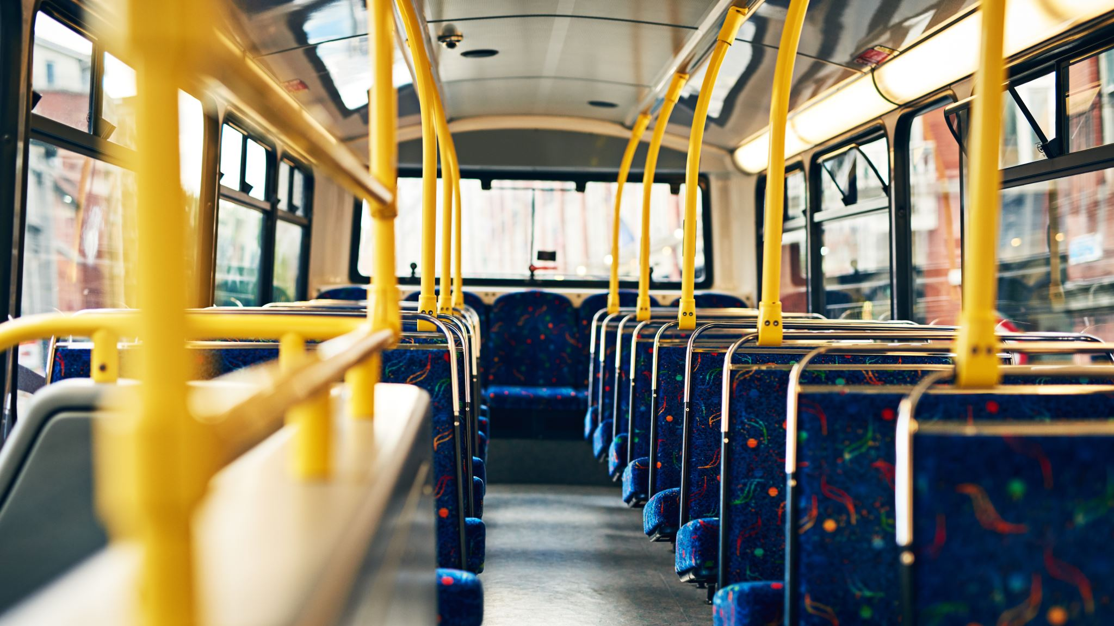
For the Passengers

Slide 15
Creating a Seamless Rider Experience
🚦 1. The New Rider Expectation: Seamless MobilityRiders no longer think in silos: “How do I get there?” is the new mindset—not “Which mode should I take?”From planning to payment to arrival, they want a frictionless journey—just like booking a flight.
🤝 2. Inter-Agency Cooperation is KeyShowcase examples like:Bay Area's Clipper system (multiple agencies, one card)Dallas DART + Uber partnerships for first/last mileDiscuss the challenges (governance, funding, turf) and solutions (MOUs, regional mobility boards)

Slide 16
Technical Improvements
💳3. Integrated Fare and Account-Based Systems –
Fare interoperability is crucial—no one wants to juggle five cards and three apps
Account-based fare systems (tap anywhere, transfer across systems)
Fare capping. Open payment systems using credit/debit/phones
🧭4. Planning Tools that Actually Work TogetherRiders expect:
Trip planners that blend bus, rail, bike share, scooters, walking
Real-time info across modes using tools with General Transit Feed Specification (GTFS) feeds, Application Programming Interfaces (APIs), and open data cooperation between cities

Slide 17
Want to go all in?
🛴 5. Including Non-Traditional Modes -
Value of: Microtransit, Shared mobility (e-scooters, bikes)TNCs (Uber, UZURV, Lyft integrations)
Consider designing for flexibility: mobility hubs, universal pickup zones
🧠 6. Emerging Tech Driving the Change
Mobility as a Service (MaaS) platforms that unify booking, fare, and real-time data
AI and predictive analytics to optimize routing and demand-based service
Integrated control centers to monitor performance across systems

Slide 18
What’s our Rider Focus?
👥 7. Put the Rider at the Center
UX matters: one app, one interface, one account, one trip Focus on accessibility, language options
Create focus on On Time Performance (OTP) & Safety
Include stories or testimonials from real riders to ground the tech in human value
The future of mobility isn’t about more apps or more vehicles—it’s about less friction and more freedom.

Slide 19
For the Transit Supporting Public

Slide 20
Reframe your role from just a transportation provider to a community value creator
🛣️ 1. Support Congestion Relief (Even for Non-Riders)
  Promote high-capacity corridors that ease traffic flow
  Communicate transit’s benefit to drivers (e.g., fewer cars = faster roads)
  Implement bus-only lanes and signal priority to show visible impact
  👵 2. Invest in “Mobility for All”
    Improve accessibility for Seniors and people with disabilities
    Riders needing access to medical appointments
    Expand paratransit and on-demand microtransit coverage
    Partner with healthcare and social services to reach vulnerable populations

Slide 21
Community Value Proposition - continued..
💰 3. Promote Economic Development Ties
  Show how transit investment attracts: Employers, retail, and housing Talent that values walkable, transit-connected neighborhoods
  Use storytelling: businesses near transit = stronger sales, hiring, access
  📢 4. Engage the 84% as Advocates
    Don’t just market to riders—speak to the silent majority:"You may not ride, but you benefit“
    Offer "supporter" programs or transit ambassador roles
    Survey them to find what would make them ride (not just why they don’t)

Slide 22

How To Succeed in Transit
Agencies should add focus on the 84% who support transit but aren’t regular passengers -
Building policies and projects that reflect the reasons they already value transit.

Slide 23
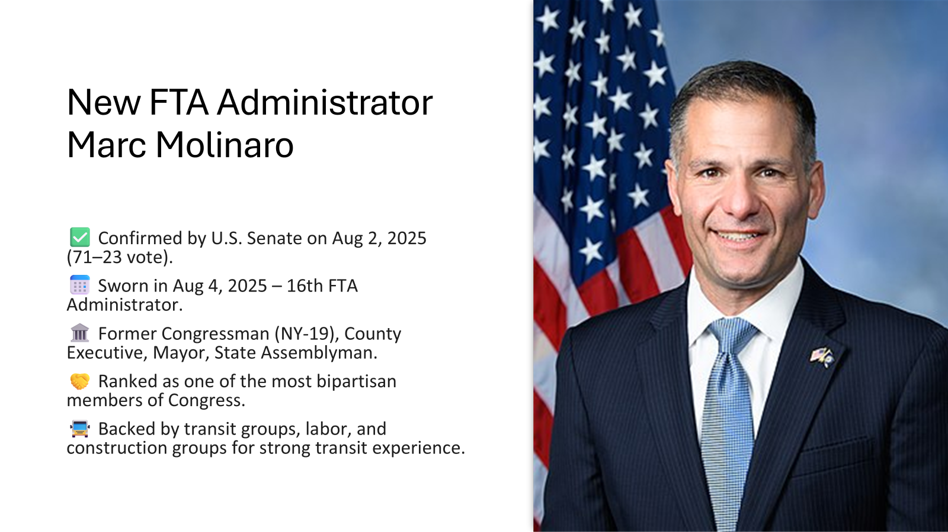

Slide 24
Molinaro’s First Month Actions Show Priorities
🛡️ Safety Enforcement
Issued Special Directive 24‑6 to New York’s MTA Response to multiple safety failures: worker fatality and severe injury.
Signals FTA’s readiness to intervene decisively where agencies fall short.
🌍 Simplified Grant Scoring
Proposed removal of the 'social cost of carbon' from Capital Investment Grant evaluations.
Environmental reviews to use EPA air quality standards instead.
Goal: reduce regulatory complexity and speed up project approvals.
🚍 On‑Site Agency Engagement
First official visit as Administrator to CDTA in Albany Reaffirmed FTA’s mission: safe, clean, and efficient transit operations.

Slide 25
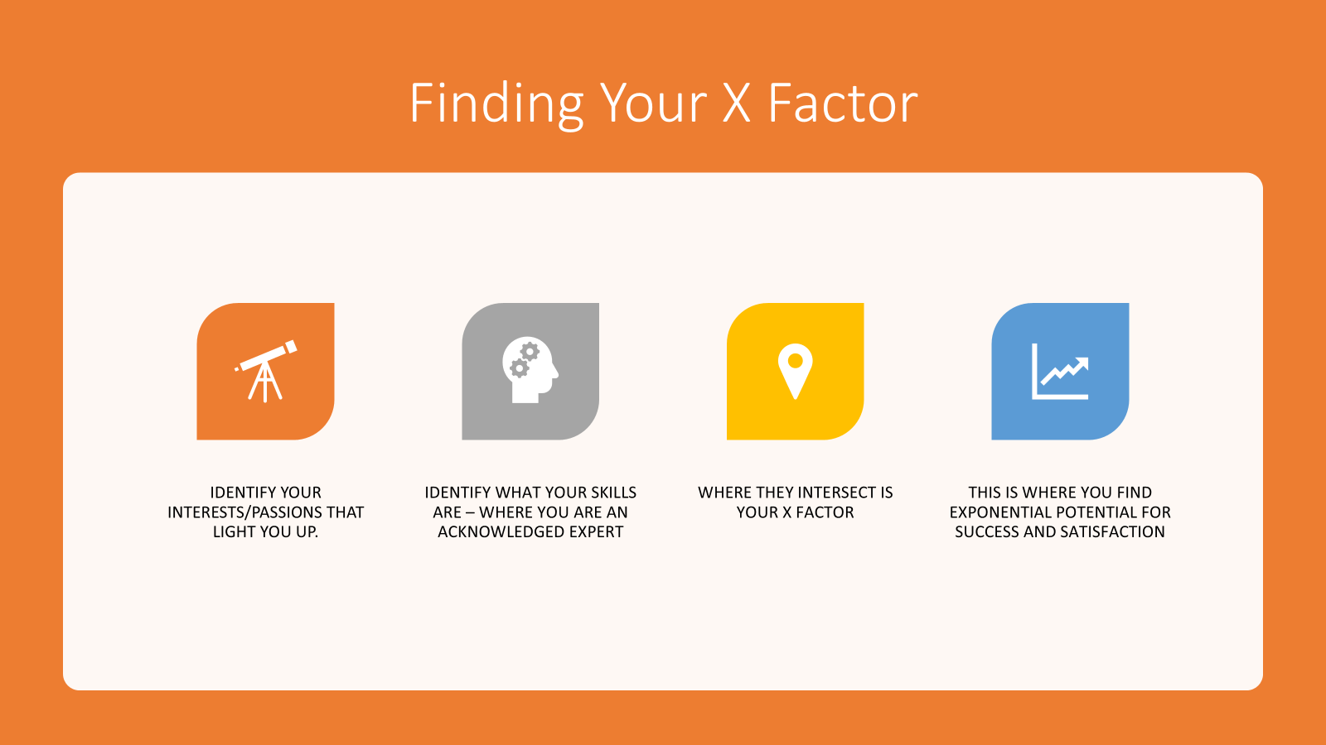

Slide 26





Transit Unplugged continues to grow
Newsletter
TV Show
LIVE CEO Roundtable
Podcast
Weekly News Minute

Slide 27


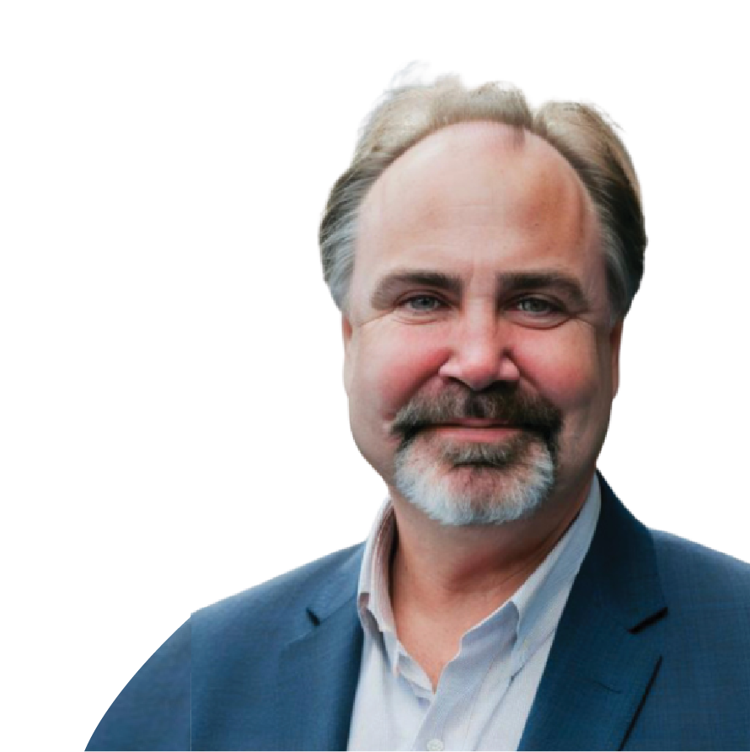
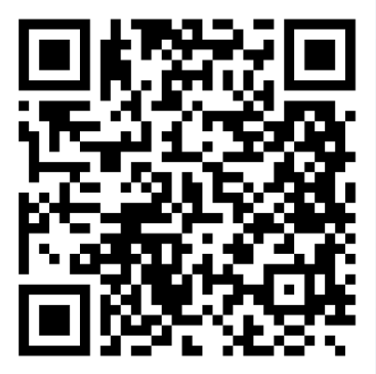

Trends & insights from transit leaders for transit leaders.

Slide 28
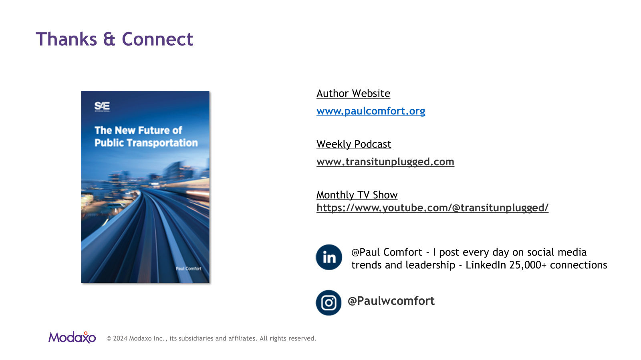

Slide 29

Thank you

