Slide 1



Numbers Matter:
Value of Research in Transit Advocacy
WWW.MOPUBLICTRANSIT.ORG

Slide 2
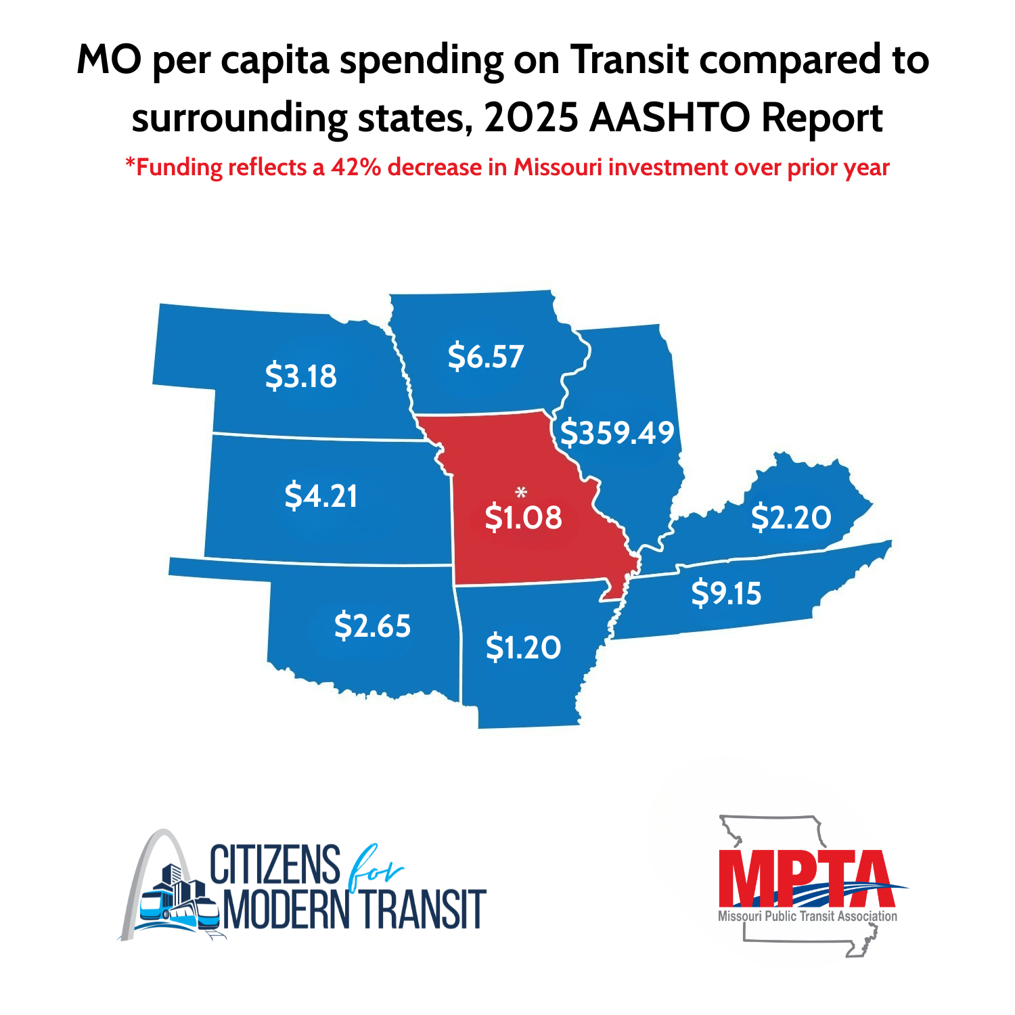
Why Numbers Matter
Lack of Data on economic impact on transit investment – what are we getting for our money
Critical coming out pandemic to be able to demonstrate service gaps with operator shortages
Priorities have changes – now need to know jobs, connection to jobs and ROI
Great role for associations and partners to help fill the gap

Slide 3
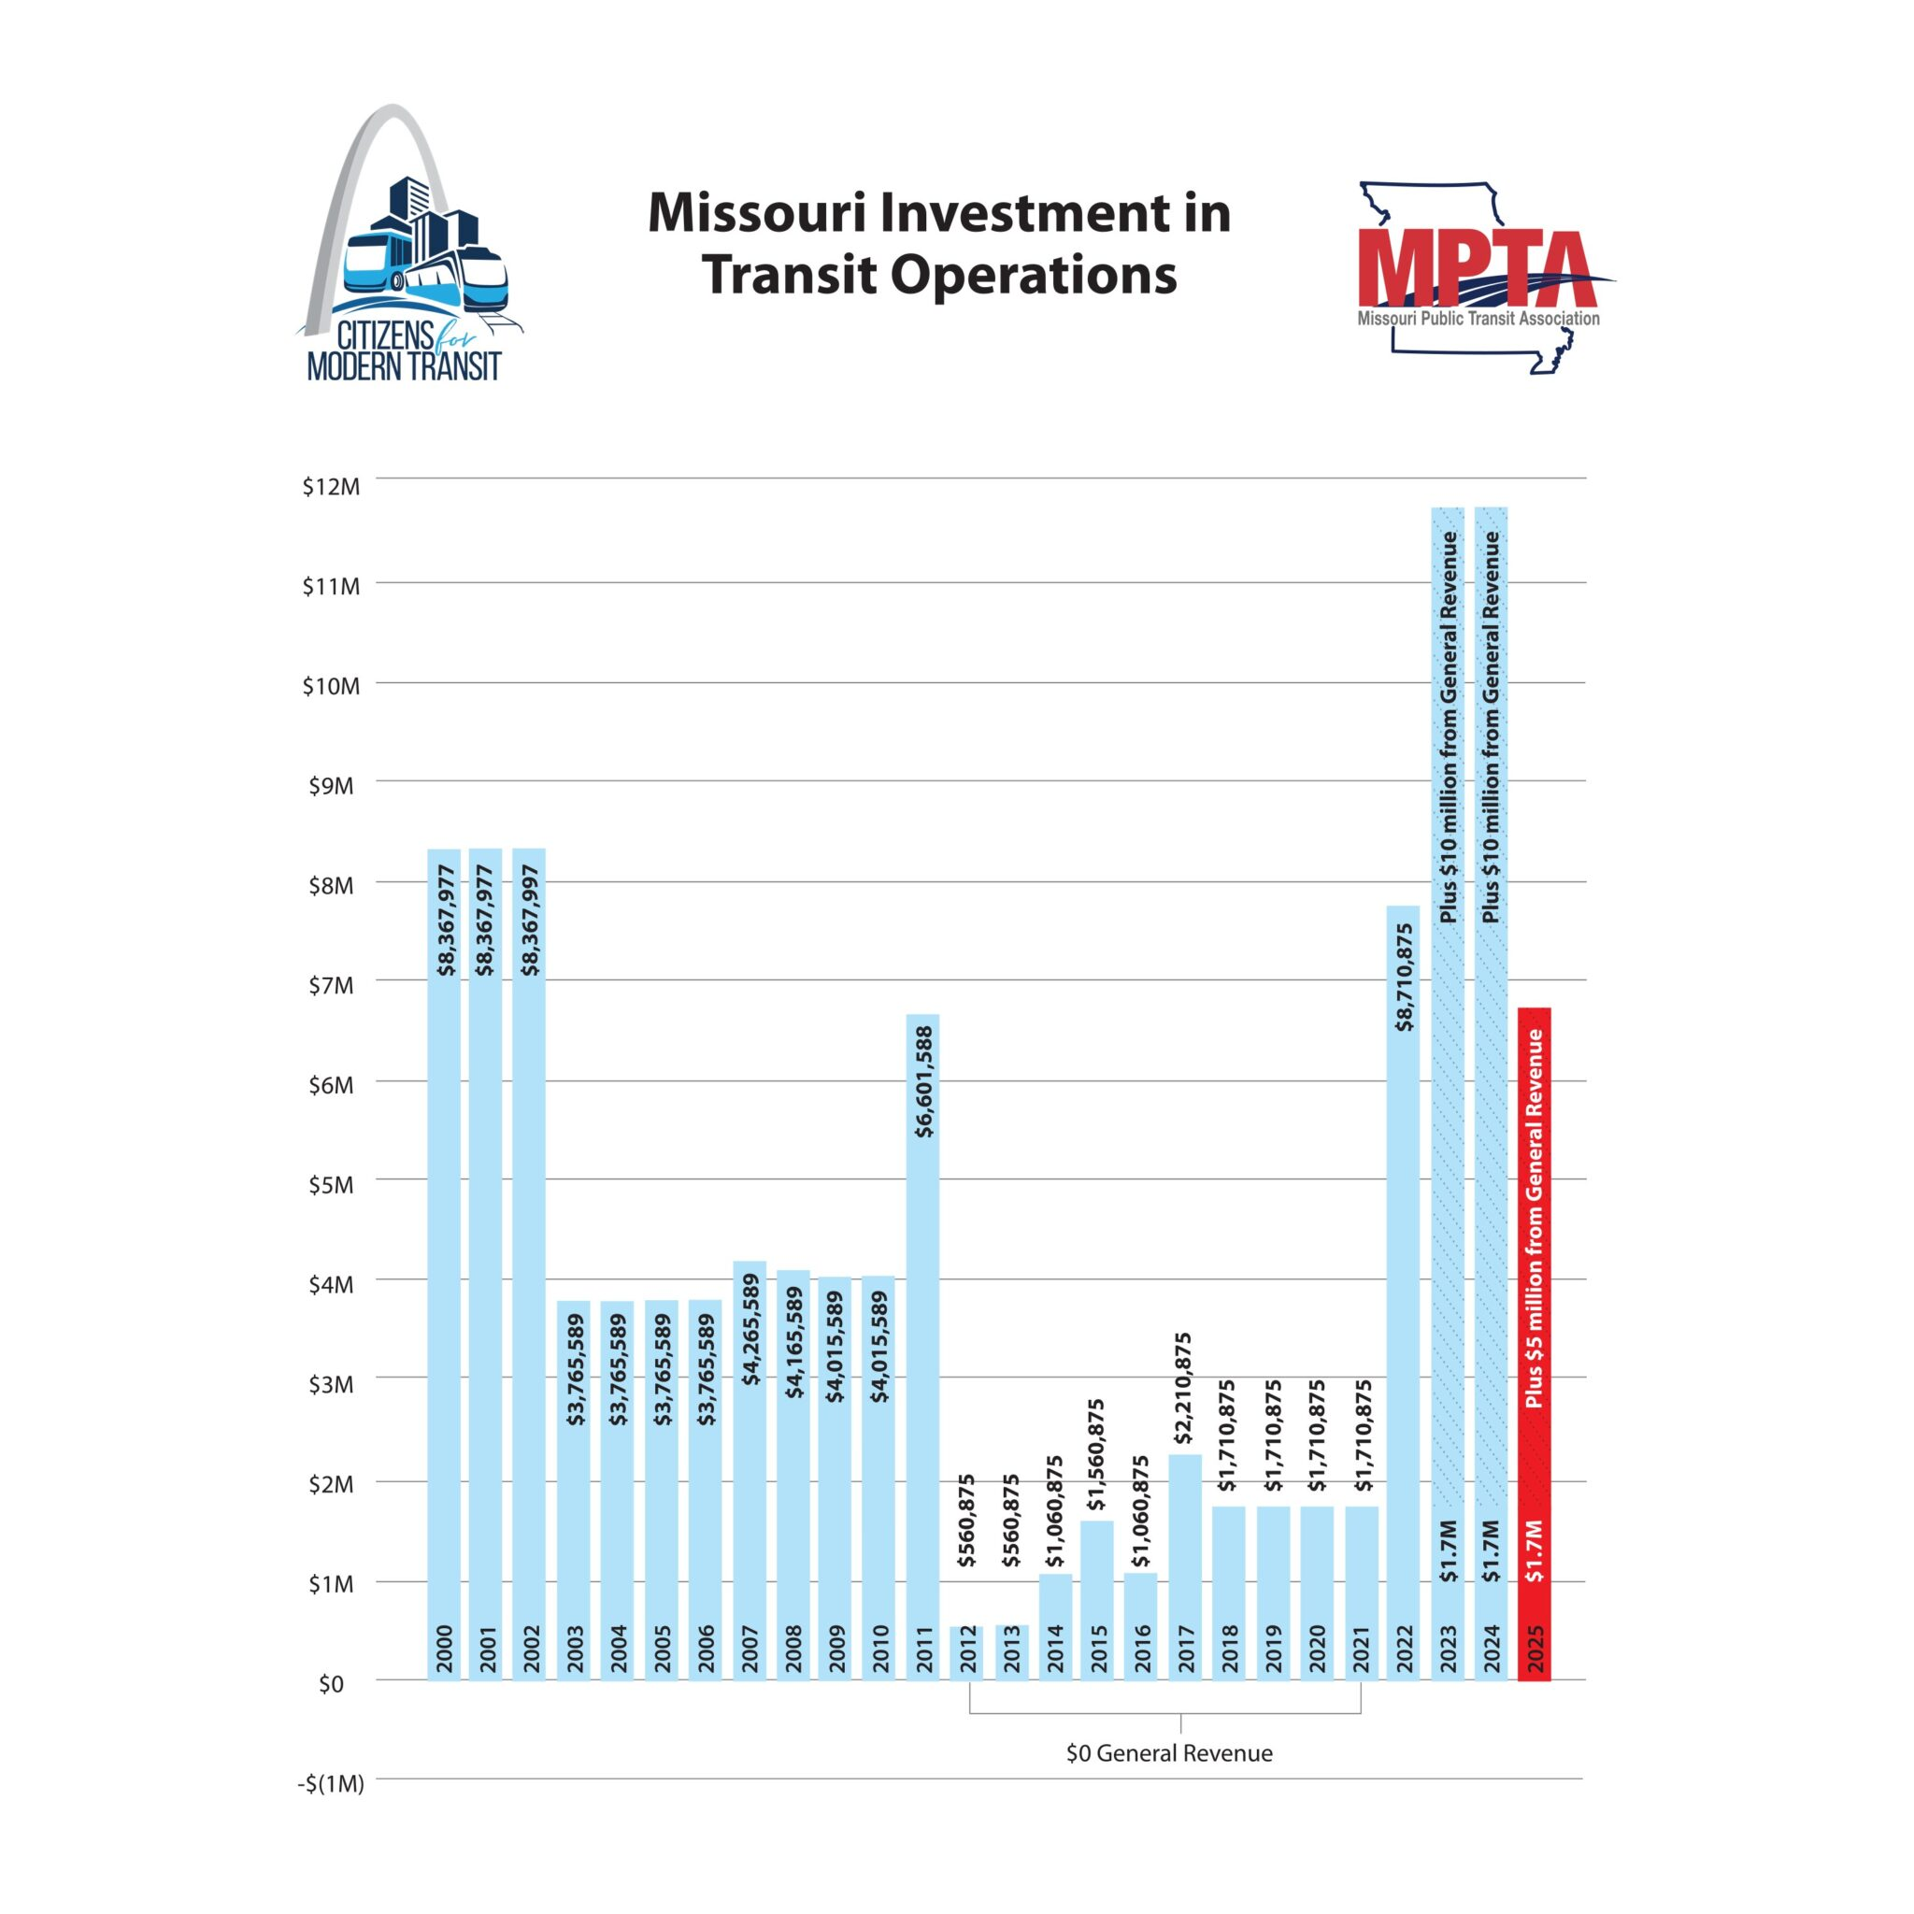
Where we are in MO
Two Economic Impact Studies
2019
2024
Two Transit Needs Assessment Studies
2022
2025
Possible future studies
Funding opportunities – what funding mechanisms are available for transit
Continuation of Economic Impact Studies to determine impacts over time
Moved the needle on state transit investment

Slide 4

2025 Transit Needs Assessment Study Results
1-year terms
Peter Williams,
Lochmueller Group

