Slide 1

Region 7 - Federal Transit Administration
i
Midwest Transit Conference
Kansas City, Missouri
Notes:
The Preferred fonts throughout the template are:
Headers: Franklin Gothic Heavy (48pt or 36Pt)
Major Titles: Franklin Gothic Demi (24 pt)
Standard Text: Franklin Gothic Book (24 pt)
Accessibility Notes:
Remember to add Alt Text/ Captions to photos that are representative of what is happening in the image.
You can right click on the image and choose ‘View Alt Text”, or go to Review -> Check Accessibility -> Alt Text to add or have PPT generate Alt text

Slide 2
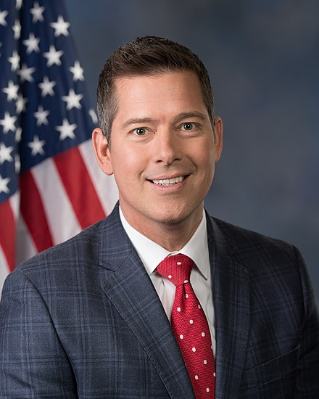
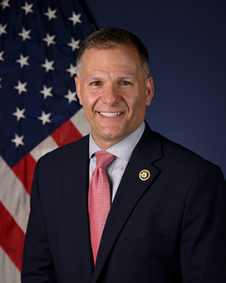
Leadership
Transportation Secretary Sean P. Duffy
FTA Administrator
Marc Molinaro
Notes:
The bullets shown are representative to show that you must use different bullet types for each level of bullets. Also bulleted text is meant to be short and concise versus using long sentences or paragraphs in a slide format. (there may be certain exceptions for detailed technical information that needs to be conveyed. However whenever possible keep the text in the slide as minimal as possible and use the speaker notes section here for the details. When slides are shared, the speaker notes will be viewable by the reader.
Accessibility Notes:
Remember to add Alt Text/ Captions to photos that are representative of what is happening in the image.
You can right click on the image and choose ‘View Alt Text”, or go to Review -> Check Accessibility -> Alt Text to add or have PPT generate Alt text
If you add jpgs/images of graphs or tables make sure the captions describe the graph/ table in detail. Include percentages, numbers and comparisons.
Best practice is to copy or import tables and graphs as Excel or Microsoft objects
Avoid using Smart Objects unless necessary, they require alt text just like images and can be difficult to edit
For text, make sure your color contrast passes the WCAG AA and that your text is no smaller than 16pts if possible. A contrast checker can be found at WebAIM: Contrast Checker

Slide 3


FTA’s Mission, Vision, and Values
Mission
Vision
Improve America’s Communities through Public Transportation
A Better Quality of Life for All Built on Public Transportation Excellence
Values
Service | Provide reliable, transparent, responsive, and anticipatory services to meet stakeholder needs.
Integrity | Commit to the highest professional and ethical standards.
Innovation | Foster new ideas, concepts, and solutions for improved outcomes.
Resiliency | Optimize decisions, resources, and systems to make long-term positive impacts on the environment, infrastructure, and safety.
Notes:
FTA's Mission, Vision, and Values were created to enhance mobility, promote economic growth, and improve the quality of life in communities. As transportation evolved, the FTA has adapted its strategies to address challenges concerning sustainability and technological advancements.

Slide 4




FTA’s Operations
FTA operations and authority are defined by several elements:
FTA Mission, Vision, and Values
FTA Core Functions
FTA’s Lines of Business
Research
Financial Assistance
Technical Assistance
Oversight
Notes:
FTA’s Mission, Vision, and Values are embedded into the actions we take and unite our organization towards shared goals.
FTA’s core functions define the roles and responsibilities of the FTA.
FTA’s four lines of business are the fields in which we execute our core functions, guided by our mission, vision, and values.

Slide 5
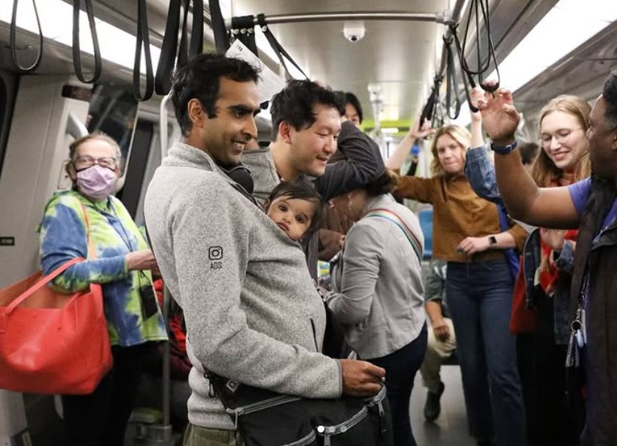
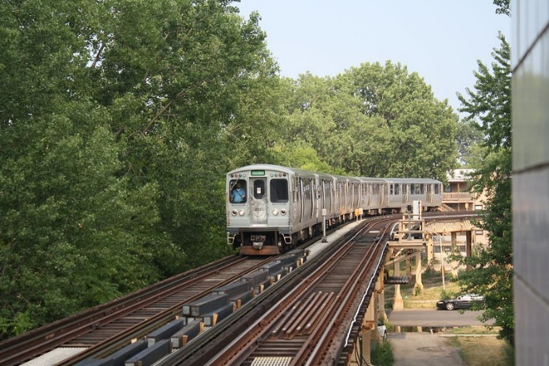
FTA provides $21 billion annually to support transit providers delivering 7 billion trips that connect transit riders to jobs, education, healthcare, and other activities.
FTA regulates the safety of
transit providers.

Slide 6
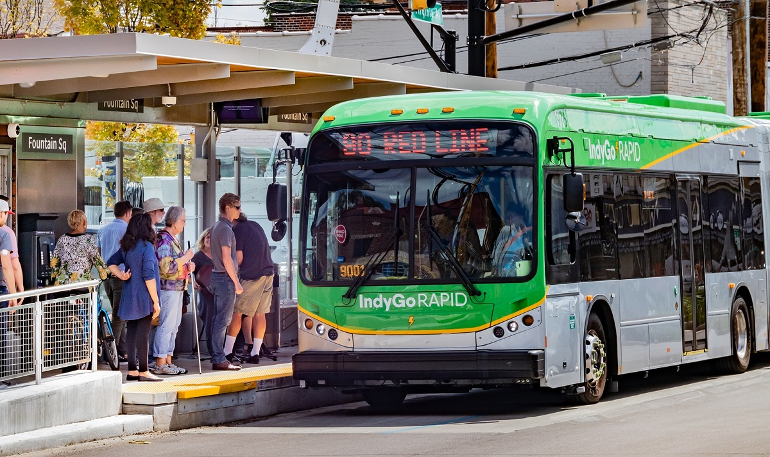
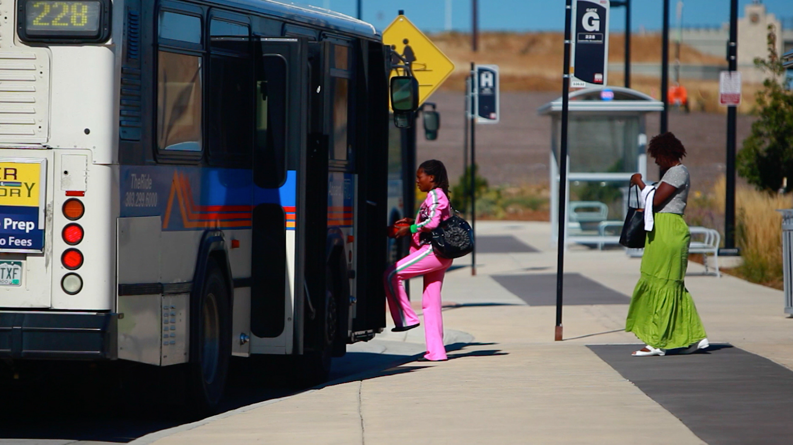
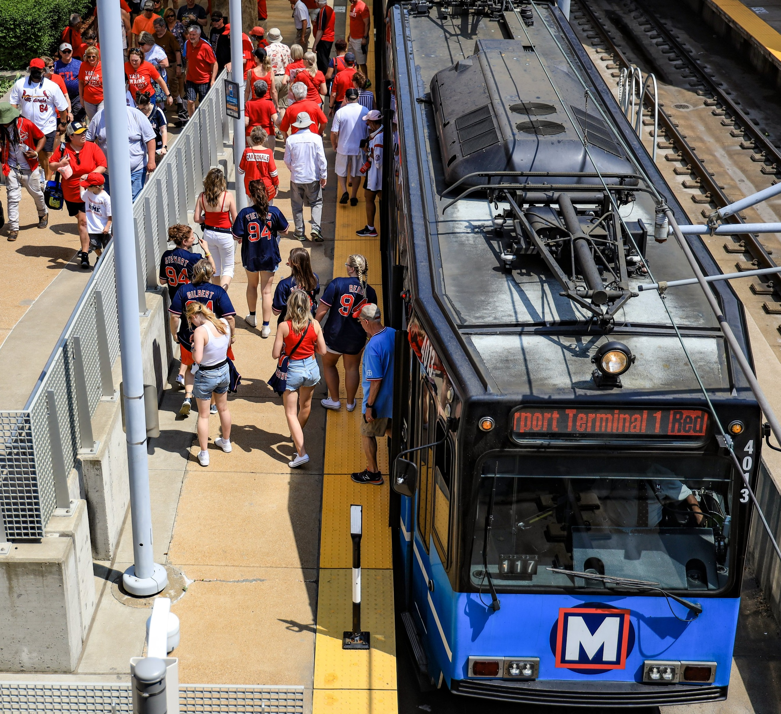
Public Transportation Toplines
~4,000 U.S. public transportation providers
2,000⁺ U.S. businesses in 48 states supplying U.S. transit providers
Sources: 2023 FTA National Transit Database, 25th Edition FHWA-FTA Conditions and Performance Report, 2024 APTA Fact Book

Slide 7
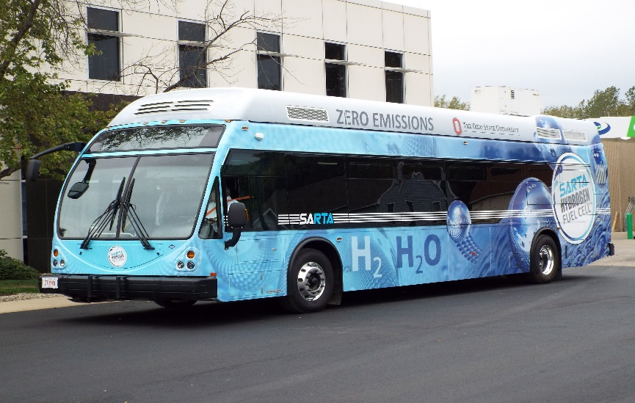
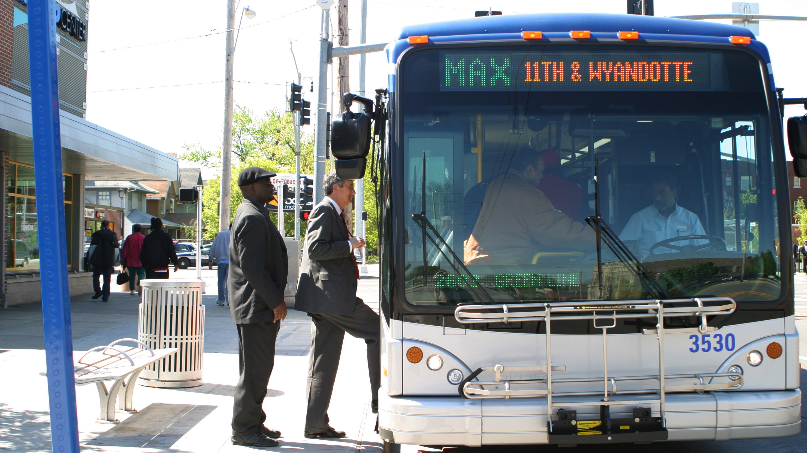
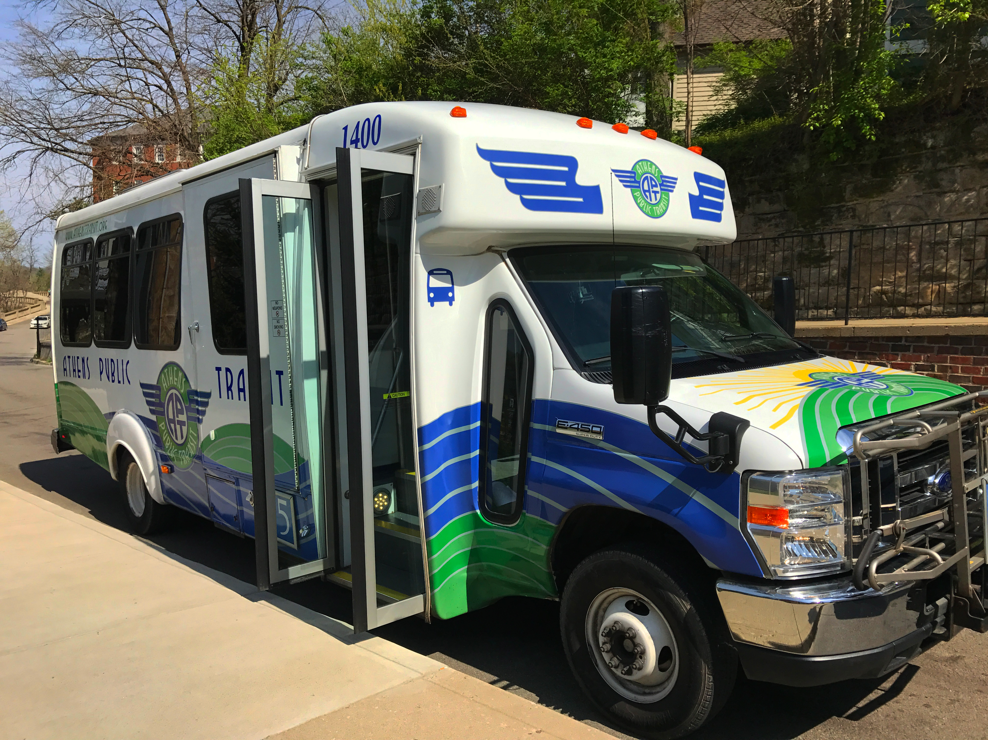
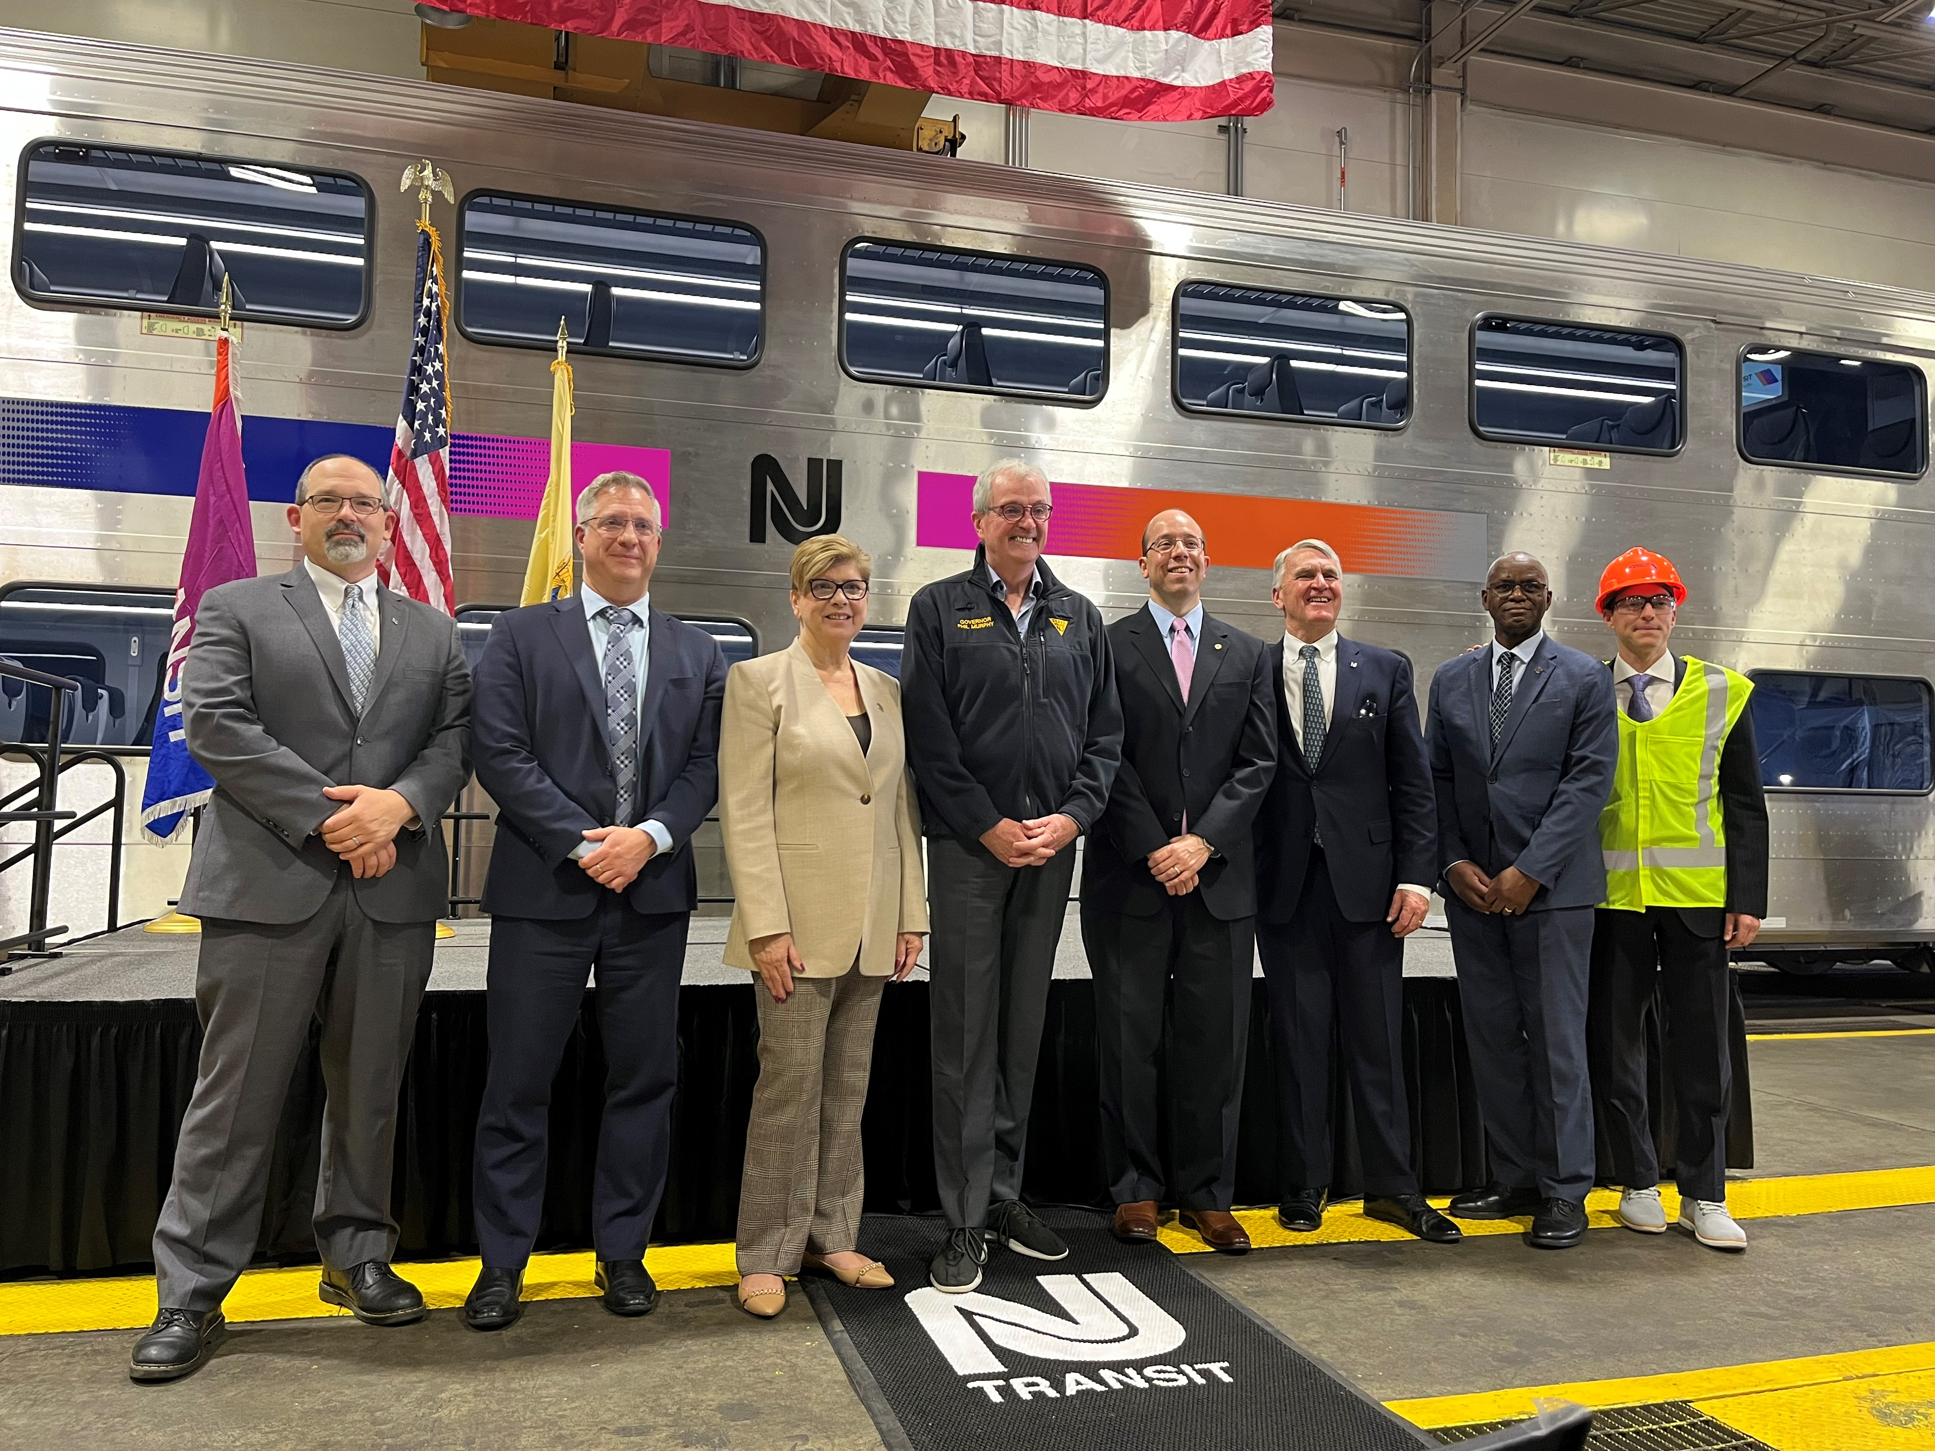
Transit Assets
Assets: ~$1.2 trillion
170,000 transit vehicles
15,000 miles of fixed guideway and high intensity bus
14,500 transit stations, maintenance facilities, etc.
Industry revenue = $90 billion
Sources: 2023 FTA National Transit Database, 25th Edition FHWA-FTA Conditions and Performance Report, 2024 APTA Fact Book

Slide 8
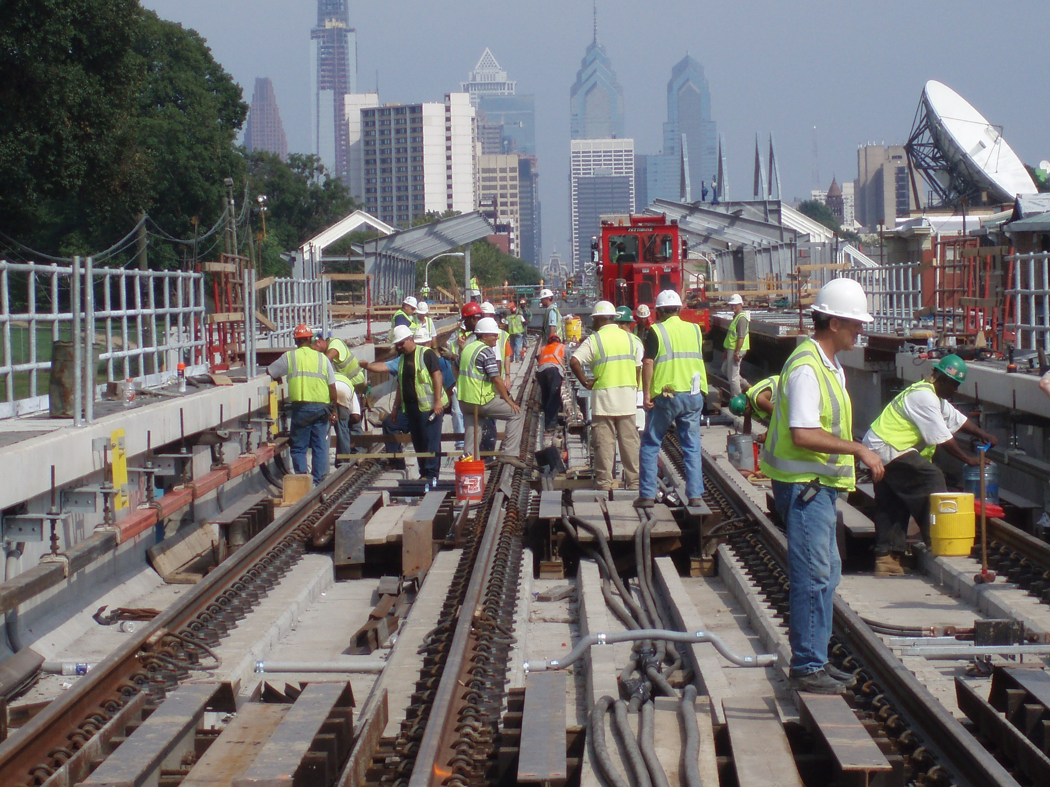
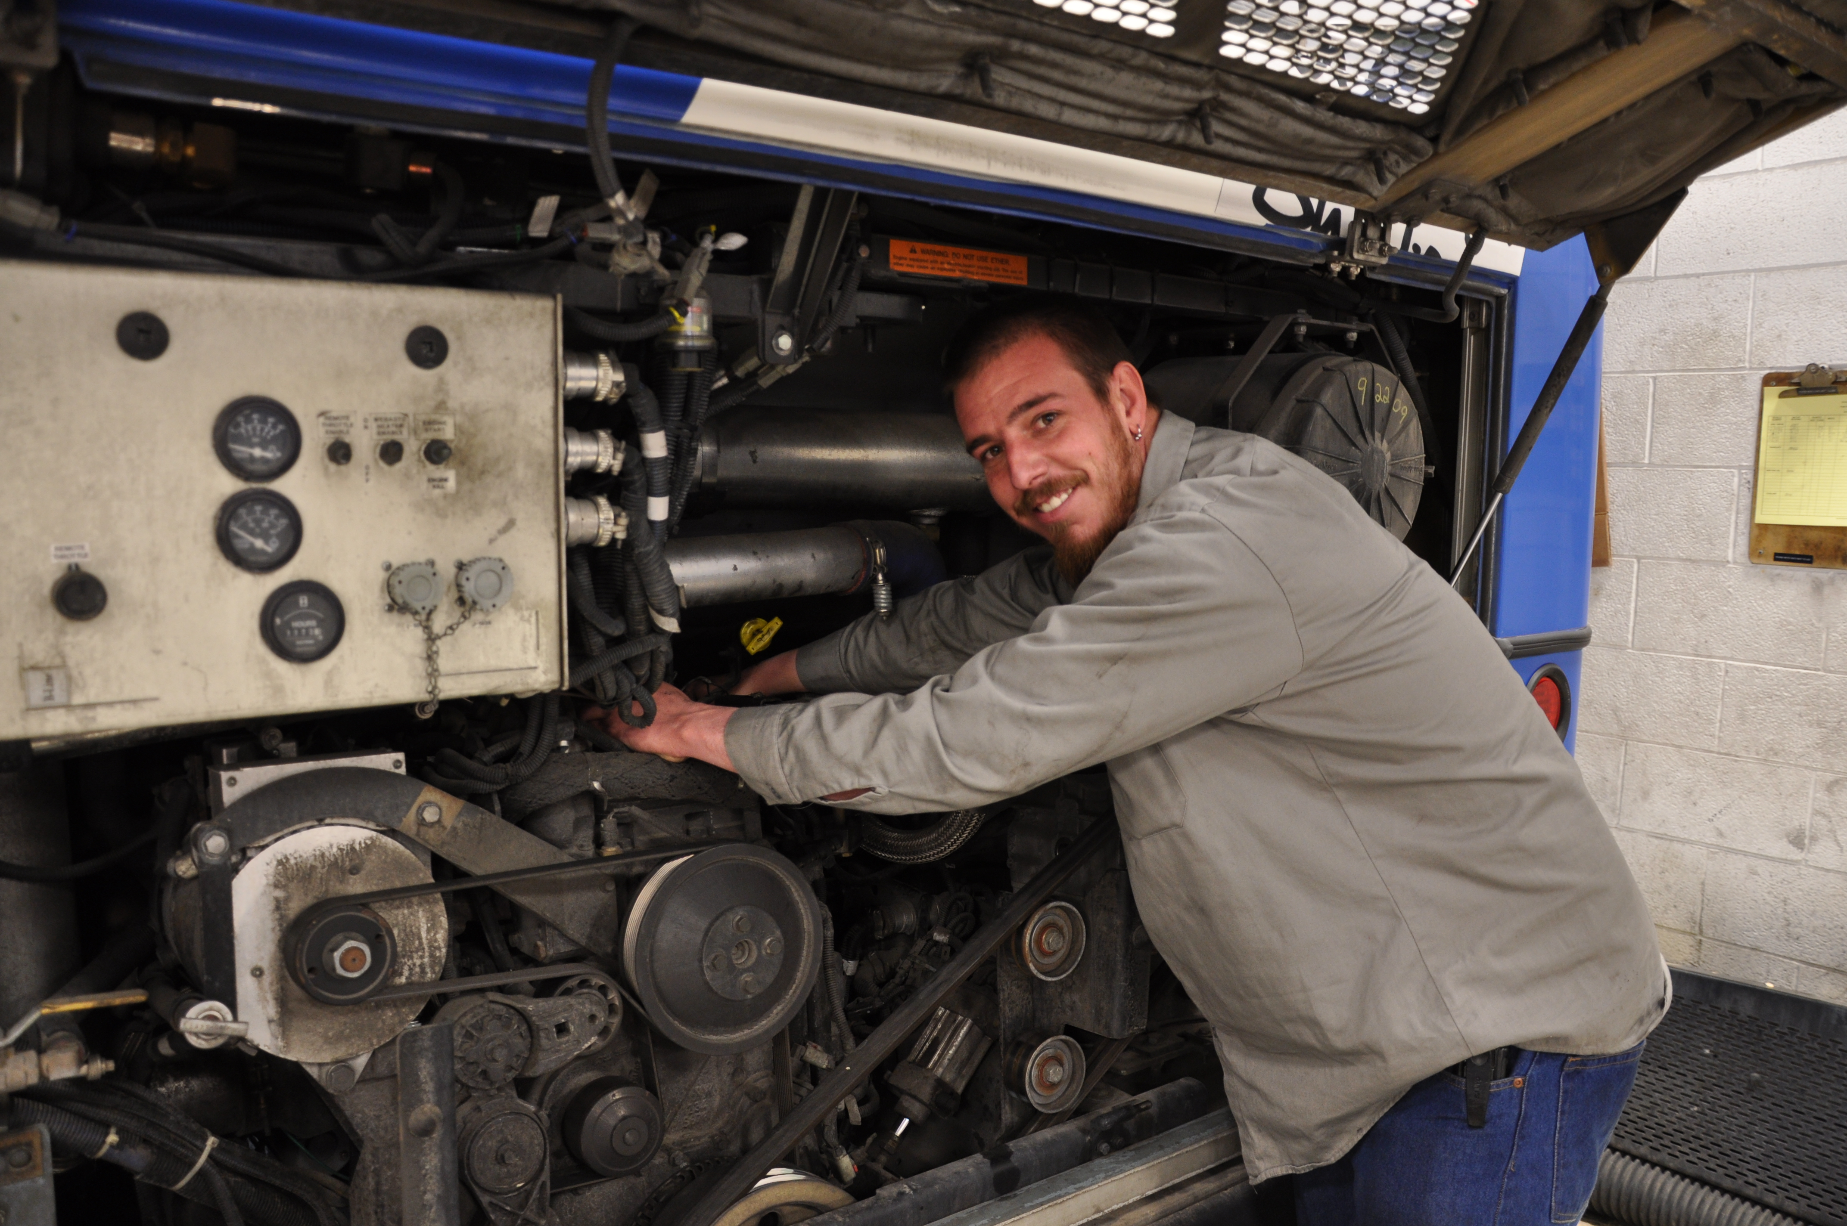
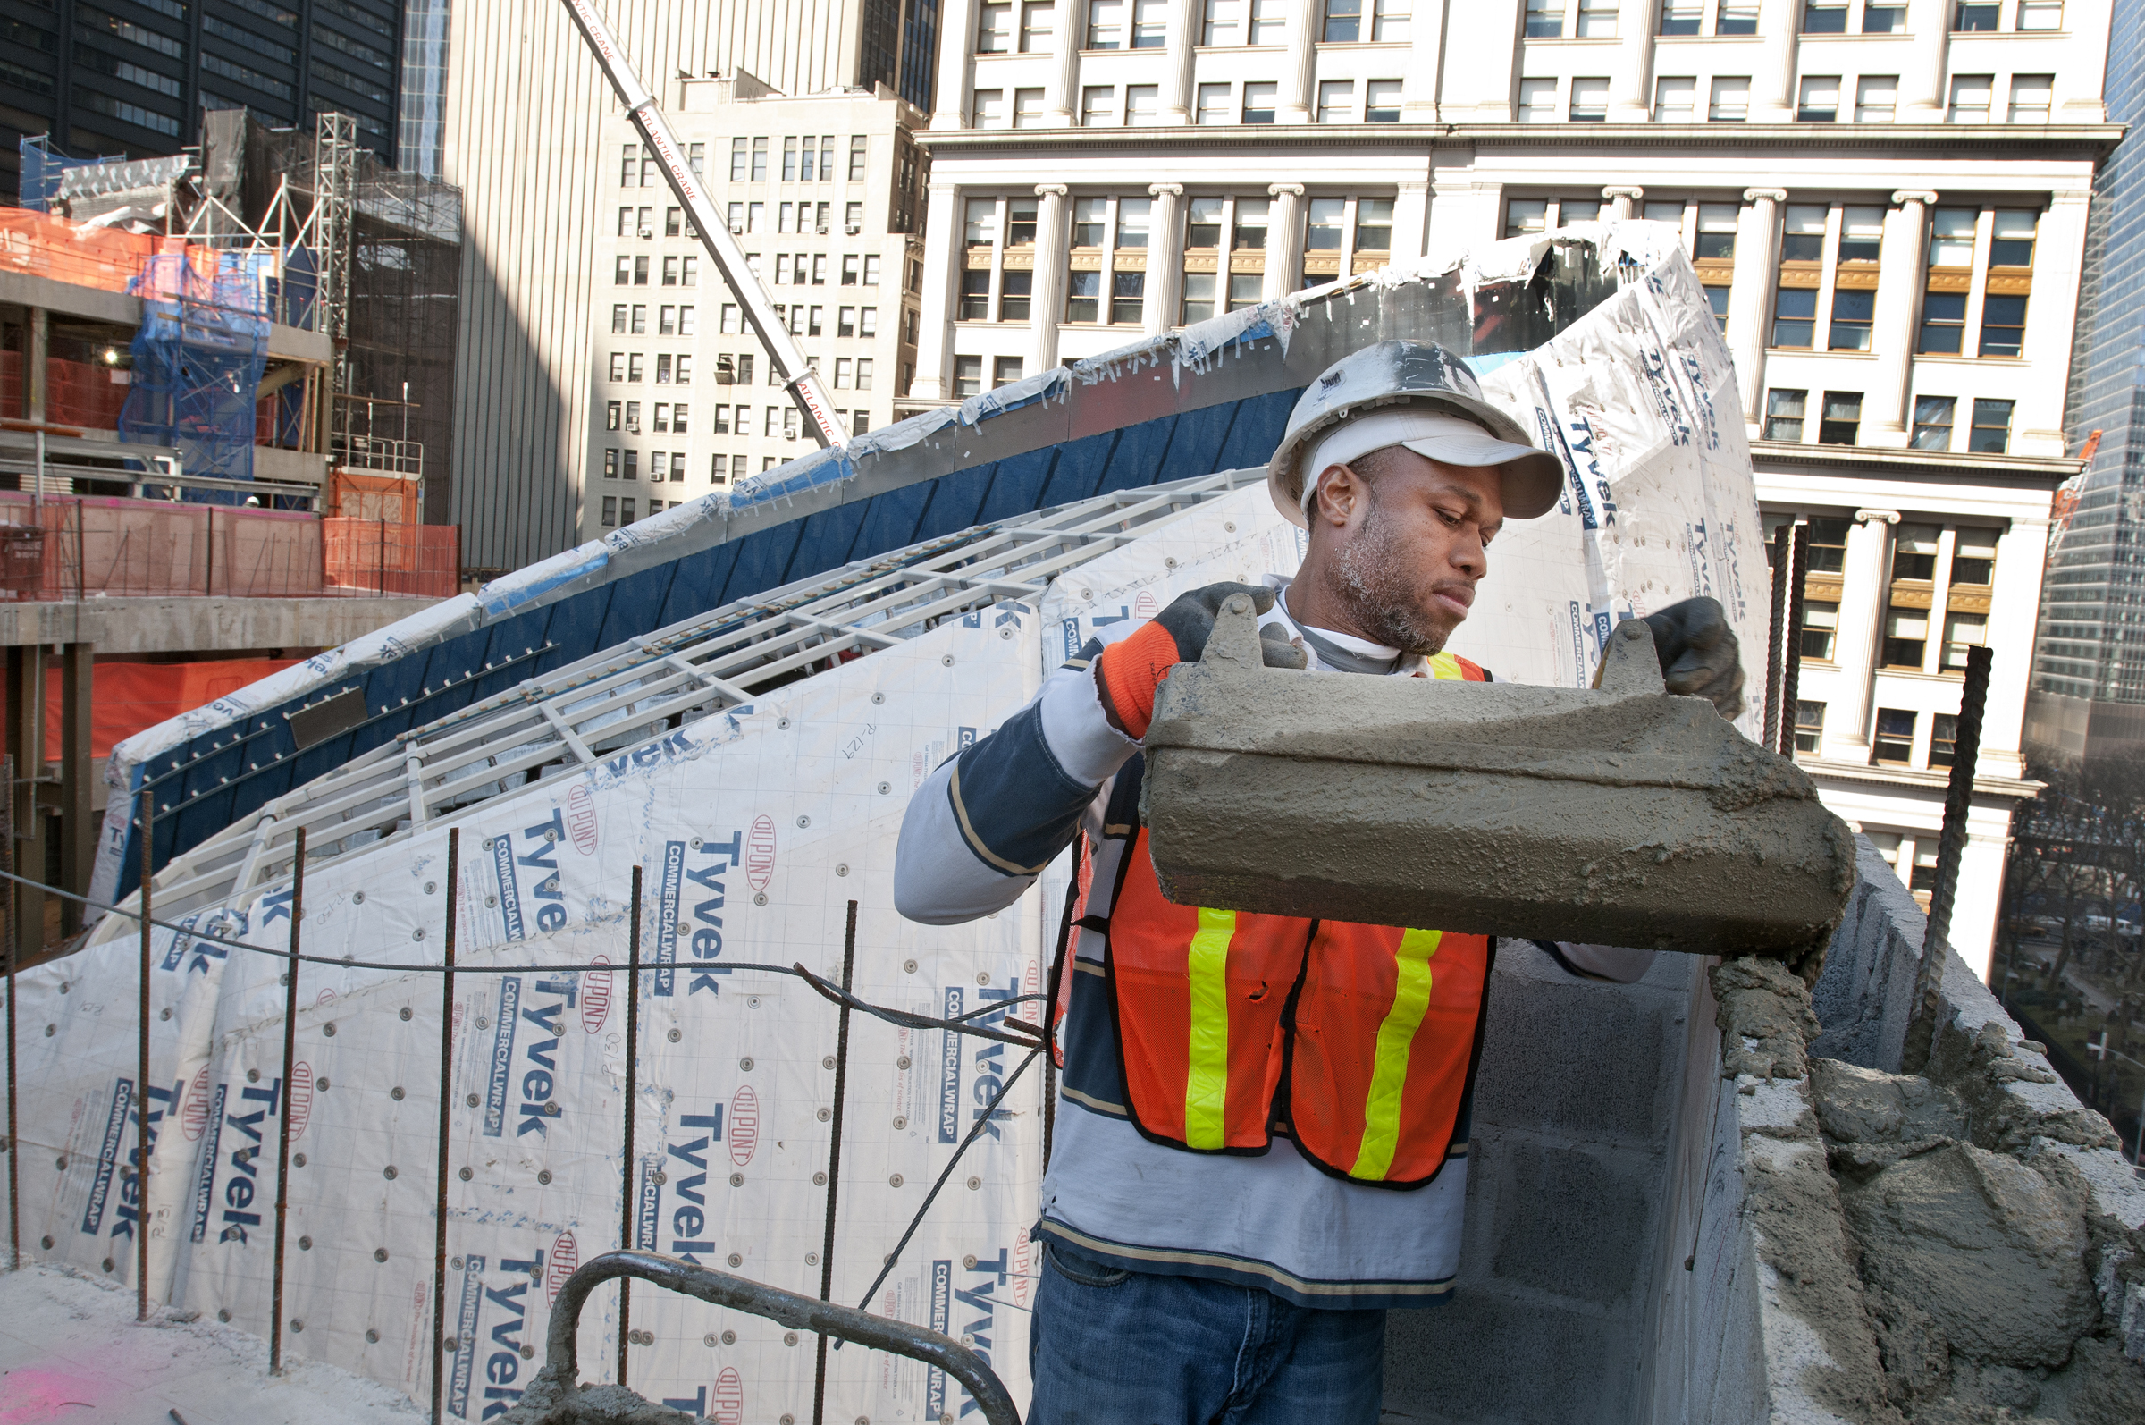
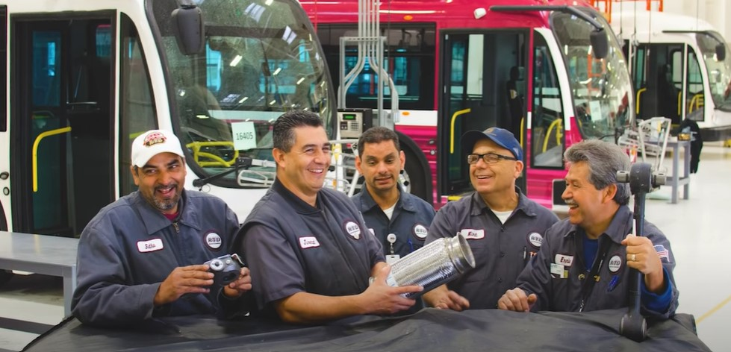
Transit Workforce
~430,000 people work for transit agencies
96% operations & maintenance
4% capital & administration
Sources: 2023 FTA National Transit Database, 25th Edition FHWA-FTA Conditions and Performance Report, 2024 APTA Fact Book

Slide 9
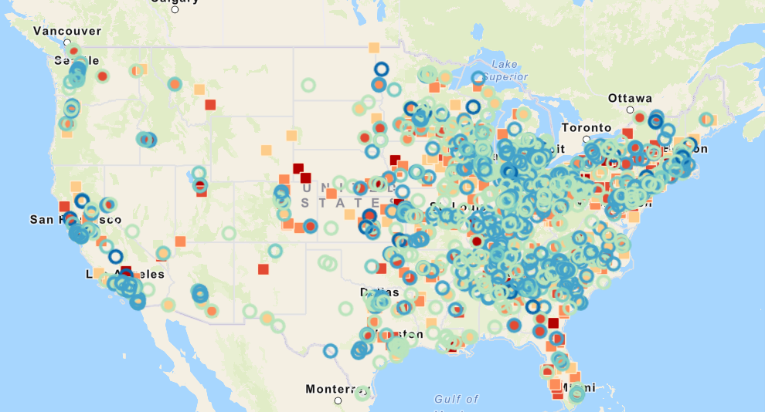
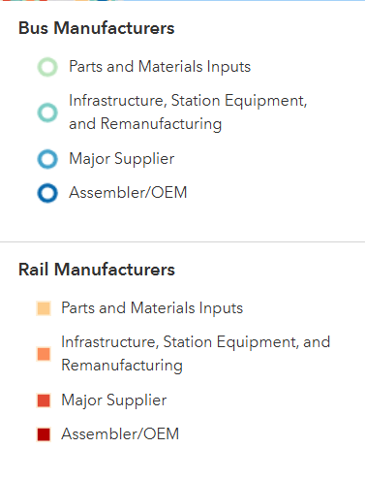
2,000+ U.S. Firms Supply Public Transport Sector
1,400 rail manufactures and over 1,200 bus manufacturers
Note: Some firms supply both rail and bus manufacturers
Source: Public Transportation Industry Footprint. American Public Transportation Association

Slide 10
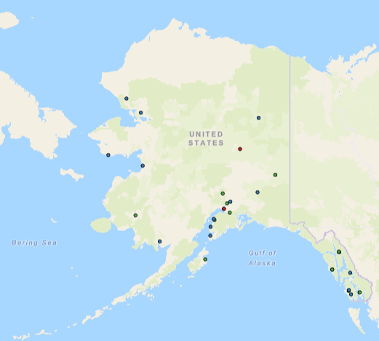
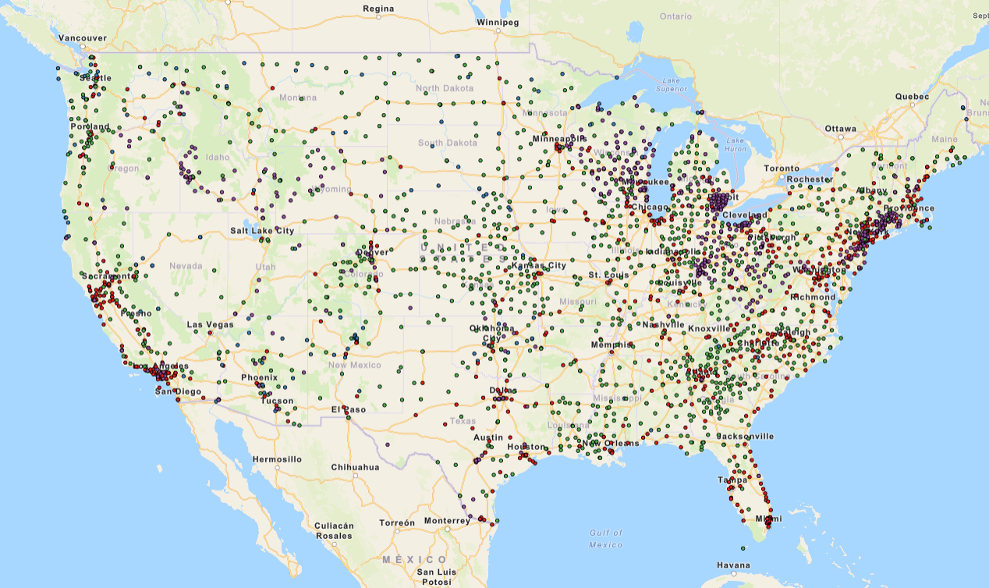
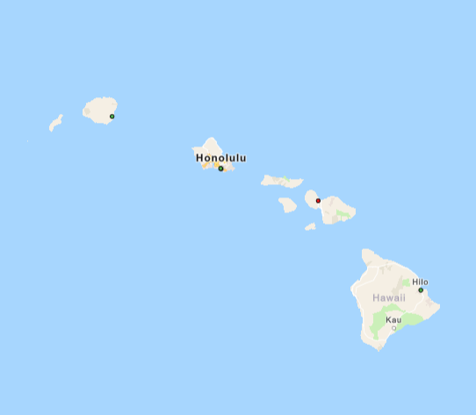
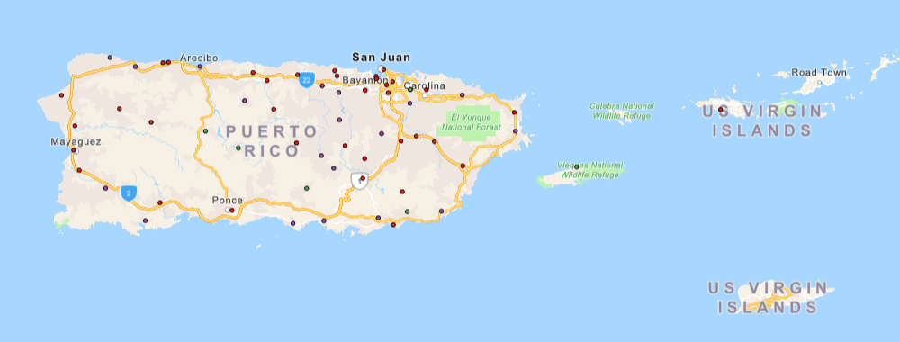

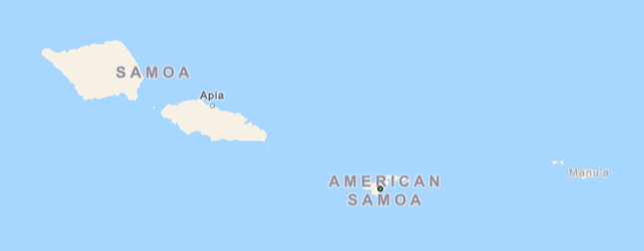
Grantees (states, counties, cities) across the U.S.
FTA programs support 4,000 transit providers delivering trips in nationwide.
Pins represent locations of 1K FTA direct recipients. An additional 3K recipients receive FTA funds through state DOTs.
Sources: 2023 FTA National Transit Database (Sec. 5335) and Community Transportation Association of America (CTAA)
Notes:
The bullets shown are representative to show that you must use different bullet types for each level of bullets. Also bulleted text is meant to be short and concise versus using long sentences or paragraphs in a slide format. (there may be certain exceptions for detailed technical information that needs to be conveyed. However whenever possible keep the text in the slide as minimal as possible and use the speaker notes section here for the details. When slides are shared, the speaker notes will be viewable by the reader.
Accessibility Notes:
Remember to add Alt Text/ Captions to photos that are representative of what is happening in the image.
You can right click on the image and choose ‘View Alt Text”, or go to Review -> Check Accessibility -> Alt Text to add or have PPT generate Alt text
If you add jpgs/images of graphs or tables make sure the captions describe the graph/ table in detail. Include percentages, numbers and comparisons.
Best practice is to copy or import tables and graphs as Excel or Microsoft objects
Avoid using Smart Objects unless necessary, they require alt text just like images and can be difficult to edit
For text, make sure your color contrast passes the WCAG AA and that your text is no smaller than 16pts if possible. A contrast checker can be found at WebAIM: Contrast Checker

Slide 11
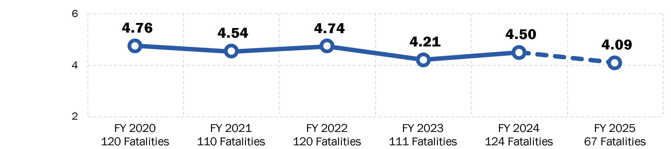
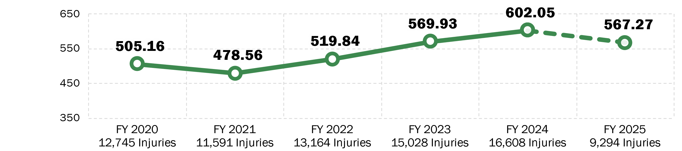
State of Bus Transit Safety – Annual Trends
Fatalities per
100 Million Vehicle Revenue Miles (VRM)
Injuries per
100 Million VRM
Source: National Transit Database (NTD)
FY2024–25 data are preliminary. FY 2025 only includes data from Oct 2024–Apr 2025
Produced Using NTD Data Pulled On: 8/1/2025
Notes:
Notes about the metrics in case they are helpful:
The fatality and injury rates shown are per 100 million “vehicle revenue miles” (VRM), which provide a good general estimate of the amount of bus transit service provided by agencies
VRM is actually a measurement of the total number of miles buses travel during revenue service.)
Additional information that may be helpful:
Slide produced using NTD data pulled on Aug 1, 2025.
All charts on this table are based on NTD events that occurred in fiscal years (FY) 2020 to 2025. Data from FY 2024 and 2025 are still subject to NTD reporter revision. Rates from FY 2023 are subject to minor revision until NTD’s 2024 Annual Reporting validation is completed.
Data analysis notes:
Data include only NTD Full Reporters. Rural bus agencies and urban bus agencies operating 30 or fewer vehicles at maximum service are excluded.
Bus modes include standard Bus, Bus Rapid Transit, Commuter Bus, Demand Response, Publico, Trolleybus, and Vanpool modes.)

Slide 12
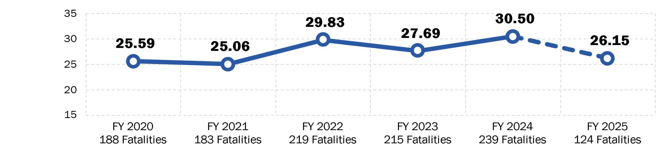
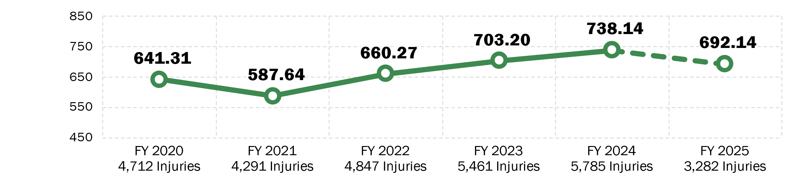
State of Rail Transit Safety – Annual Trends
Fatalities per
100 Million VRM
Injuries per
100 Million VRM
Source: National Transit Database (NTD)
FY2024–25 data are preliminary. FY 2025 only includes data from Oct 2024–Apr 2025
Produced Using NTD Data Pulled On: 8/1/2025
Notes:
Notes about the metrics in case they are helpful:
We measure the rate as the number of fatalities per 100 million vehicle revenue miles.
VRM is actually a measurement of the total number of miles railcars travel during revenue service.
Slide produced using NTD data pulled on Aug 1, 2025.
All charts on this table are based on NTD events that occurred in fiscal years (FY) 2020 to 2025. Data from FY 2024 and 2025 are still subject to NTD reporter revision. Rates from FY 2023 are subject to minor revision until NTD’s 2024 Annual Reporting validation is completed.
Data analysis notes:
Data include only NTD Full Reporters. Rail agencies overseen by FRA are excluded.
Rail modes include Cable Car, Heavy Rail, Inclined Plane, Light Rail, Monorail/Automated Guideway, Streetcar, and Hybrid Rail modes.)

Slide 13
FTA’s Mission, Vision, and Values
Mission
Vision
Improve America’s Communities through Public Transportation
A Better Quality of Life for All Built on Public Transportation Excellence
Values
Service | Provide reliable, transparent, responsive, and anticipatory services to meet stakeholder needs.
Integrity | Commit to the highest professional and ethical standards.
Innovation | Foster new ideas, concepts, and solutions for improved outcomes.
Resiliency | Optimize decisions, resources, and systems to make long-term positive impacts on the environment, infrastructure, and safety.
Notes:
FTA's Mission, Vision, and Values were created to enhance mobility, promote economic growth, and improve the quality of life in communities. As transportation evolved, the FTA has adapted its strategies to address challenges concerning sustainability and technological advancements.

