Slide 1


Learning from Peers:
Small Urban & Rural Transit Case Studies
Alvaro Villagran
Director of Federal Programs
Thursday, September 4, 2025

Slide 2
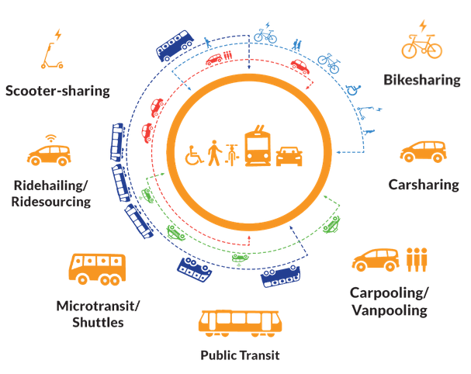

The Shared-Use Mobility Center (SUMC) is a non-profit organization working in the public interest.
SUMC is working to replace car-centric transportation with people-focused shared mobility to fight climate change, promote equity, and strengthen community.
About SUMC
Notes:
The Shared-Use Mobility Center is a Chicago-based non-profit organization working in the public interest to transition from car-centric transportation to people-focused shared mobility to fight climate change, promote equity, and strengthen community.
We have offices in Chicago and Los Angeles, and we work with agencies, local governments, private mobility companies, and non-profit organizations throughout the country, in urban, suburban, and rural contexts.

Slide 3
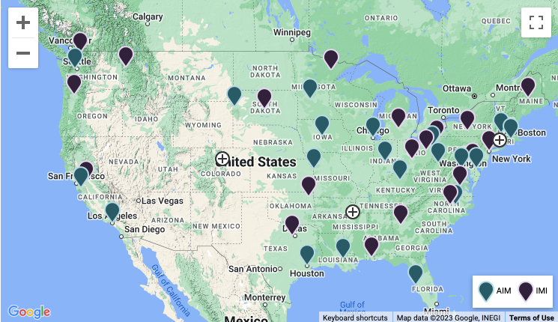

Mobility Innovative Collaborative
https://sumcmic.org/

Slide 4
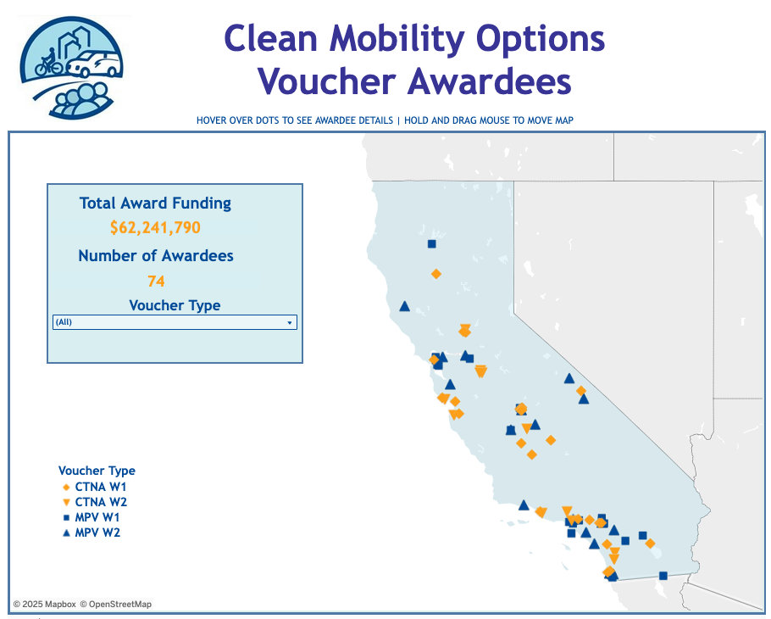

Clean Mobility Options Program
https://cleanmobilityoptions.org
Notes:
SUMC is a co-administrator of the California Air Resource Board (CARB) sponsored Clean Mobility Options (CMO) Program, a statewide public program that empowers under-resourced communities to better understand and overcome mobility obstacles with vouchers that fund community needs assessments and clean, shared, zero-emission transportation projects.

Slide 5
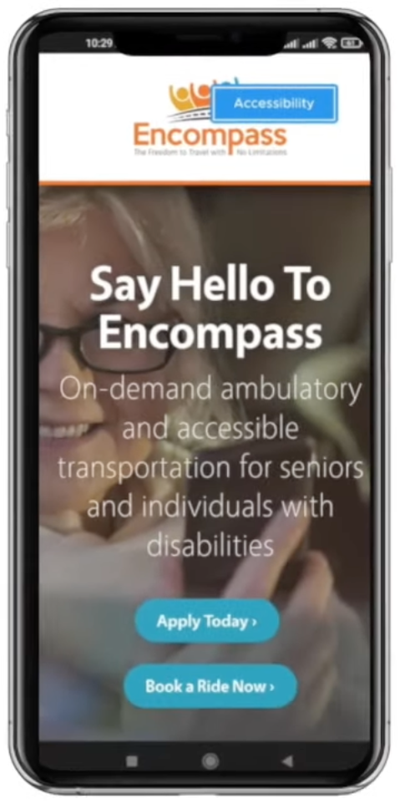

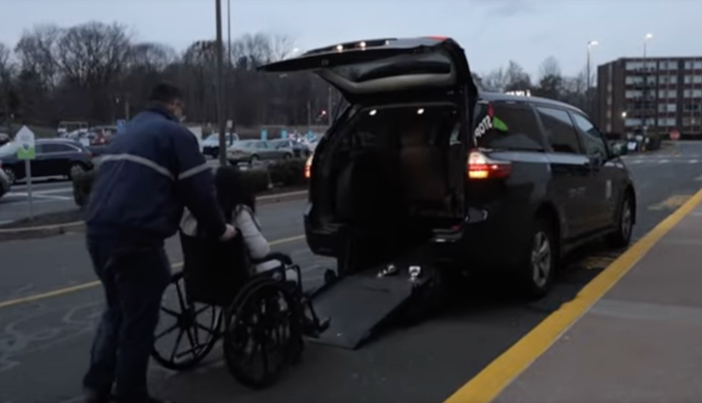
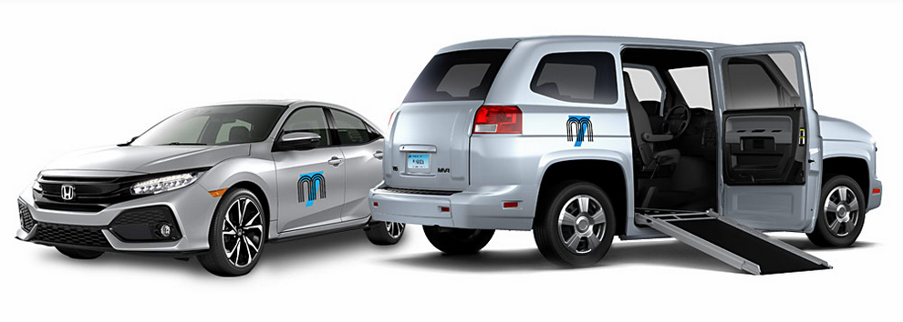
Innovation: Users, Service, Partners
https://sumcmic.org/encompass-enhancing-mobility-for-seniors-and-individuals-with-disabilities/

Slide 6
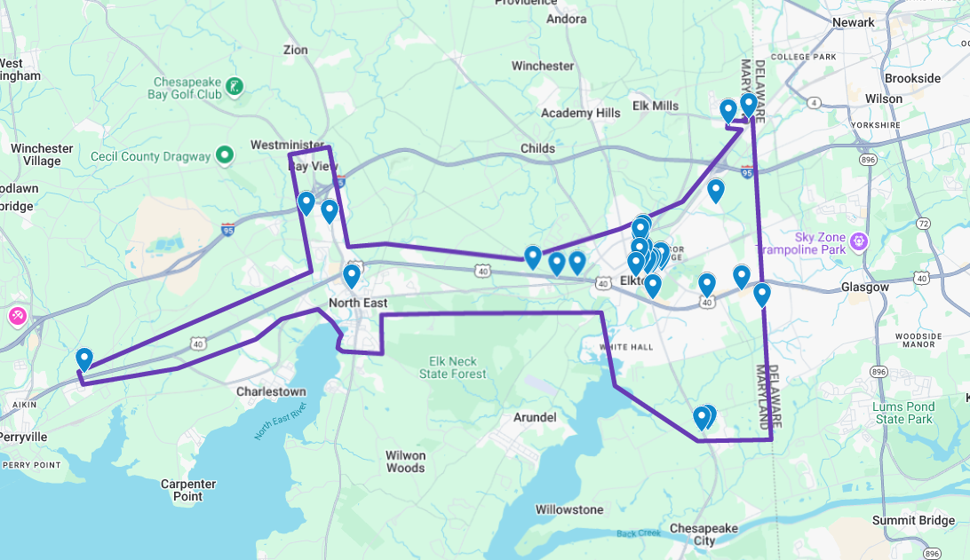

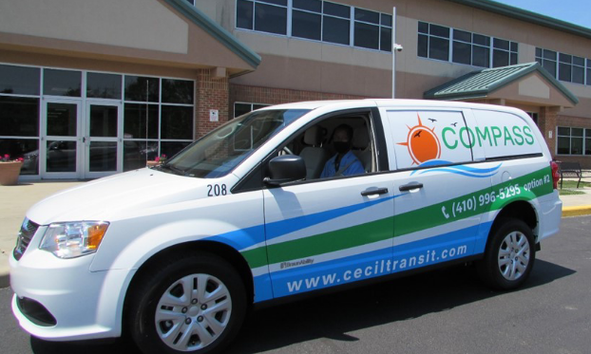

Innovation: Users, Service, Funding
https://learn.sharedusemobilitycenter.org/casestudy/using-compass-to-navigate-cecil-county-md/

Slide 7
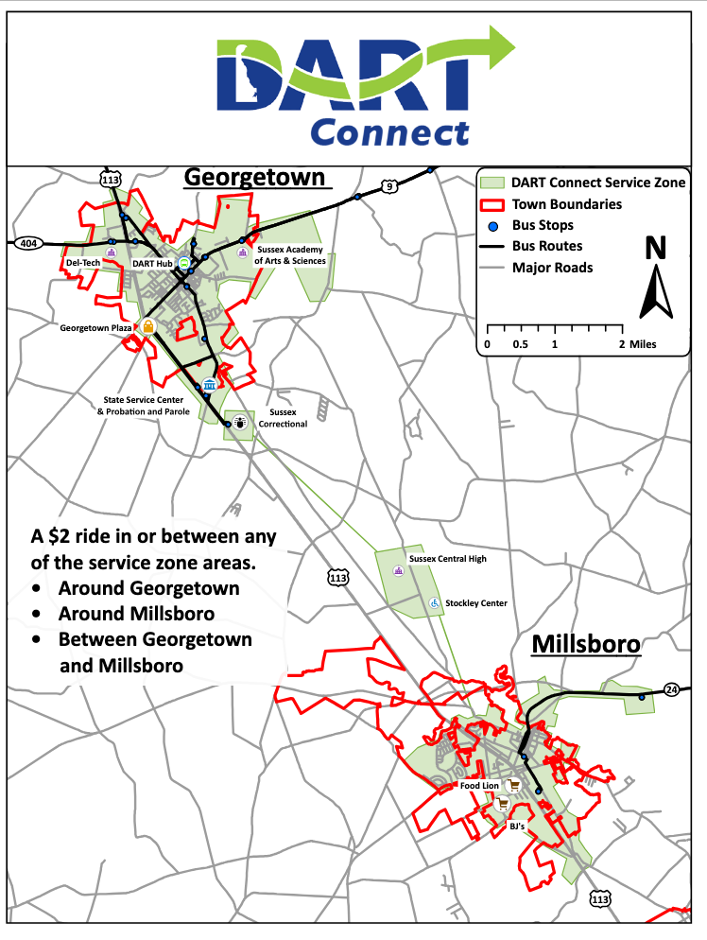
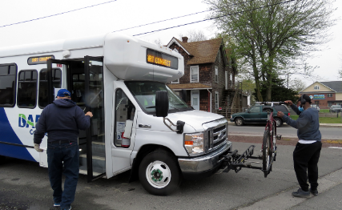
Innovation: Users, Destinations, Partners
https://learn.sharedusemobilitycenter.org/casestudy/connecting-rural-communities-with-dart-connect/

Slide 8
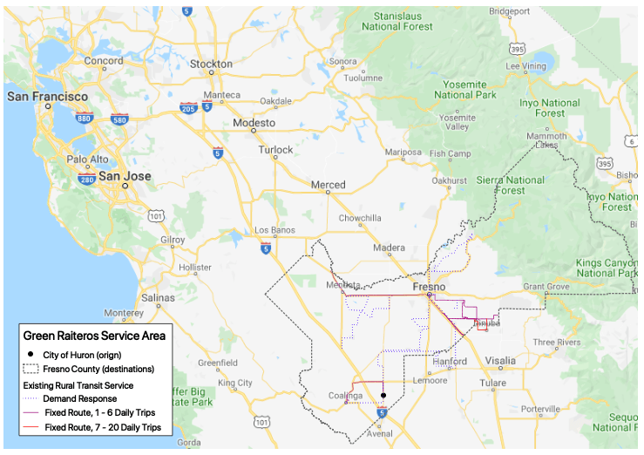
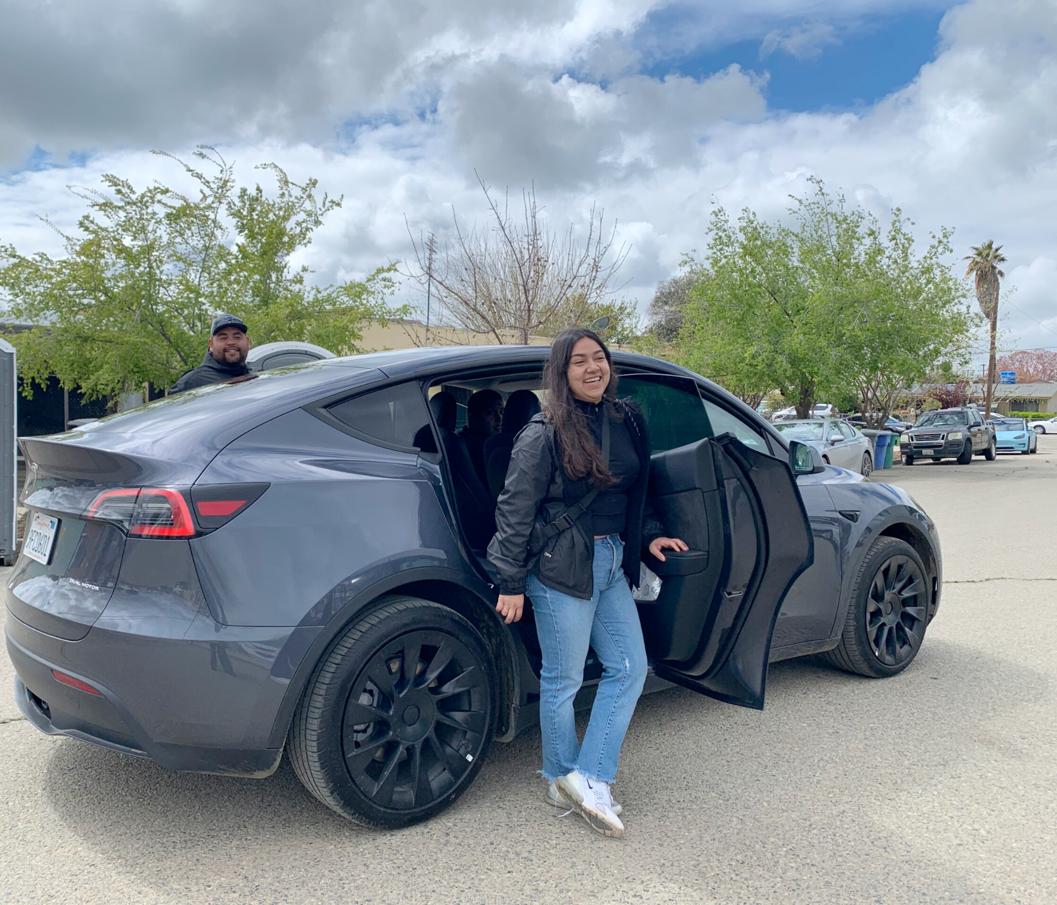


Innovation: Service, Vehicles, Funding
https://learn.sharedusemobilitycenter.org/casestudy/green-raitero-and-green-riderz-shared-rides-in-huron-ca/

Slide 9
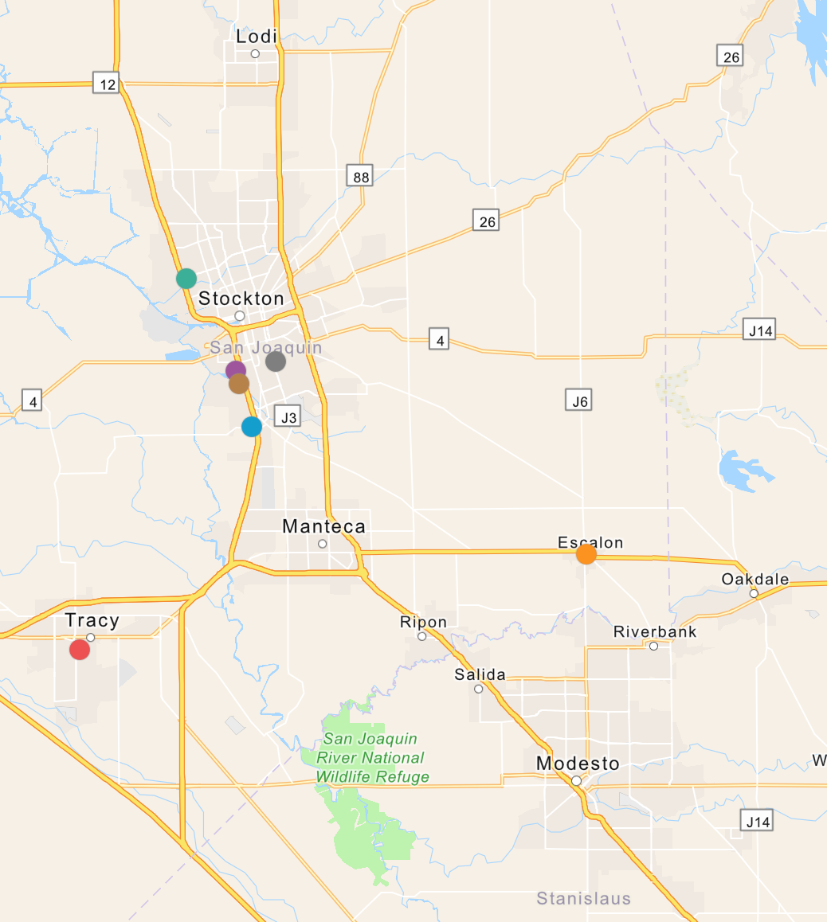
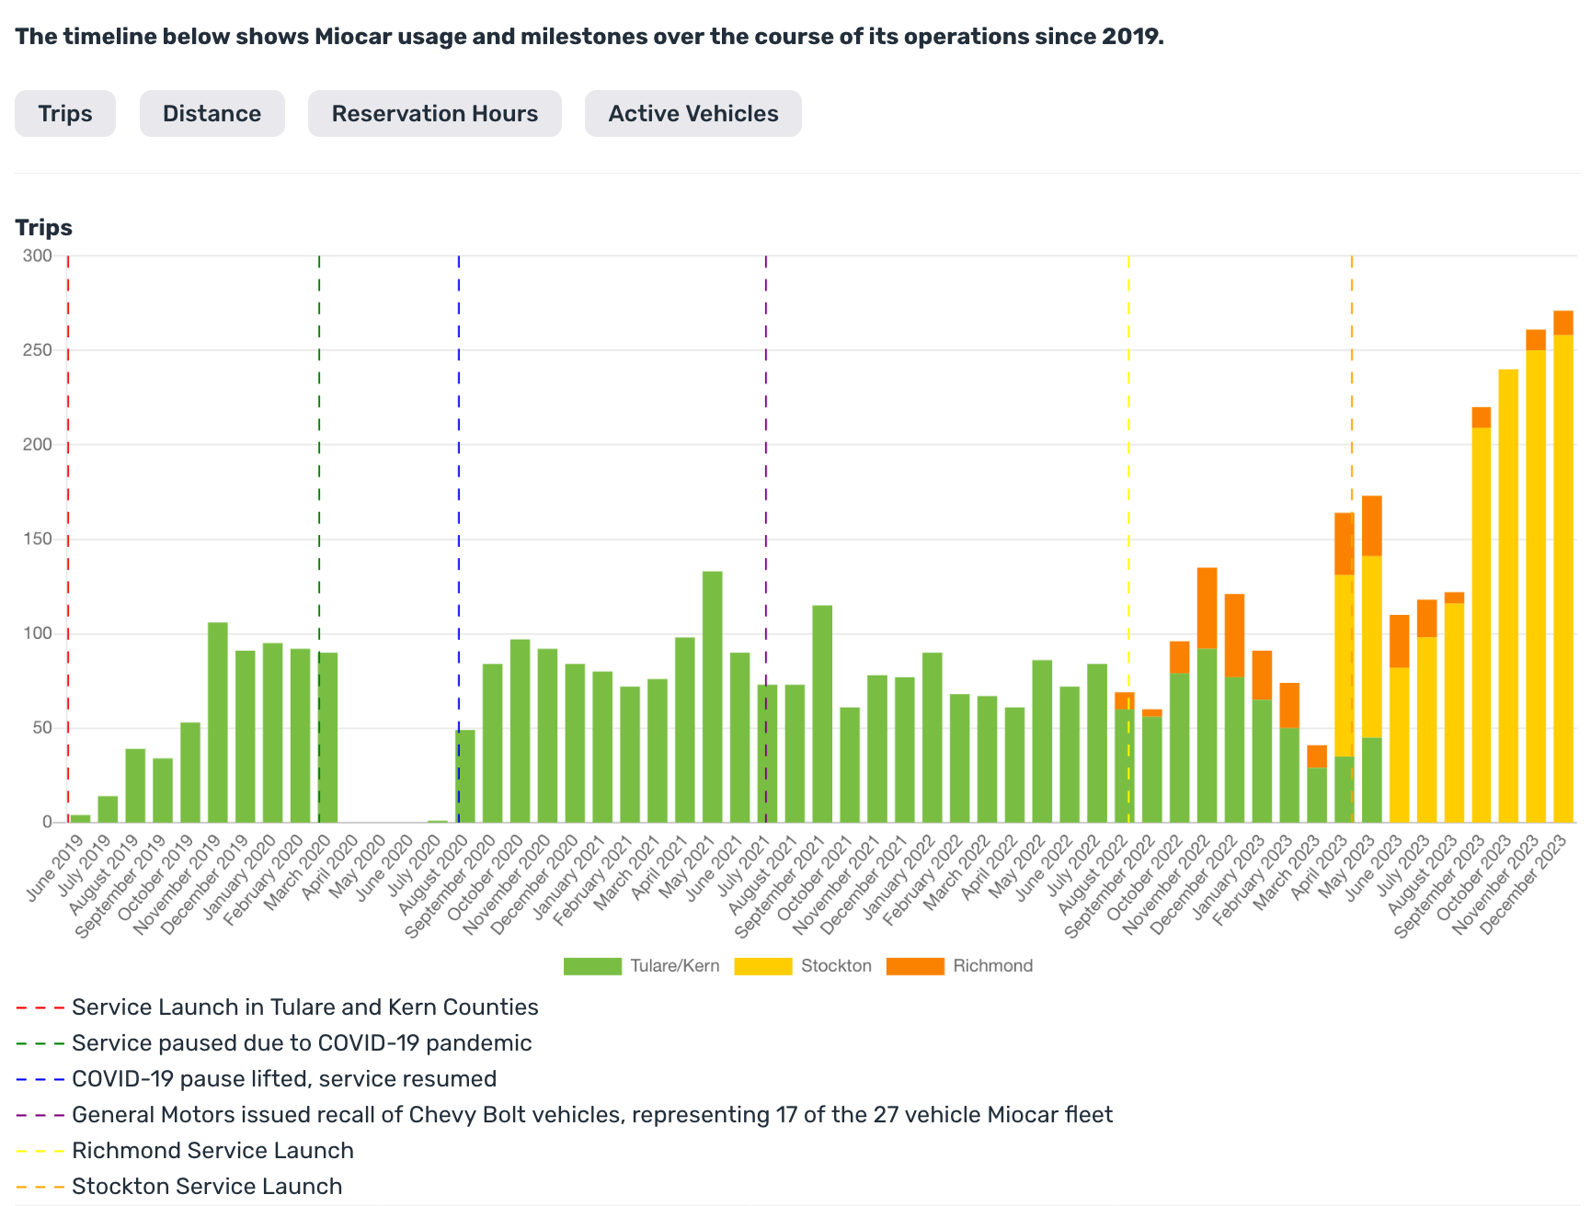
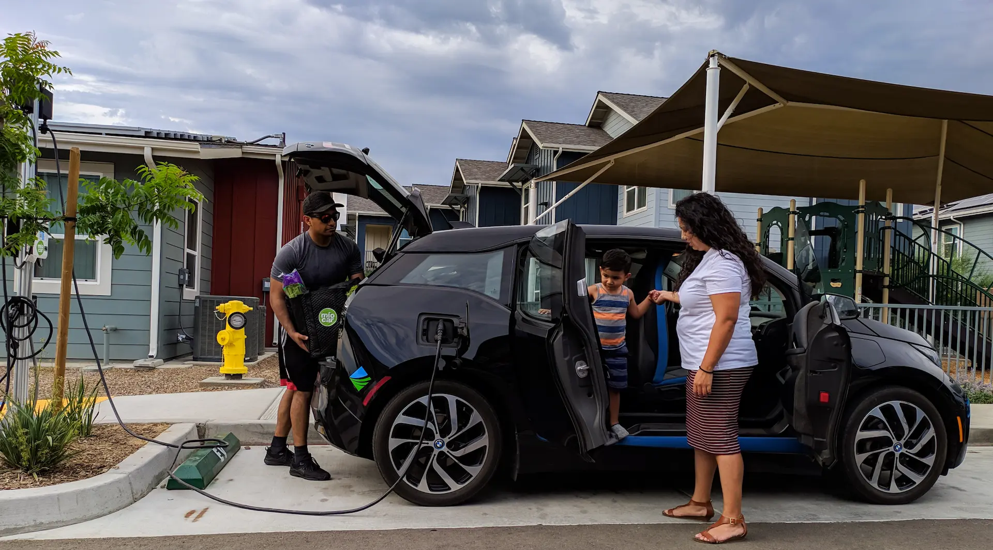
Innovation: Service, Vehicles, Funding
https://miocar.org/?page_id=15270
Notes:
Data time frame: 2024-01-28 – 2025-06-24
- 708 vehicle check-outs
- 57 Unique Registered Users
- Grantee: San Joaquin Council of Governments (SJCOG)
- Started in 2024
- $1.8 million in grant funding allocated
- Funds used to purchase 11 electric vehicles and to purchase and install 5 charging stations
Community members can reserve vehicles from various hubs in San Joaquin County on the day of travel or booked in advance
- SJCOG collaborates with partners including City of Stockton, City of Tracy, Miocar, and the Housing Authority of the County of San Joaquin

Slide 10
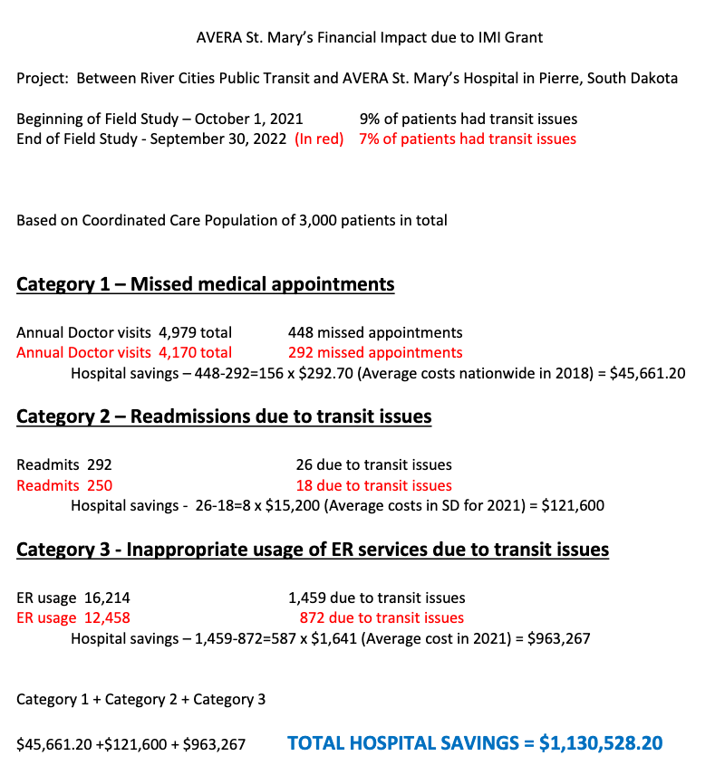
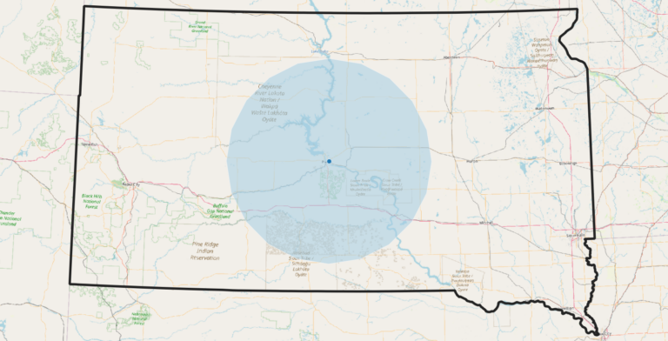
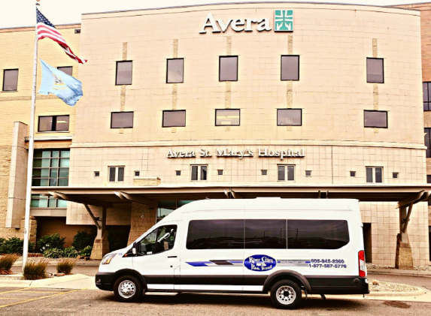

Innovation: Users, Service, Partner
https://learn.sharedusemobilitycenter.org/casestudy/partnering-to-reduce-missed-medical-appointments-pierre-sd/

Slide 11
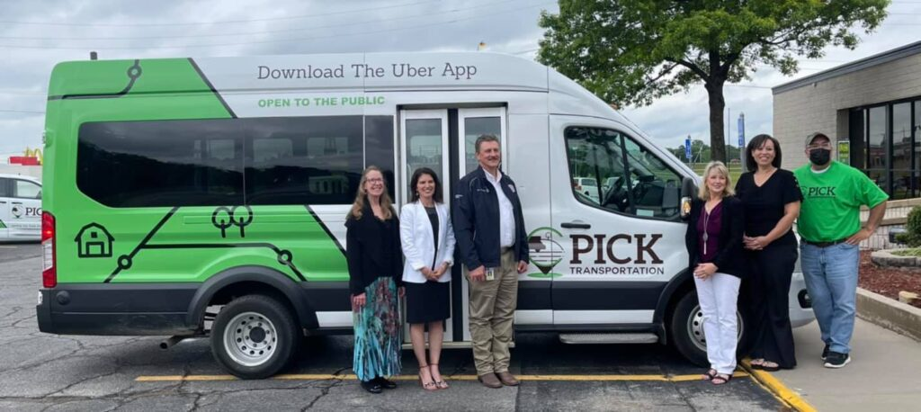
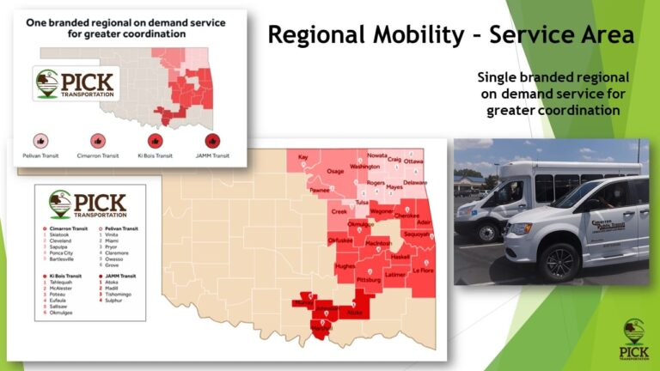
Integration: Brand, Platform, Coordination
https://learn.sharedusemobilitycenter.org/casestudy/bringing-regional-mobility-on-demand-service-to-rural-oklahoma-a-case-study-of-pick-transportation/
Notes:
Albany’s Pop ~100,000

Slide 12
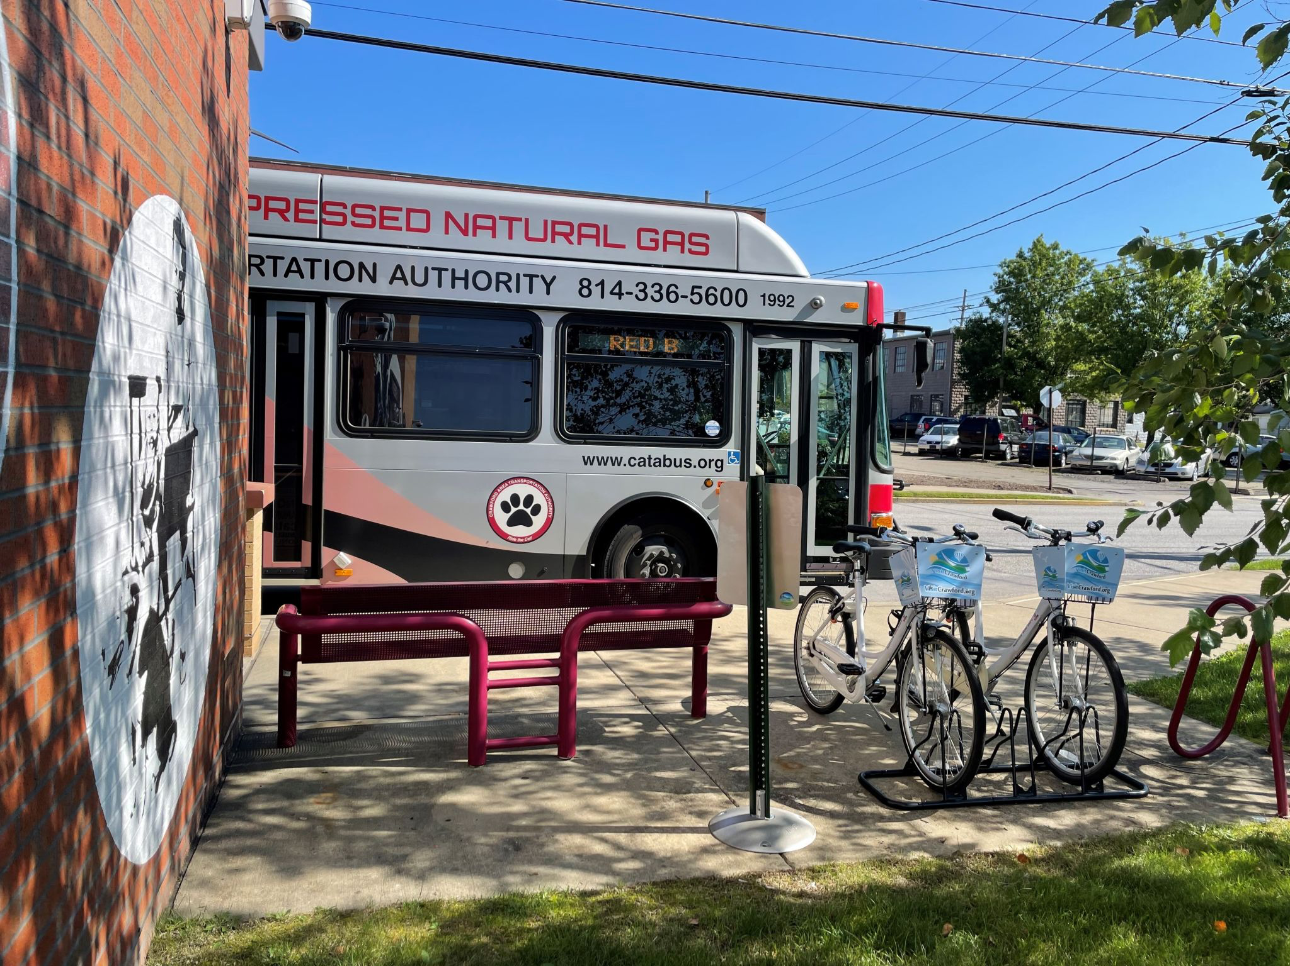

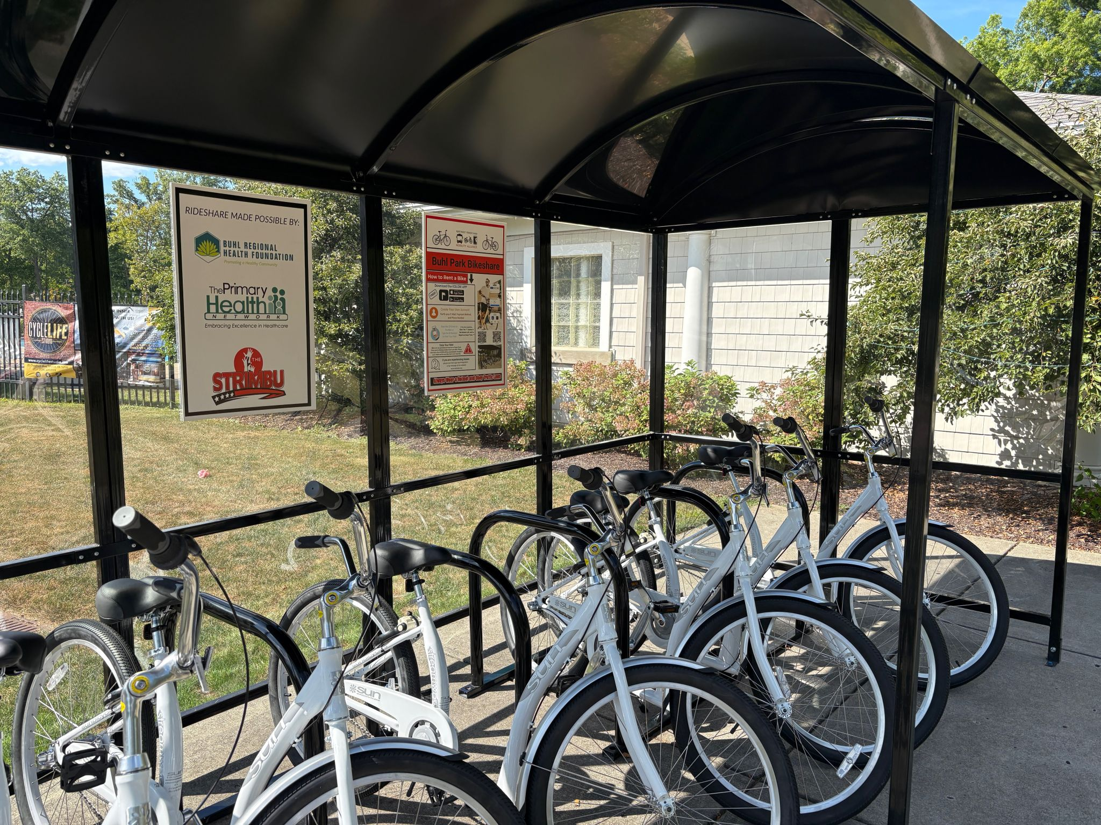
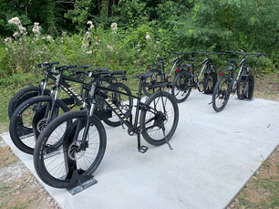
Integration: Transit and Micromobility
https://learn.sharedusemobilitycenter.org/casestudy/meadville_bikeshare/
Notes:
Meadville Pop ~12,000; Crawford County ~85,000

Slide 13
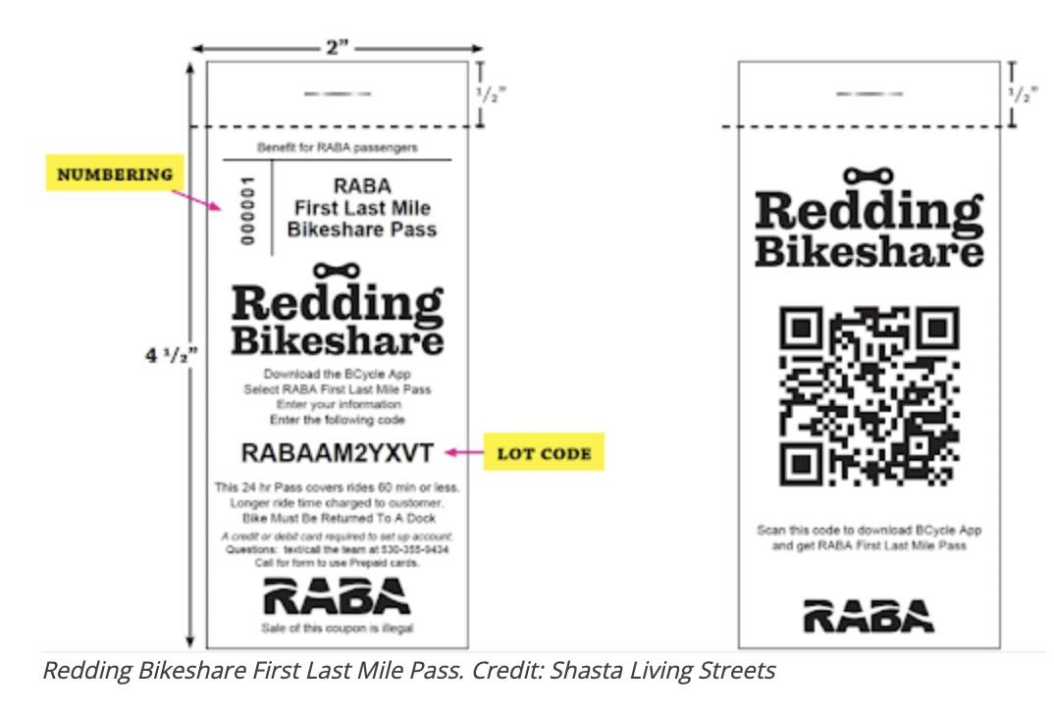
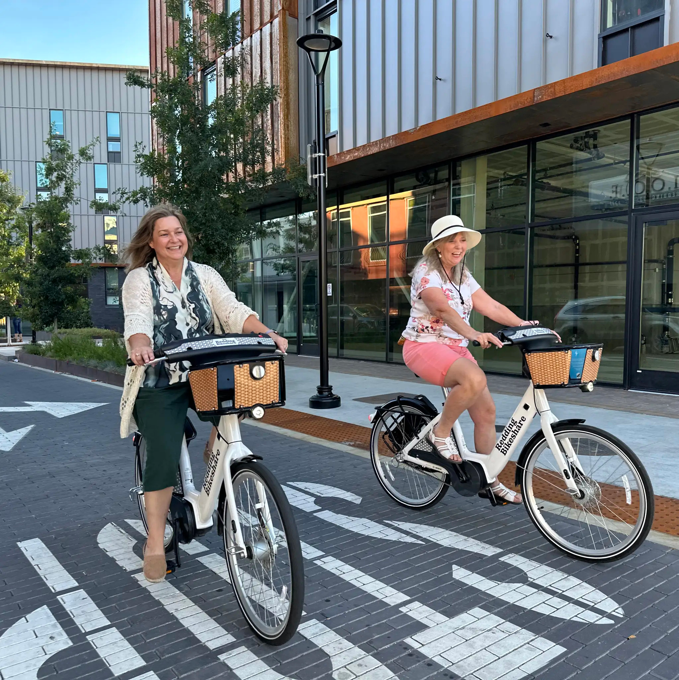
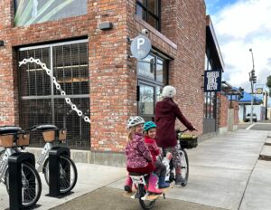
Integration: Transit and Micromobility
https://learn.sharedusemobilitycenter.org/casestudy/living-streets-redding-bikeshares-integration-with-public-transit/

Slide 14



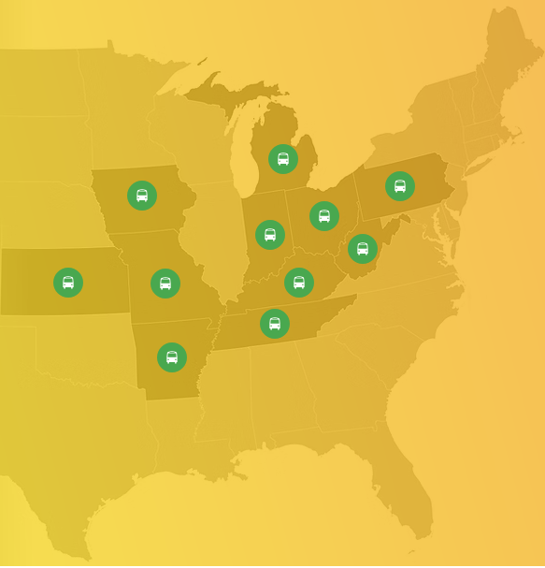
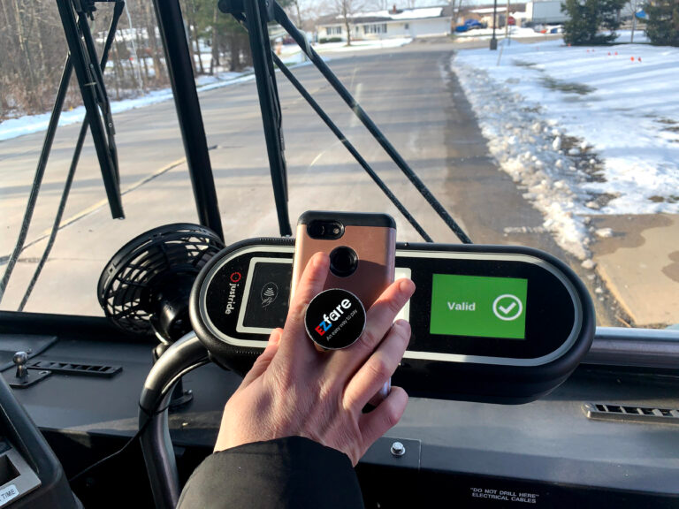
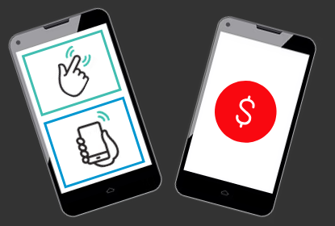
Integration: Organization, Payment, Customer Service
https://learn.sharedusemobilitycenter.org/casestudy/one-account-many-transit-agencies-integrating-transit-payments-with-neoride-ezfare/
https://www.neoride.org/

Slide 15
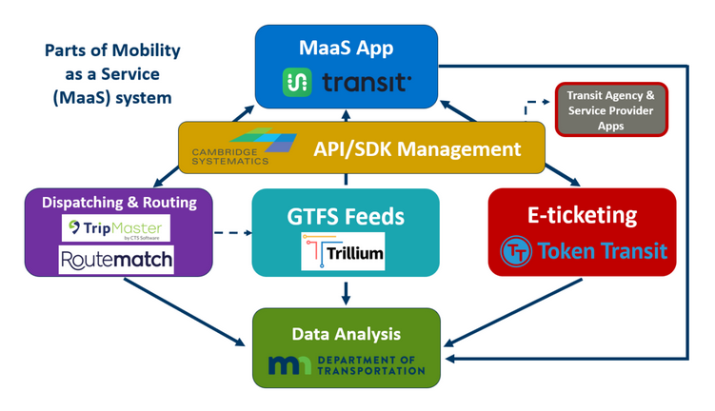
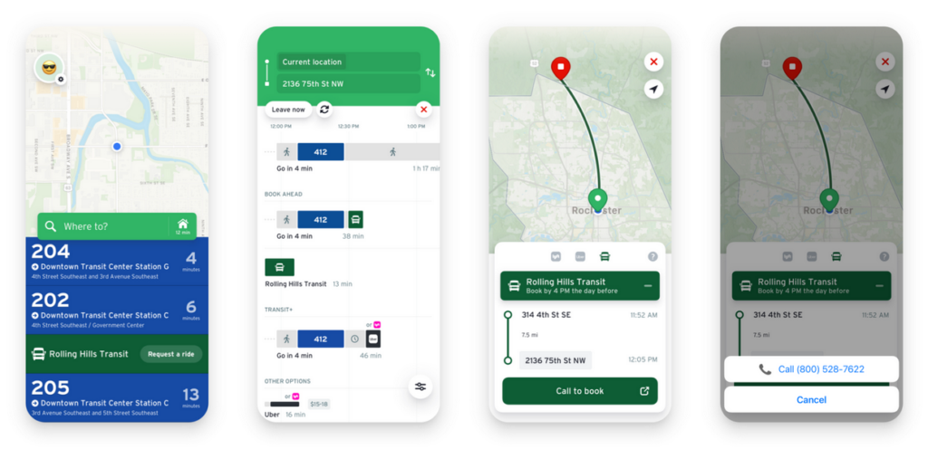
Integration: Modes, Data, Information
https://learn.sharedusemobilitycenter.org/casestudy/maas-in-minnesota-developing-a-regional-trip-planning-platform/

Slide 16
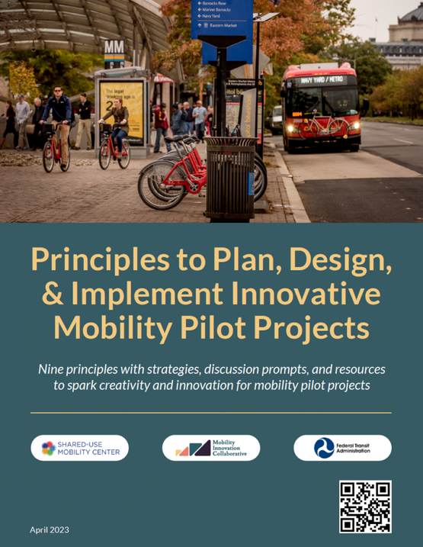
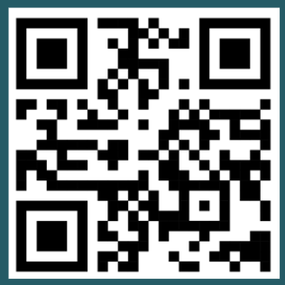
Mobility Innovation Guidebook
https://learn.sharedusemobilitycenter.org/tools/mobility-innovation/

Slide 17
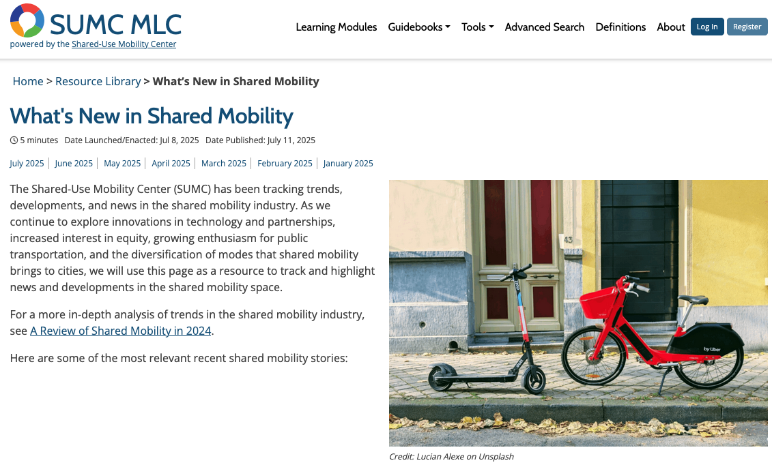
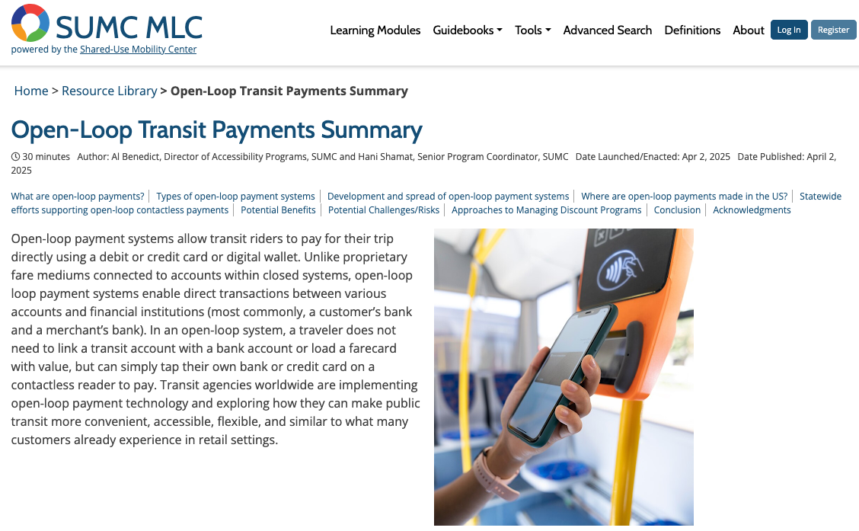
Mobility Learning Center
https://learn.sharedusemobilitycenter.org/

Slide 18
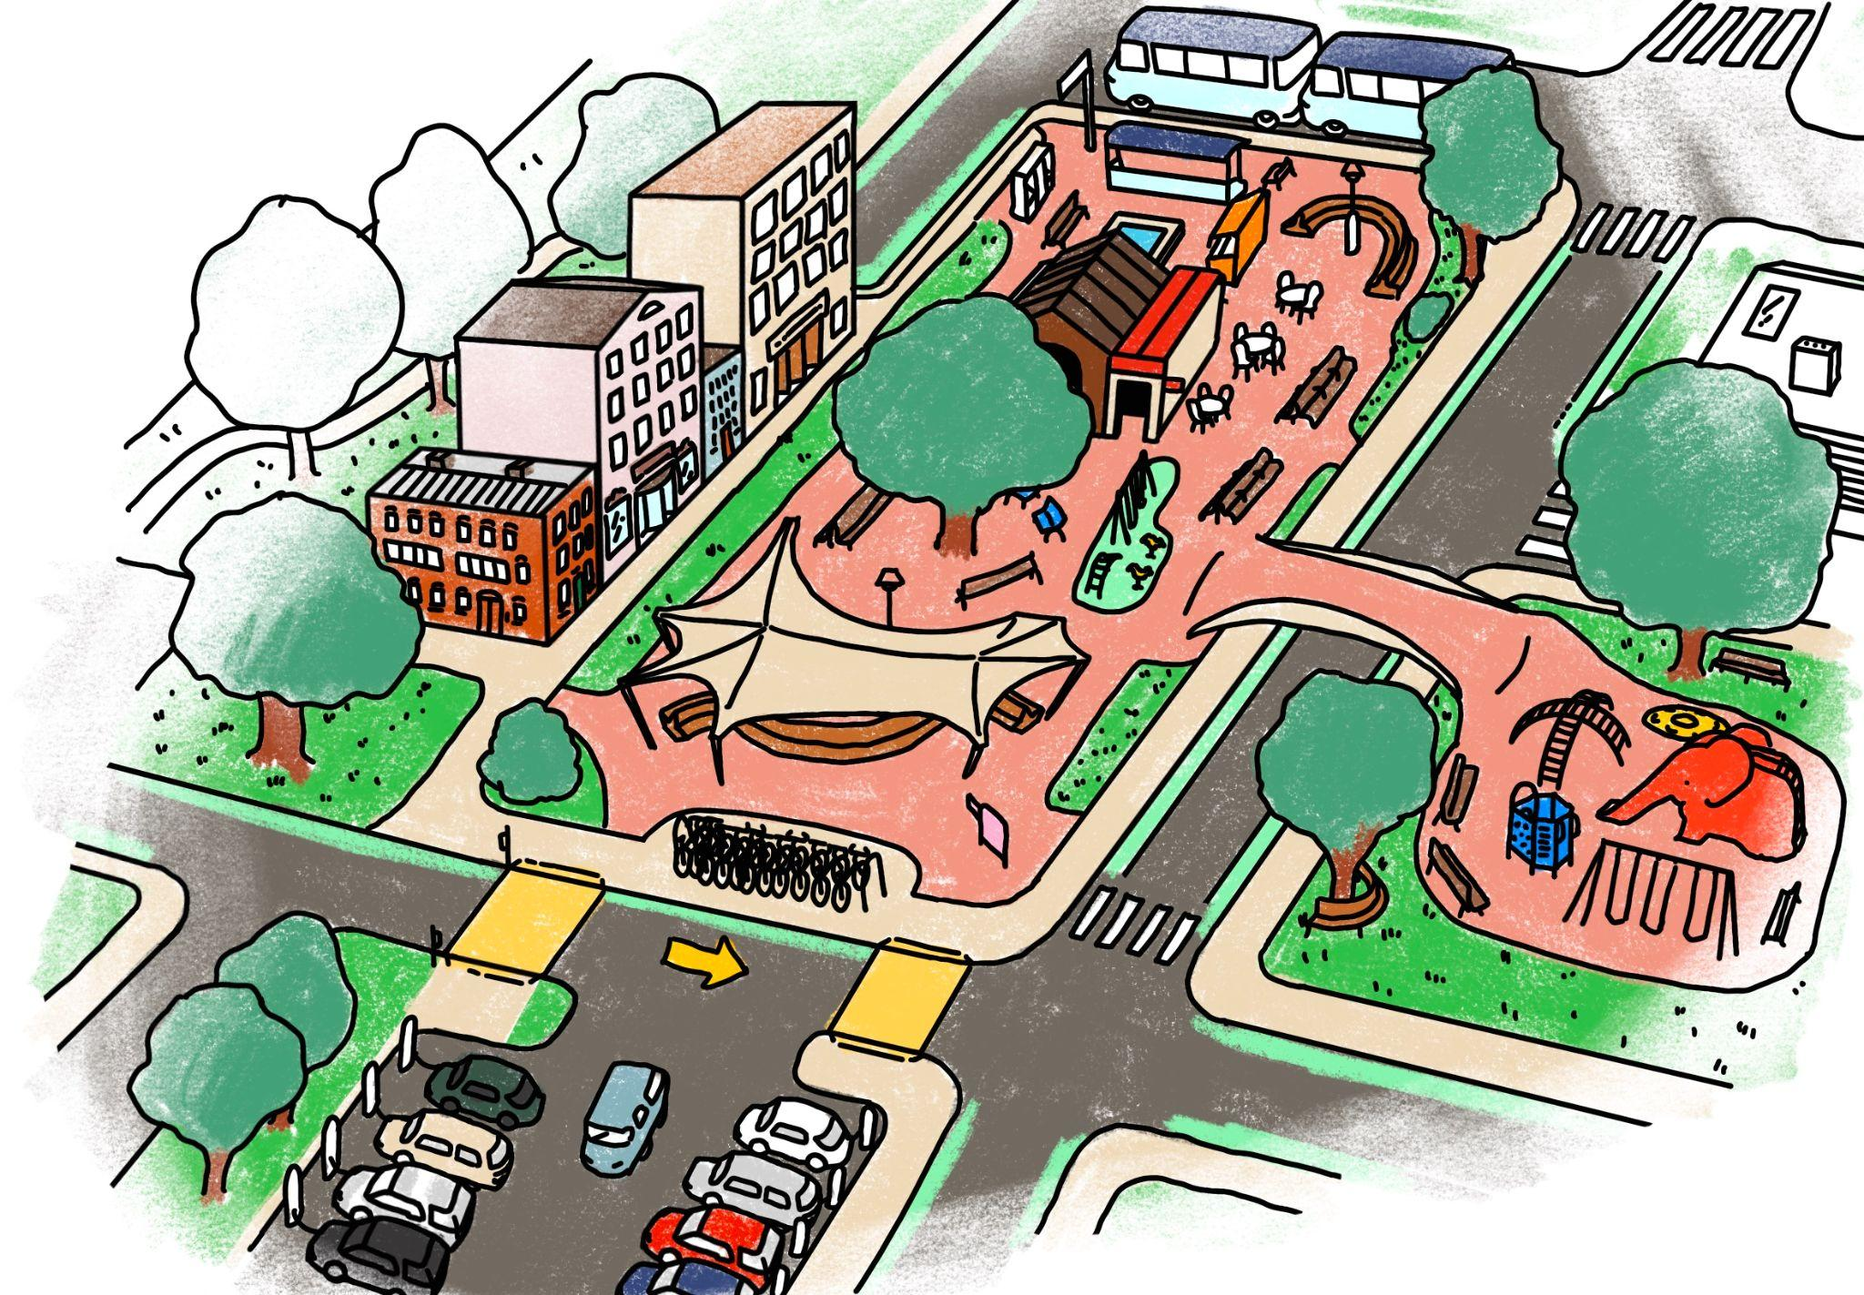
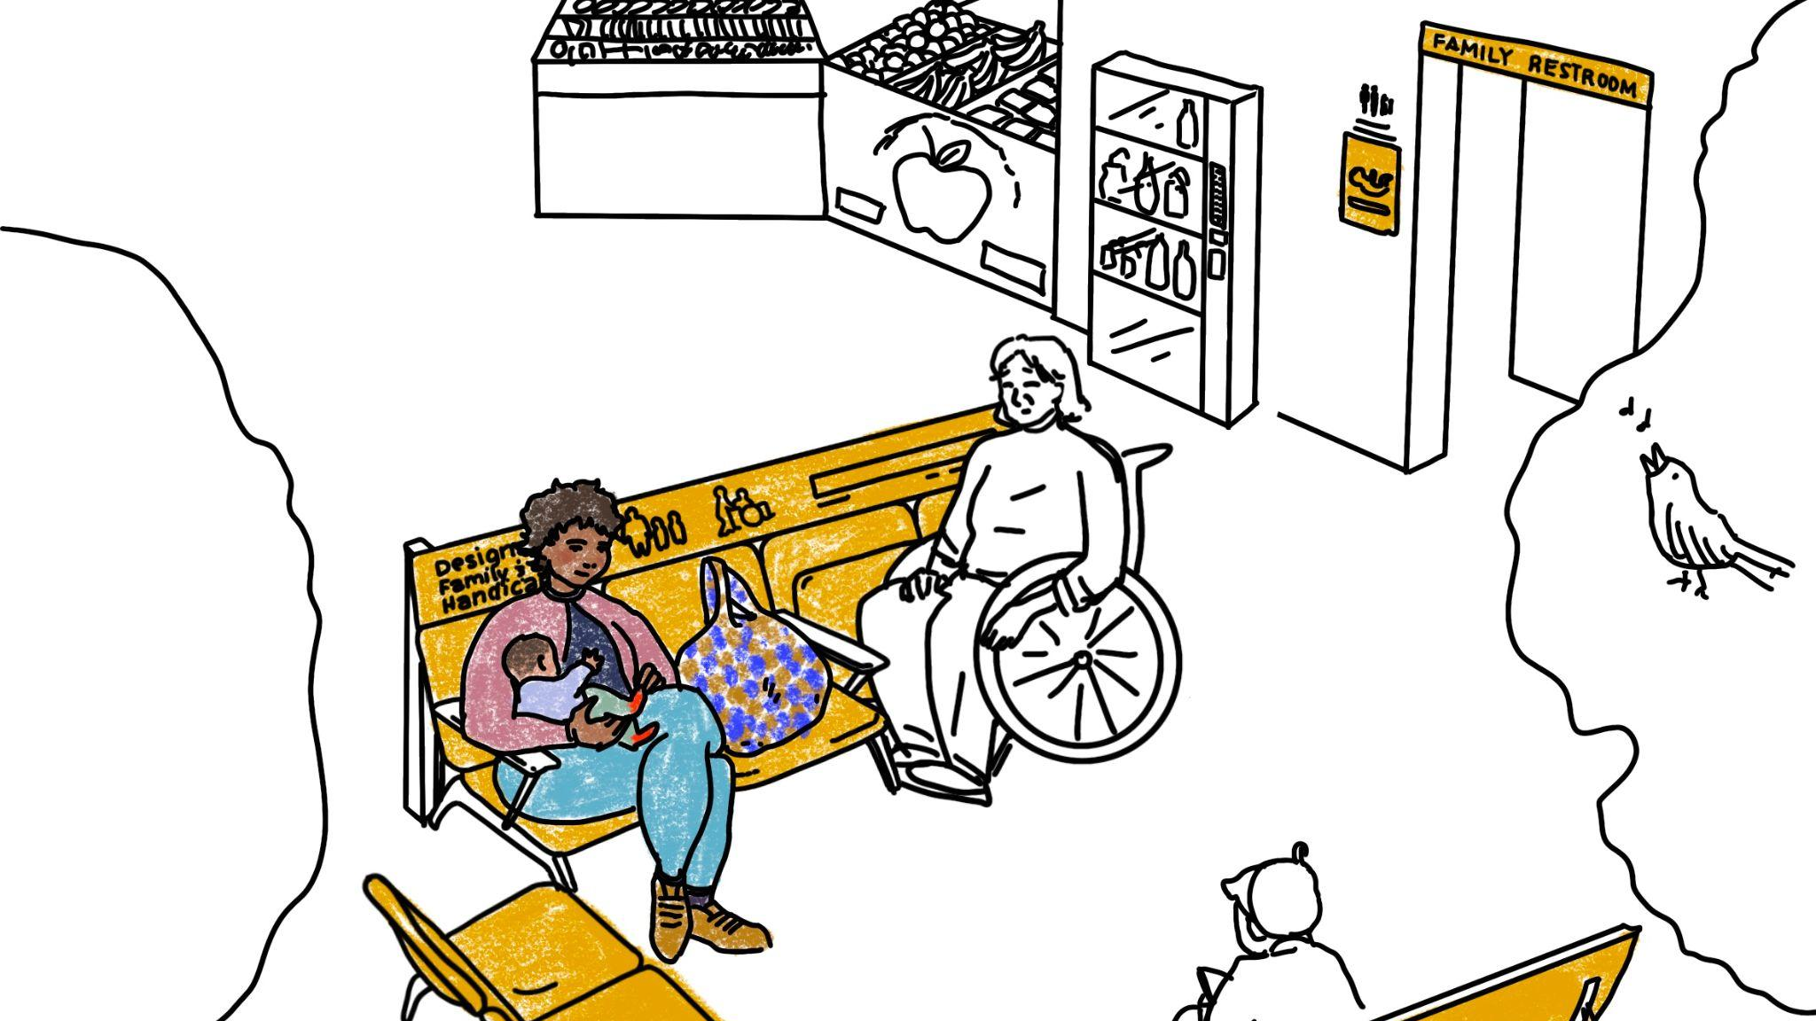
Mobility Hubs for Women and Caregivers
https://sharedusemobilitycenter.org/publications/

Slide 19
Conversation

Slide 20
Thank you!
Alvaro Villagran
Director of Federal Programs
alvaro@sharedusemobilitycenter.org
https://sharedusemobilitycenter.org/
Notes:
Is this too many QR codes??

