Slide 1
FTA Regional Update
Jason Pollock - Bill Kalt
FTA Region 7
September 7, 2023

Slide 2
Overview
Agenda:
Bipartisan Infrastructure Law
Procurement
Vehicle Procurement
Buy America Updates
School Bus Service
The contents of this presentation do not have the force and effect of law and are not meant to bind the public in any way. This presentation is intended only to provide clarity to the public regarding existing requirements under the law or agency policies.

Slide 3
Bipartisan Infrastructure Law
Five-year reauthorization, FY 22-26, of surface transportation programs and direct advanced appropriations
Total transportation funding in this five-year package is $660 billion.
• Highways / Bridges: $365 billion
• Transit: $107 billion
• Rail: $102 billion
• Aviation: $25 billion
• Traffic Safety: $8 billion
• Commercial Motor Vehicle Safety: $5 billion
• Maritime: $2.25 billion
• Build America Bureau: $100 billion ($30 billion in Private Activity Bonds)
• $140 billion in funding for USDOT in FY 2022

Slide 4
Increased Funding for Public Transportation
$25.00
$21.64
$21.93
$22.29
An additional $45 Billion
$21.01
$21.28
$20.00
authorized over 5 years
$15.00
$12.38
$12.59
$12.96
$11.79
$12.18
$12.18
$10.00
$5.00
$-
2016
2017
2018
2019
2020
2021
2022
2023 2024
2025
2026
FAST Act
Bipartisan Infrastructure Law

Slide 5
Formula Programs
Urbanized
Area Formula
30% increase to program funding levels from FY21 to FY22 ($4.8B to $6.3B)
Increases the set-aside for Small Transit Intensive Cities from 2% to 3%
Requires recipients in large UZAs to use at least 0.75% of their funds for safety-related projects eligible under the Urbanized Area Formula program (Section 5307)
30% increase to program funding levels from FY21 to FY22 ($601M to $781M)
Provides $229 million for Public Transportation on Indian Reservations over five years
20% of the Public Transportation on Indian Reservations funds must be distributed on a competitive basis, while the remainder must be apportioned by formula
3% of Rural Formula funding is available for the Appalachian Development Public Transportation Assistance program
Formula Grants for Rural Areas
Buses and
Bus Facilities
30% increase to program funding levels from FY21 to FY22 ($461M to $599M)
The Formula National Distribution is increased to $4 million for each State and $1 million for each territory
Encourages use of Innovative Procurement tools, such as cooperative procurement contracts or state cooperative procurement schedules

Slide 6
Bipartisan Infrastructure Law

Slide 7
Bipartisan Infrastructure Law

Slide 8
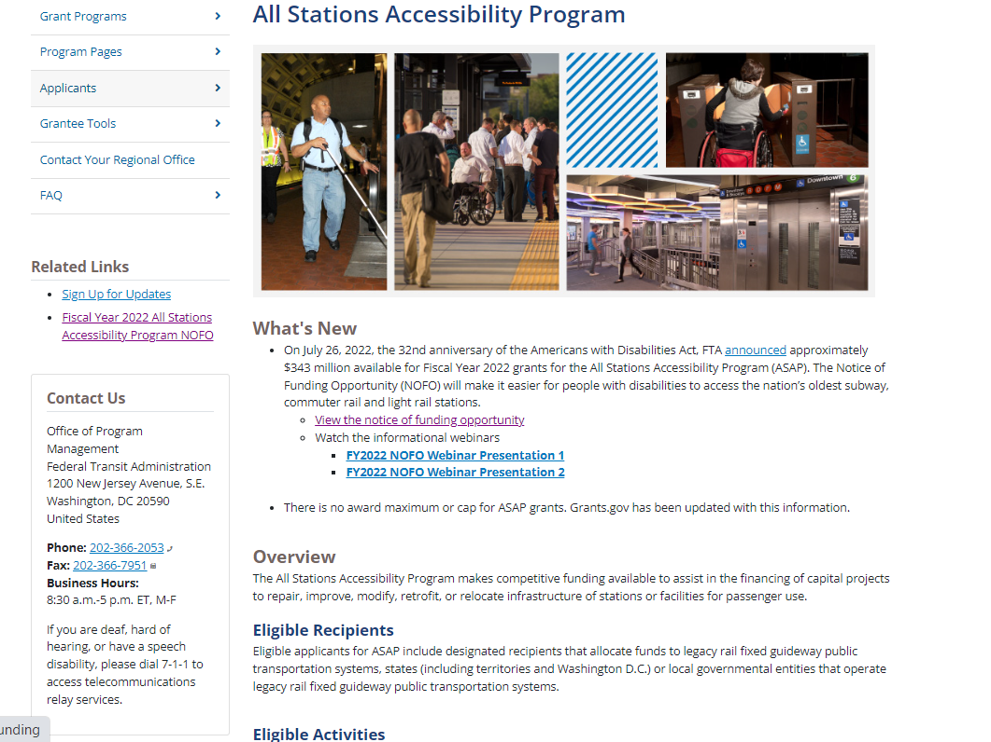
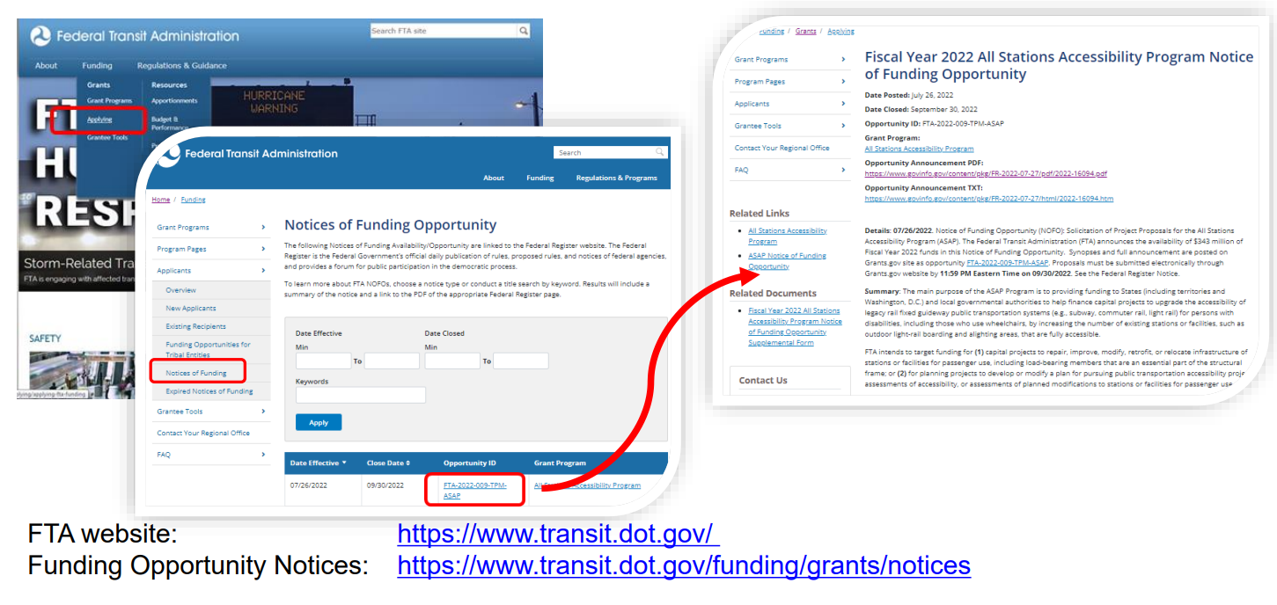
Notices of Funding Opportunities (NOFOs)
How will you be notified of these NOFOs?
Region 7 Dear Transit Partner Emails
Sign Up for FTA Email Notifications: https://public.govdelivery.com/accounts/usdotfta/subscriber/new
FTA Website:

Slide 9
Notices of Funding Opportunities
Tips for Preparing Successful Applications
Be Prepared for the NOFO Announcement (generally come out the same time as previous year)
Don’t Assume Reviewers know your system, geographical area, or your system needs.
Be Descriptive - set the picture on how your application meets needs of your system and/or needs of your customers, your riders.
Address All Evaluation Criteria in detail
Attach Supporting Documents
Attend Program Webinars
Reviewers review only what you submit, are sequestered and cannot ask questions on your application.
Regional Reviewers Recused from Reviewing Application Submittals from own Region

Slide 10
Resources and Contacts
Bipartisan Infrastructure Law Website - https://www.transit.dot.gov/BIL
Program Fact Sheets - https://www.transit.dot.gov/funding/grants/fta-program- fact-sheets-under-bipartisan-infrastructure-law
Contact FTA-IIJA@dot.gov
Contact Region 7 for assistance

Slide 11
Notable Dates
TrAMS Closed Monday, September 25, 2023 for Financial Transactions
Annual or/4th Quarter Financial and Milestone Progress Reports are due October 30th
Completed Planning Basis Worksheets (feasibility studies)/environmental analysis for planned construction projects should be submitted to FTA Region VII Planning Team by February 1st.
Carryover Letters for FY2023 funds and prior will be sent out in early winter.

Slide 12
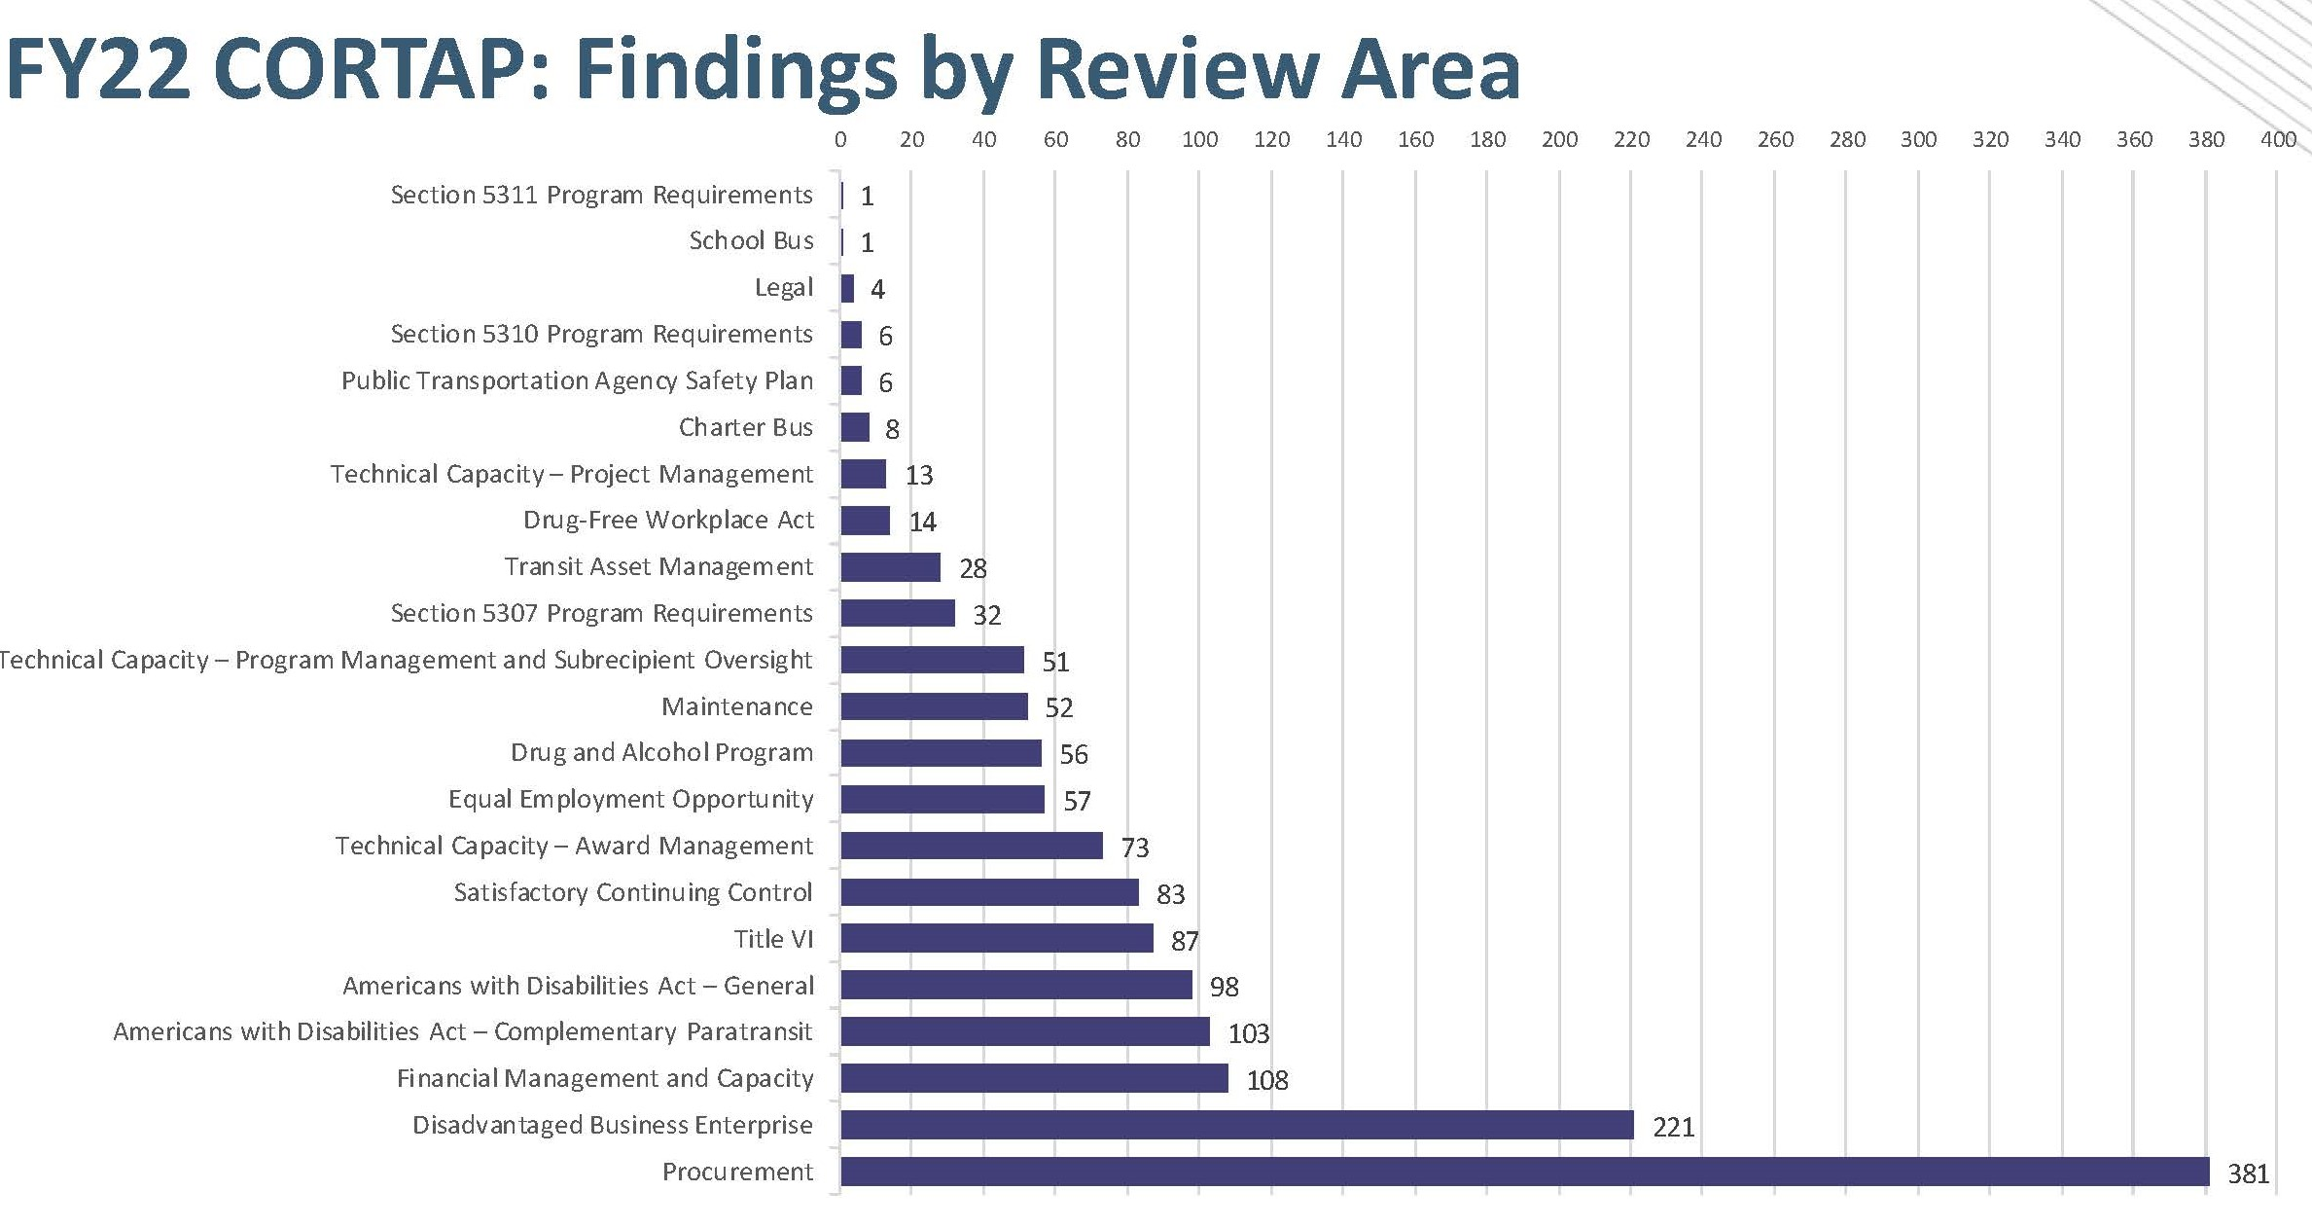
Procurement

Slide 13
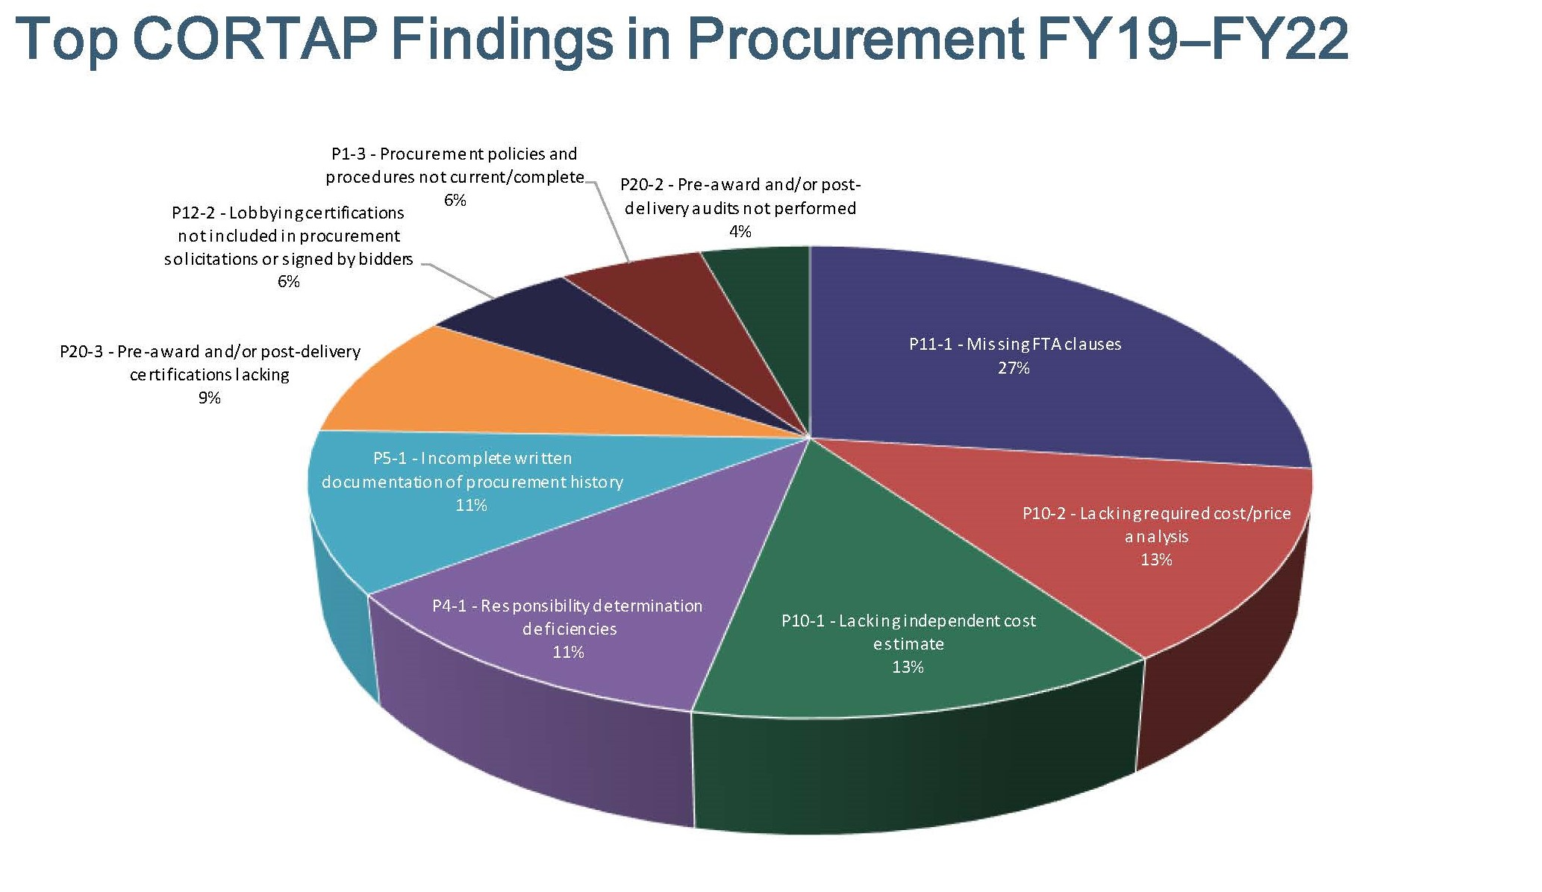
Procurement

Slide 14
Procurement
Procurement Resources:
Comprehensive Review Contractor’s Manual:
https://www.transit.dot.gov/regulations-and-programs/program-oversight/fy23-comprehensive-review-contractors-manual
FTA’s Master Agreement:
https://www.transit.dot.gov/funding/grantee-resources/sample-fta-agreements/fta-grant-agreements
FTA Circulars:
https://www.transit.dot.gov/guidance#sectionJumpMark20
July 2023 Procurement Presentation:
https://www.transit.dot.gov/regulations-and-programs/program-oversight/procurement-webinar-identifying-fta-funded-procurements

Slide 15
Bipartisan Infrastructure Law
Additional Federal Programs that Support Public Transportation
https://www.transit.dot.gov/funding/federal-programs-support-public-transportation
Competitive Programs
Rebuilding American Infrastructure with Sustainability and Equity (RAISE) - The RAISE Discretionary Grant program provides a unique opportunity for the DOT to invest in road, rail, transit and port projects that promise to achieve national objectives.
Consolidated Rail Infrastructure and Safety Improvements (CRISI) - CRISI funds projects that improve the safety, efficiency, and reliability of intercity passenger and freight rail (including short-line and regional rail).
Railroad Crossing Elimination program - The Railroad Crossing Elimination program funds highway-rail or pathway-rail grade crossing improvement projects that improve the safety and mobility of people and goods.

Slide 16
Bipartisan Infrastructure Law
Additional Federal Programs that Support Public Transportation
https://www.transit.dot.gov/funding/federal-programs-support-public-transportation
Federal Loan Programs Administered by the USDOT Build America Bureau
Transportation Infrastructure Finance and Innovation Act (TIFIA) program - Provides credit assistance for qualified projects of regional and national significance. Many large-scale, surface transportation projects - highway, transit, railroad, intermodal freight, and port access - are eligible for assistance.
TIFIA 49 Program: Up to 49% of Project Cost & Counts As Non-Federal Share
https://www.transportation.gov/buildamerica/TIFIA49
Railroad Rehabilitation and Improvement Financing (RRIF) - Provides loans and direct guarantees to finance development of railroad infrastructure. This can include intermodal facilities and transit-oriented development.

Slide 17
Bipartisan Infrastructure Law
Additional Federal Programs that Support Public Transportation
Flexible Funding for Transit and Highway Improvements
Congestion Mitigation and Air Quality (CMAQ) program - The CMAQ program provides funding for transportation projects and programs to help meet the requirements of the Clean Air Act.
Surface Transportation Block Grant (STBG) - The STBG program provides funding to best address State and local transportation needs.
Tribal Transportation Program - The TTP supports safe and reliable transportation and public road access to and within Indian reservations, Indian lands, and Alaska Native Village communities.
National Highway Performance Program - NHPP provides support for the condition and performance of the National Highway System, supports the construction of new facilities, ensures that investments of Federal-aid funds in highway construction are directed to support progress toward the achievement of performance targets in a State's asset management plan, and supports activities to increase the resiliency of the nation’s highways.

Slide 18
Bipartisan Infrastructure Law
Congestion Mitigation and Air Quality (CMAQ) Funds for Operating Costs
Pre-BIL:
Operating Costs were limited to a five-year startup period to start up operating costs for new transportation services or the incremental costs of expanding such services, including transit, commuter and intercity passenger rail services, intermodal facilities, and travel demand management strategies, including traffic operation centers.
https://www.fhwa.dot.gov/environment/air_quality/cmaq/policy_and_guidance/cmaq13ig.cfm
Post-BIL:
No time limit on operating costs for transit system located in certain areas. BIL §11115(7)
A route described in subparagraph (B) [System for which CMAQ funding was eligible in 2012 or State-supported Amtrak] or
A transit system located in
Non-urbanized area or
An urbanized area with a population of 200,000 or fewer

Slide 19
Bipartisan Infrastructure Law Changes
Updates to Procurements of Buses using 49 U.S.C. 5339 Funds
If a recipient is using 5339 funding to procure buses:
Maximizing use of funds.
(A) In general.—Eligible recipients under this subsection should, to the extent practicable, seek to utilize the procurement tools authorized under section 3019 of the FAST Act (49 U.S.C. 5325 note; Public Law 114–94).
(B) Written explanation.—If an eligible recipient under this subsection purchases less than 5 buses through a standalone procurement, the eligible recipient shall provide to the Secretary a written explanation regarding why the tools authorized under section 3019 of the FAST Act (49 U.S.C. 5325 note; Public Law114–94) were not utilized
FAST Act Section 3019
https://www.transit.dot.gov/funding/grants/innovative-procurement-leasing-fact-sheet-section-3019
State Cooperative Procurement Schedules
State Government enters into a cooperative procurement contract with one or more vendors. A recipient may purchase from any state’s cooperative procurement contract or schedule.
Recipient needs to ensure the procurement allows for out-of-state buyers.
Initial term of not more than two years and may include three optional extensions of one year each

Slide 20
Bipartisan Infrastructure Law Changes
Disposal Changes
Sold prior to November 15, 2021:
Sell rolling stock, equipment, and aggregate supplies and apply the proceeds to reduce the gross cost of another FTA eligible capital transit project
Sold after November 15, 2021:
For rolling stock, equipment, and aggregate supplies with a fair market value of more than $5,000, the recipient shall retain $5,000 AND a percentage of the remaining proceeds equal to the local share percentage.
Does not apply to:
Insurance Claims
Items disposed of prior to end of useful life
Items transferred to another eligible entity
Real Property
Any remaining amount must be returned to FTA via Pay.gov
Please see FAQs: https://www.transit.dot.gov/funding/grants/bipartisan-infrastructure-law-disposition-requirements-frequently-asked-questions

Slide 21
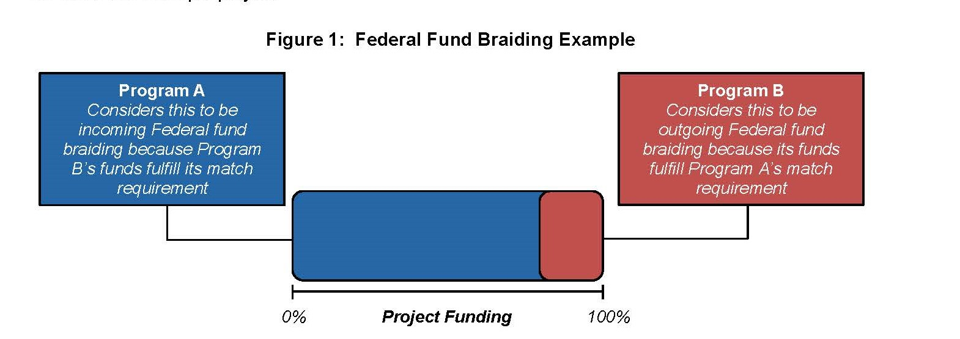
Sources of Local Match
Federal Braiding Guide
https://www.transit.dot.gov/regulations-and-programs/ccam/about/coordinating-council-access-and-mobility-ccam-federal-fund

Slide 22
Resources
Funding Resources
https://public.govdelivery.com/accounts/USDOTFTA/subscriber/new
https://www.transit.dot.gov/funding
Notices of Funding
https://www.transit.dot.gov/funding/grants/notices
Tribal Funding
https://www.transit.dot.gov/funding/tribal-governments
https://www.transit.dot.gov/funding/grants/applying/existing-recipients

Slide 23
Vehicle Procurement
Contract Adjustments & Advanced or Progress Payments
https://www.transit.dot.gov/funding/procurement/guidance-response-cost-and-payment-questions
Modify a federally assisted contract to address price increases?
Yes, please consult 2 CFR 200 and your Regional Office
E.g., a recipient must perform a cost or price analysis if the modification will exceed the simplified acquisition threshold, currently $250,000. 2 CFR 200.324(a).
Advanced Payments, or mobilization payments, prior to receipt of rolling stock?
Yes, under certain conditions.
Recipient can provide sound business reasons for doing so AND has received FTA’s advanced written concurrence
Pre-condition to FTA’s concurrence, the recipient must obtain adequate security from the contractor for the advanced payment
Such as performance bond or a letter of credit

Slide 24
Vehicle Procurement
Contract Adjustments & Advanced or Progress Payments
https://www.transit.dot.gov/funding/procurement/guidance-response-cost-and-payment-questions
Progress Payments
Made prior to completion of the work.
Allowed if:
Recipient obtains adequate security for the payment to safeguard against performance difficulties
Typically, a performance bond or letter of credit
Has sufficient written documentation to substantiate completion of the work for which progress payments are requested
Payments for percentage of completion of contract is not permissible
Permissible payments include completion of discrete activities necessary to the performance of contract

Slide 25
Vehicle Procurement
2022 Dear Colleague Letter RE: Rebuilds
24-Month Waiver from November 2, 2022, of FTA’s minimum four-year useful life extension for medium size, light-duty transit buses and smaller vehicle rebuilds.
“Rebuild” defined in 5010.1E as: “a capital activity associated with rolling stock that occurs at, or near, the end of a unit of rolling stock’s useful life, and that results in an extended useful life for the unit of rolling stock consistent with the extent of the rebuilding.”
Minimum useful life extension of two years or 50,000 miles
Applies to vehicles with:
An original useful life of 5 or fewer years or 150,000 or fewer miles

Slide 26
Vehicle Procurement
Buy America Non-ADA Accessible Minivan Waiver
Two-year Buy America waiver of domestic content requirement (70%+ domestic content for components and subcomponents) for mass-produced, unmodified non-ADA accessible vans and minivans with seating capacity for at least six adults not including the driver:
Final Assembly must be in the United States as reported to NHTSA under the American Automobile Labelling Act (AALA)
Country of Origin for the engine or motor (for EVs) must be the United States as reported to NHTSA under the AALA
Expires two years from October 25, 2022 or upon publication of a recession notice if FTA determines that a fully Buy America compliant vehicle has become available, whichever occurs first.
AALA: https://www.nhtsa.gov/part-583-american-automobile-labeling-act-reports

Slide 27
Buy America Updates
Construction Materials
As part of the Bipartisan Infrastructure Law, a new domestic content requirement was added for the use of construction materials
In General.--Not later than 180 days after the date of enactment of this Act, the head of each Federal agency shall ensure that none of the funds made available for a Federal financial assistance program for infrastructure, including each deficient program, may be obligated for a project unless all of the iron, steel, manufactured products, and construction materials used in the project are produced in the United States.
§70914(a)

Slide 28
Buy America Updates
Construction Materials
Non-ferrous (non-iron) metals
Plastic and polymer-based products (including polyvinylchloride, composite building materials, and polymers used in fiber optic cables)
Glass (including optic glass)
Lumber
Drywall
Does not include cement or cementitious materials, aggregates such as stone, sand or gravel, or aggregate binding agents or additives

Slide 29
Buy America Updates
Construction Materials
“Produced in the United States”
OMB M-22-11, April 18, 2022, Initial Implementation Guidance
“Final manufacturing process and the immediately preceding manufacturing stage”
OMB Notice of Proposed Rule Making for 2 CFR 184, February 9, 2023, 88 FR 8374
Further defines the proposed standards for “all manufacturing processes” for construction materials.
E.g., Lumber. All manufacturing process, from initial debarking through treatment and planning, occurred in the United States
Comments closed March 12, 2023, and awaiting final OMB rulemaking
Prepublication “Final” Definitions: https://www.whitehouse.gov/wp-content/uploads/2023/08/REV_2-CFR-Guidance-Pre-publication-version-8.13.pdf

Slide 30
Buy America Updates
Construction Materials
USDOT issued a temporary waiver for construction materials that ran from May 14, 2022 through November 10, 2022.
BABA applies to construction materials covered by grants obligated on or after November 10, 2022.
In response to the new BABA requirement, USDOT issued two transitional waivers where the BABA requirements would not apply:
Projects with all construction-related grants obligated before November 10, 2022; and
Contracts and Solicitations Waiver (On following slides)
USDOT De Minimis & Small Grants Buy America Waiver: https://www.federalregister.gov/documents/2023/08/16/2023-17602/waiver-of-buy-america-requirements-for-de-minimis-costs-and-small-grants

Slide 31
Buy America Updates
Construction Materials
USDOT’s Contract and Solicitations Waiver
Effective January 30, 2023
For any grant obligated on or after January 30, 2023, the BABA construction materials requirement is waived for:
Any contract executed before May 14, 2022
Any contract executed on or after May 14, 2022and before November 10, 2022, but ONLY for construction materials a contractor takes delivery of before October 1, 2024.
Any contract executed on or after November 10, 2022 and before March 10, 2023, but
ONLY if the contract results from a solicitation published prior to May 14, 2022 AND
ONLY for construction materials a contractor takes delivery of before October 1, 2024.
FTA Buy America’s Presentation: https://www.transit.dot.gov/regulations-and-programs/buy-america/buy-america-update-and-waiver-presentation-slides

Slide 32
Buy America Updates

Slide 33
School Bus Service
49 CFR Part 605
A recipient may not engage in school bus operations unless it meets one of three exemptions, has received FTA approval, and uses only locally-funded equipment and facilities.
This prohibition does not apply to tripper service
49 CFR 605.3 Tripper Service:
means regularly scheduled mass transportation service which is open to the public,
and which is designed or modified to accommodate the needs of school students and personnel, using various fare collections or subsidy systems.
Buses used in tripper service must be clearly marked as open to the public and may not carry designations such as “school bus” or “school special”.
These buses may stop only at a grantee or operator's regular service stop.
All routes traveled by tripper buses must be within a grantee's or operator's regular route service as indicated in their published route schedules.
Please consult your local Regional Office.

Slide 34
FTA Mission, Vision, Values
MISSION
Improve America’s Communities through Public Transportation
VISION
A Better Quality of Life for All Built on Public Transportation Excellence
SERVICE | Provide reliable, transparent, responsive, and anticipatory services to meet stakeholder needs
INTEGRITY | Commitment to the highest professional and ethical standards
INNOVATION | Foster new ideas, concepts, and solutions for improved outcomes
SUSTAINABILITY | Optimize decisions, resources, and systems to make long-term positive impacts on the environment, infrastructure, and safety
EQUITY | Remove barriers for systemically underserved communities to access all aspects of economic, social, and civic life
VALUES

Slide 35
Important Region VII Contacts
Applications, Projects & Program questions, please contact:
Grant Manager, Logan Daniels at (816) 329-3933 or logan.daniels@dot.gov
Grant Manager, Shannon Graves at (816) 329-2926 or shanon.graves@dot.gov
Grant Manager, Jeremiah Shuler at (816) 329-3940 or jeremiah.shuler@dot.gov
Planning (including TIP/STIP), Daniel Nguyen at (816) 329-3938 or daniel.nguyen@dot.gov
Environmental (NEPA), Gerri Doyle at (816) 329-3928 or gerri.doyle@dot.gov
Civil Rights (DBE, EEO, Title VI, ADA), Marisa Appleton at (817) 978-0567 or marisa.appleton@dot.gov
Legal Matters (Buy America, C&As, Contracts), Jason Pollock at (816) 329-3936 or jason.pollock@dot.gov
Construction Projects, Engineer, Cindy Moses at (816) 329-3939 or cynthia.moses@dot.gov
Planning Director, Cathy Monroe at (816) 329-3929 or cathy.monroe@dot.gov
Oversight, Program Management Director, Bill Kalt at (816) 329-3927 or william.kalt@dot.gov

Slide 36
