Slide 1
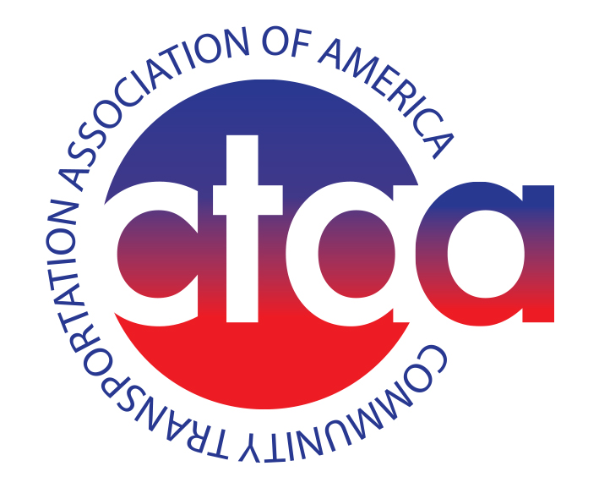
The big picture for smaller transit systems
Sept. 18, 2023

Slide 2
About CTAA
1,200 members across the country
Emphasis on rural, small-city, tribal, specialized and NEMT operators
Key activities: Training, Technical Assistance, Advocacy and Resources
New resources: Bus Funding analysis, salary & benefit survey, members-only site

Slide 3
Overview
Ridership returning to pre-pandemic levels
Driver and vehicle shortages
Generational perception vs. treading water reality
Technology and data challenges
Regulatory burdens that exceed capacity
Competing for grants

Slide 4
Operations and Ridership
Passenger relevance
Travel patterns and flexibility
Telework and the fiscal cliff
Fixed routes
On-Demand
Outcome-based trips

Slide 5
Vehicles and fleet transitions
Significant cost increases
Delivery times still lagging
Concerns about the overall bus marketplace
Buy America reality check
Common sense fleet transitions
What is low-emission?
Procurement streamlining?

Slide 6
Labor and succession
Recruitment and retention challenges
Career building
Training (mentors & apprenticeships)
Continued competition
CDL changes
Marijuana testing changes
An important good practice: Succession planning

Slide 7
Federal investment
Approps outlook: Steady growth for the next three years
Help with operating for largest transit systems?
Help with non-federal share for rurals
Rural reauth coming together
Trust fund source irony

Slide 8
On the Horizon
Reauthorization not that far away
Regulatory relief (capacity-based)
Concern: Unprecedented funding vs. not much has changed
Continued state and local funding opportunities

Slide 9
Scott Bogren
202.247.1921
bogren@ctaa.org

